Slide 1


Cooling Nairobi: Greening Schools Against Heat
Nairobi City County Government – Heat Action Project
Connective Cities | 12 June 2025
Anna Otieno & Grace Ojiayo

Slide 2
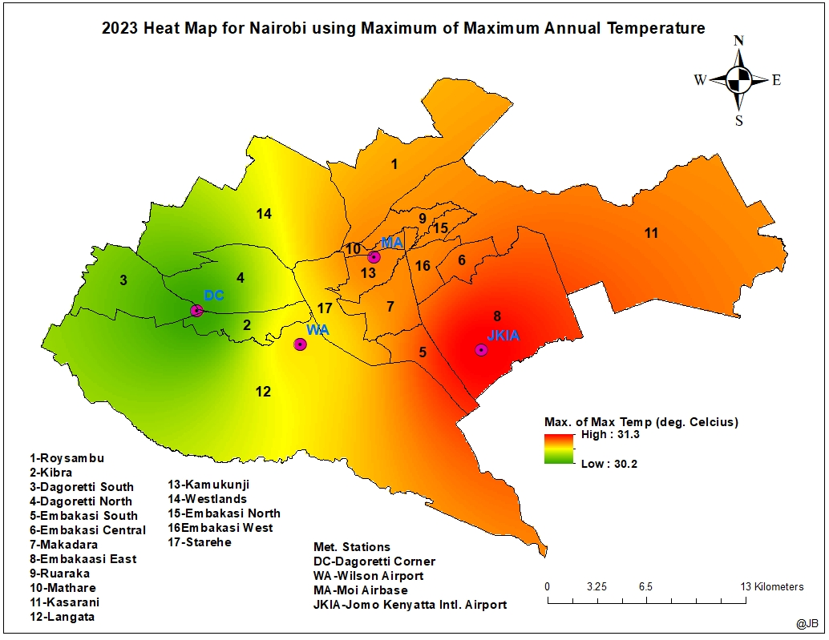
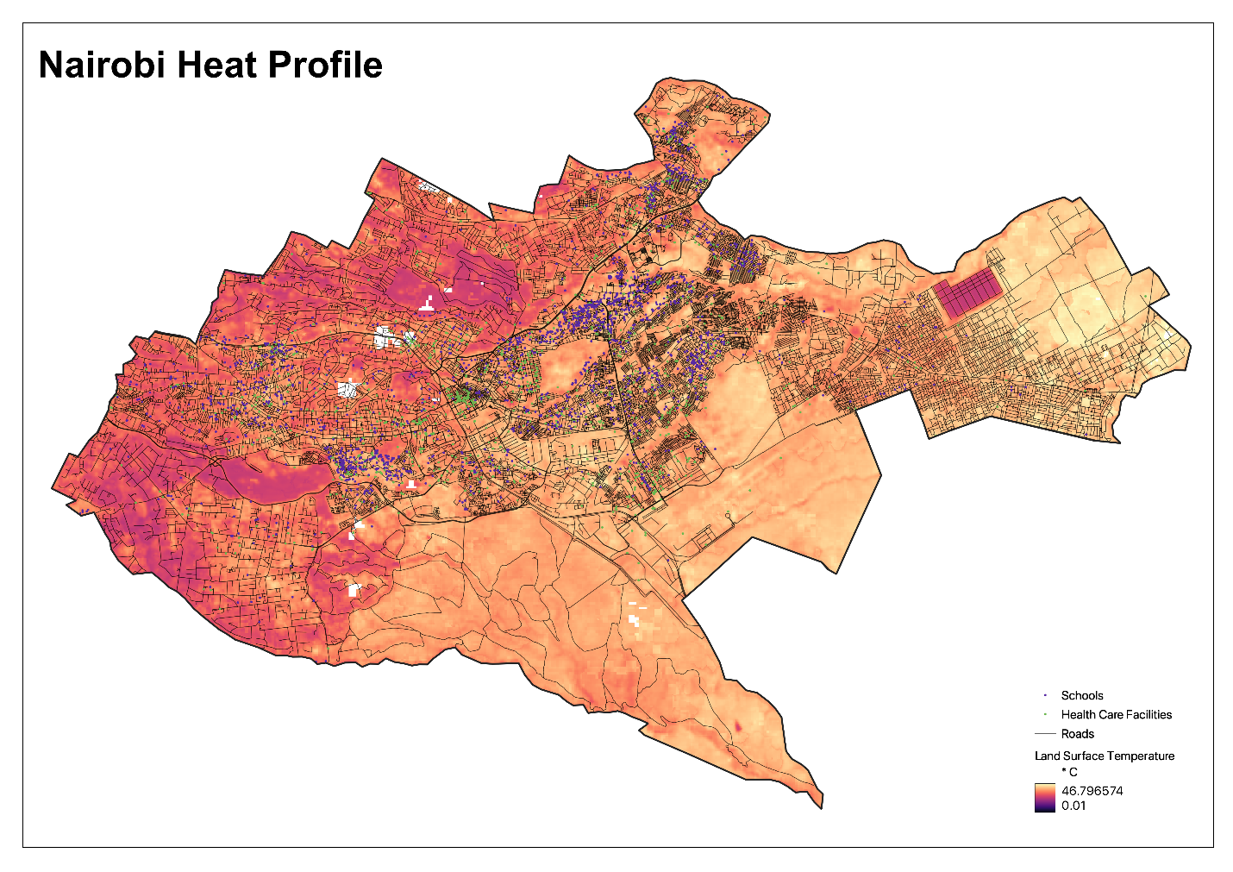
The Urban Heat Challenge in Nairobi
Rapid urbanization and climate change have increased surface temperatures.
Loss of green cover leads to Urban Heat Islands (UHIs).
The loss of vegetation in Nairobi’s built-up areas intensifies urban heat. School children, exposed daily to rising temperatures, are among the most vulnerable.
Limited localized data and inclusive solutions limits intervention.

Slide 3


Our Goals
Reduce heat stress in schools and urban hotspots.
Engage students and schools in climate action.
Build a replicable, data-informed model for heat
mitigation.
Raise awareness through community participation.

Slide 4
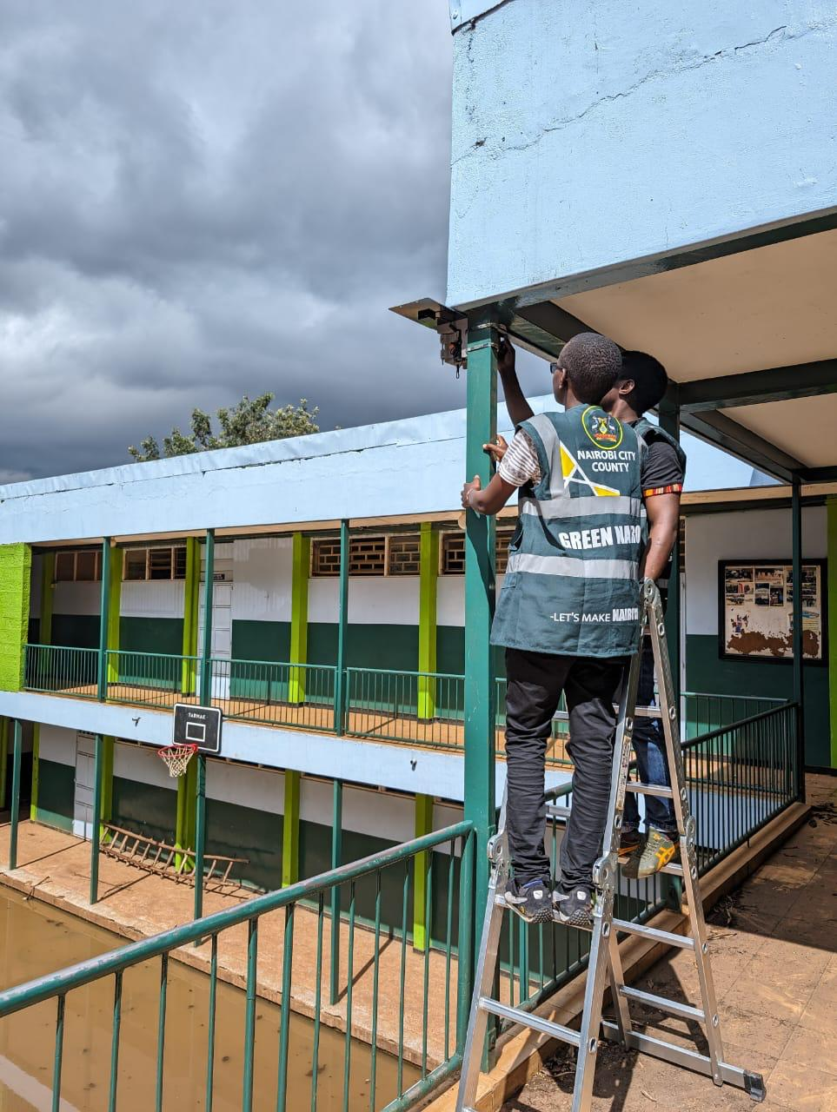
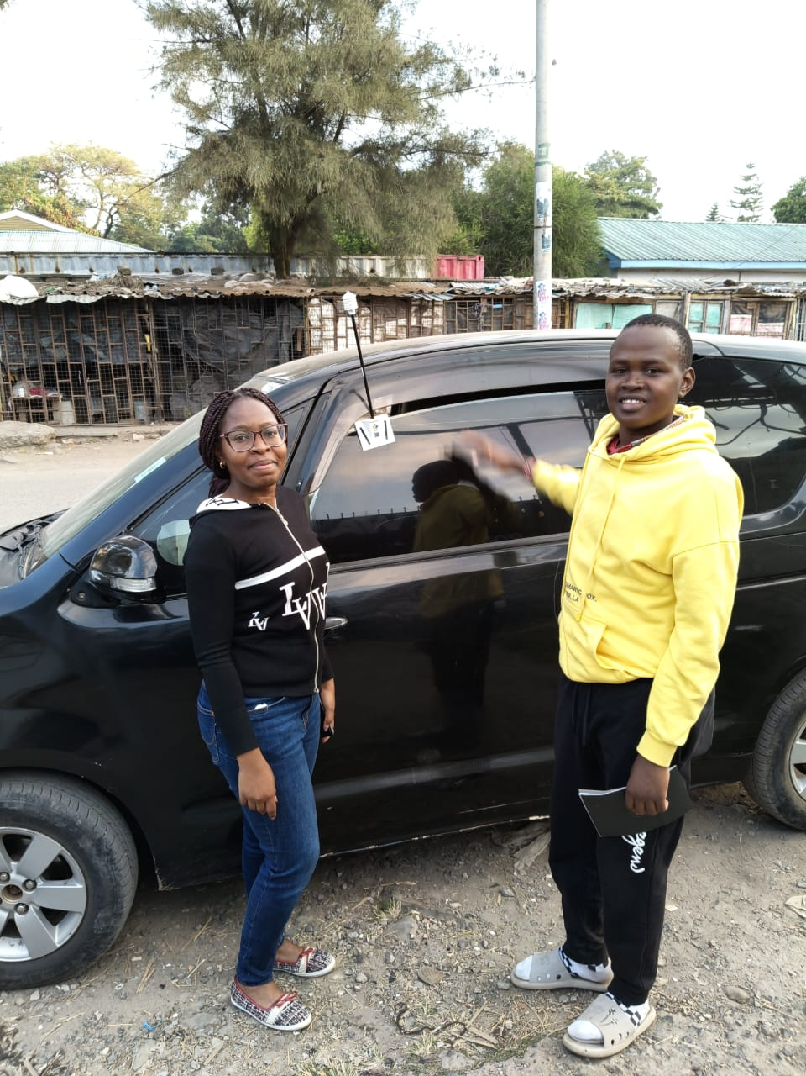
Strategy for Cooling the City
Citywide heat mapping campaign with satellite and on-site sensors.
Used temperature data to identify priority schools.
Planted fruit trees in 10 schools based on data.
Awareness sessions with students and teachers.

Slide 5
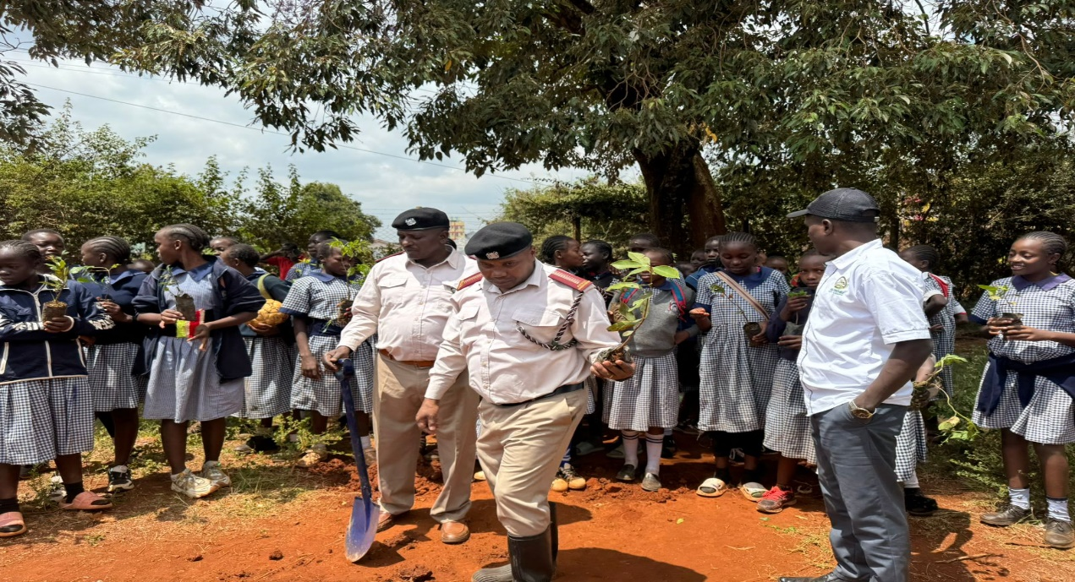
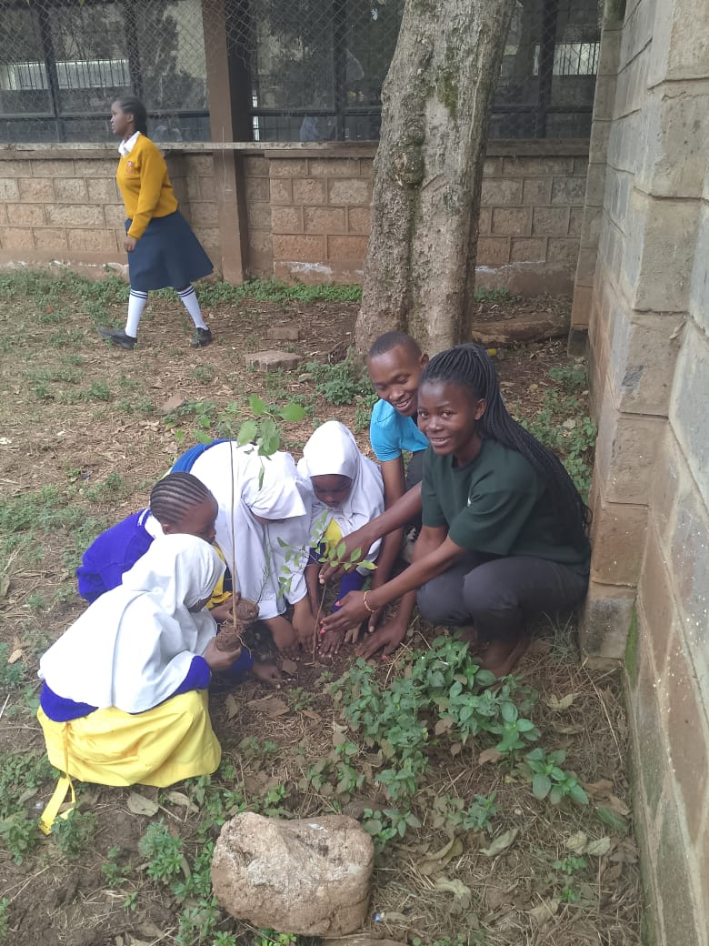
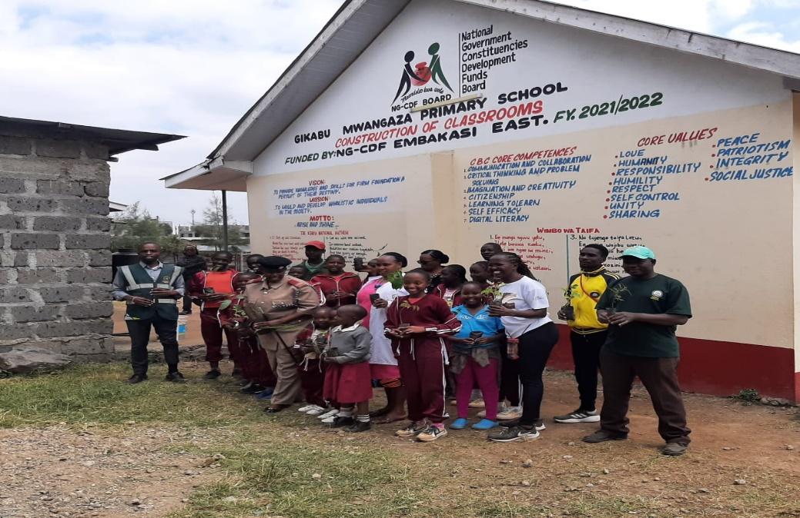
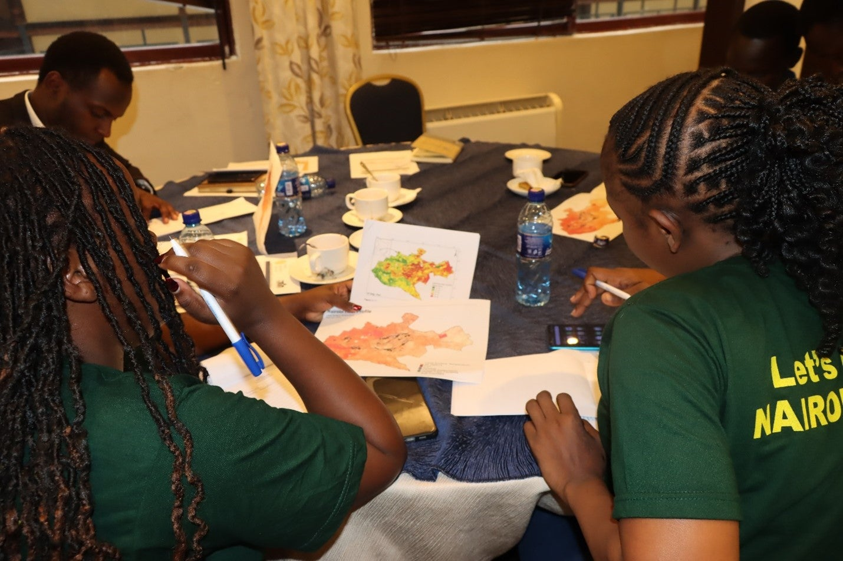
Nature-Based and Inclusive Interventions
Tree planting for shade and cooling (focus on fruit trees).
Green schoolyards as pilot cooling zones.
Citizen science: Children and teachers involved in data collection.
Educational programs on heat and climate.
Planned Heat Action Plan based on pilot
insights.

Slide 6
Collaboration for Impact
Government: Nairobi City County Departments and the Kenya Meteorological Department
Academia: Kenyatta University and University of Nairobi
Community: School leadership, students, Community Based Organizations.
Partners: World Resources Institute (WRI)

Slide 7
Tangible Benefits
Cooler classrooms and outdoor play areas.
Increased green coverage and school biodiversity.
Fruit trees provide shade and food security.
Empowered students as climate ambassadors.
Robust temperature data for city planning.
Foundation for a Nairobi Heat Action Plan.

Slide 8
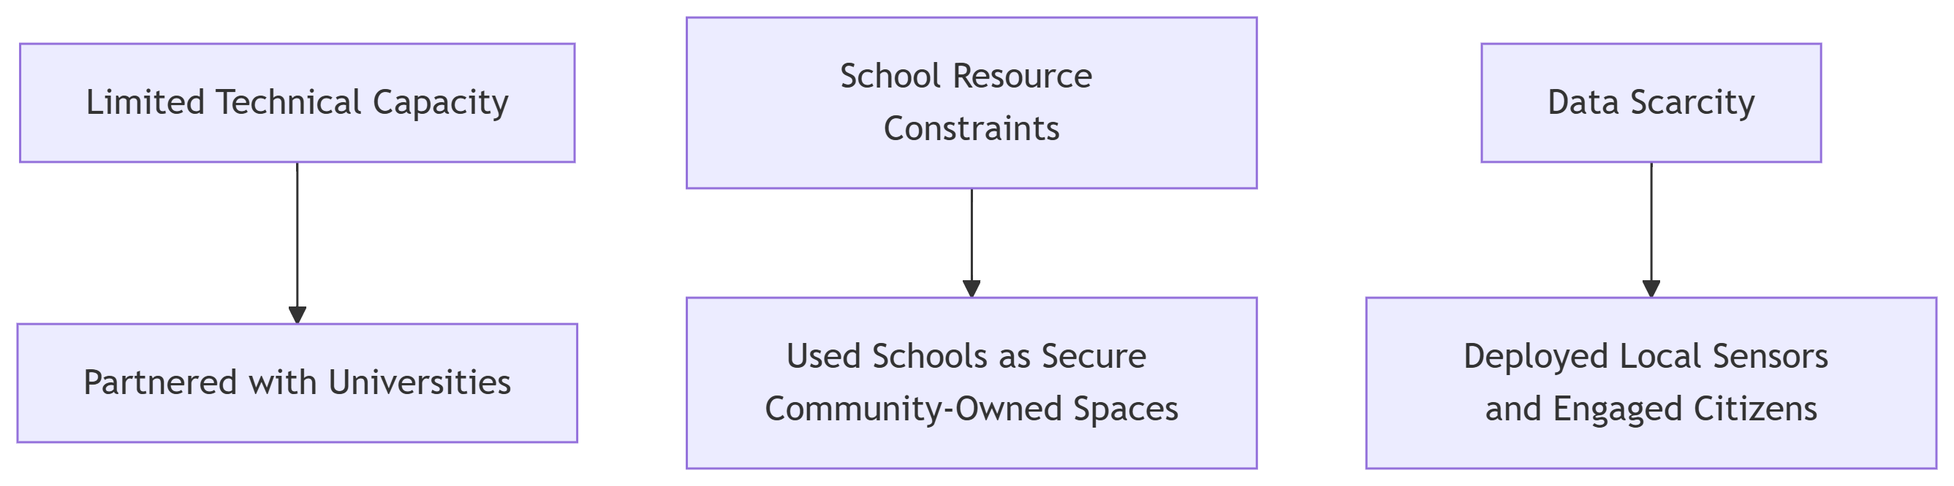
What We Faced – And How We Solved It

Slide 9
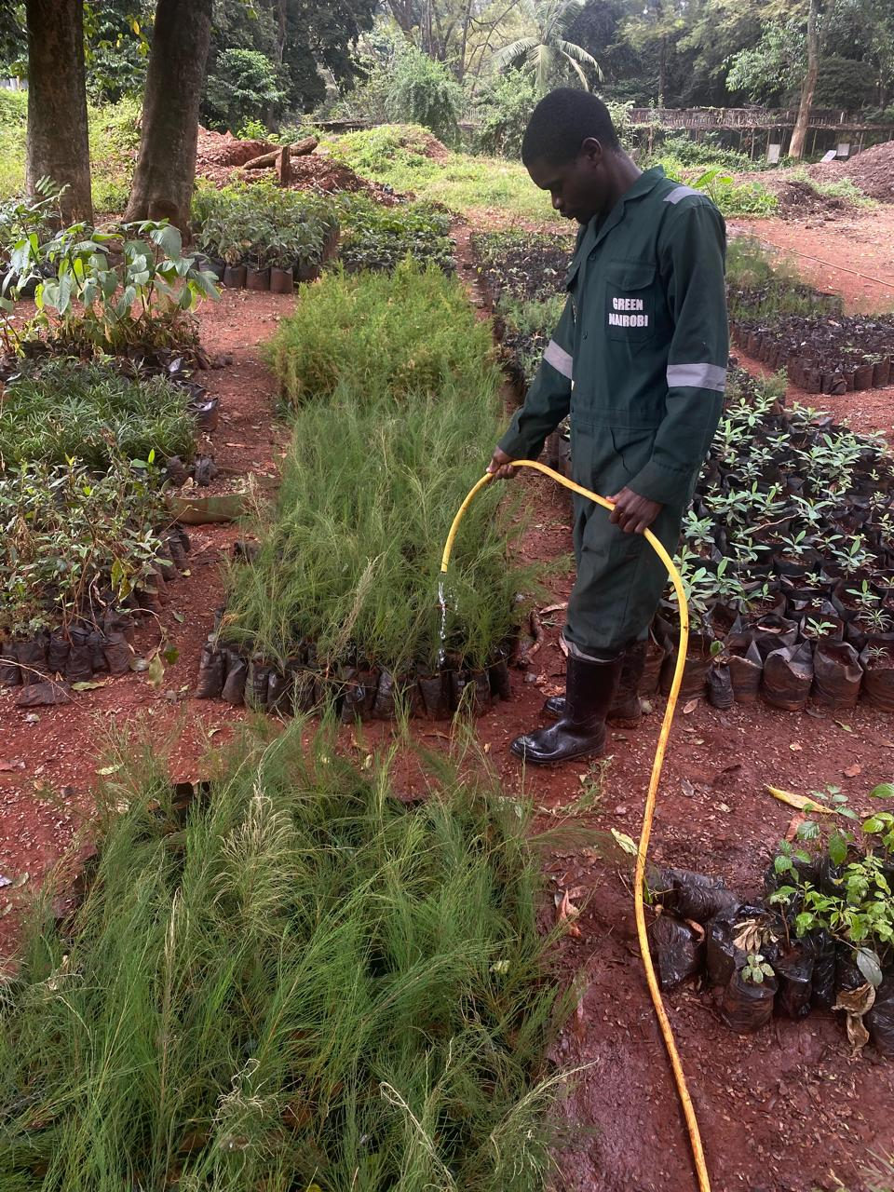
What Made It Work
Use of local data and satellite maps.
Youth-driven greening actions.
Strong cross-sector collaboration.
Community ownership through citizen science.
Available city owned tree nursery

Slide 10
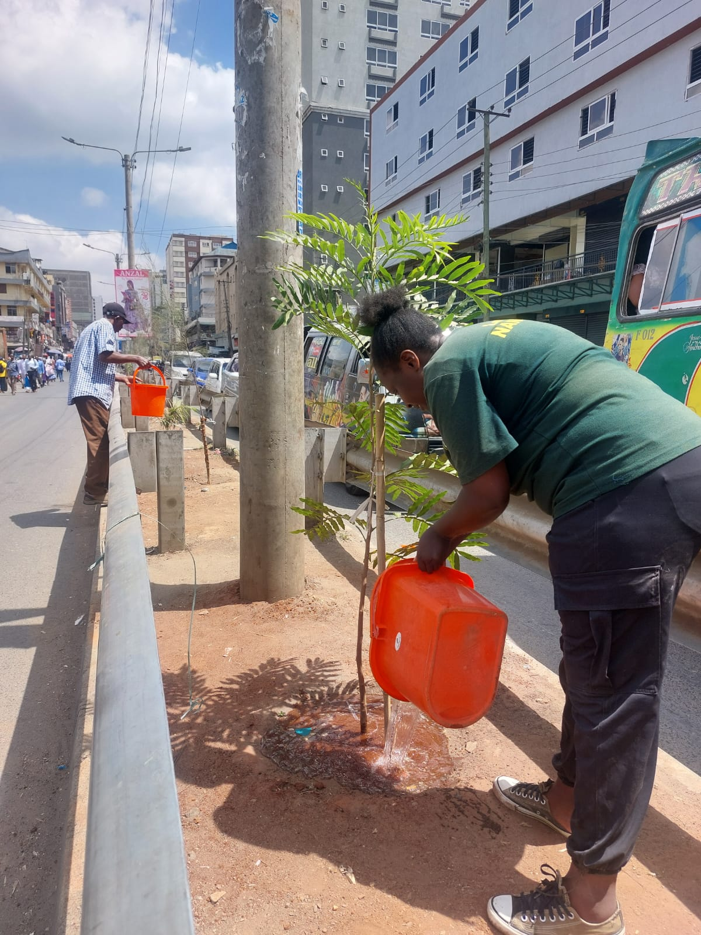
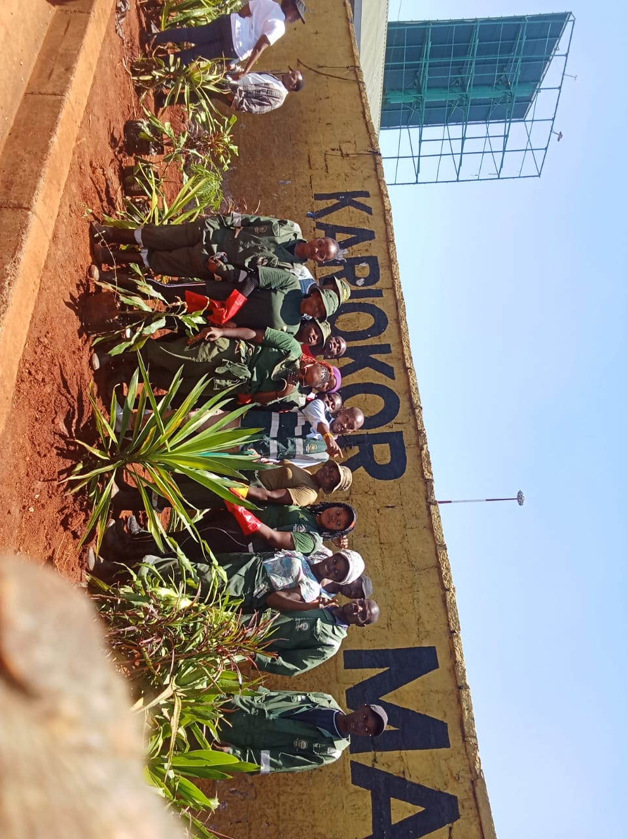
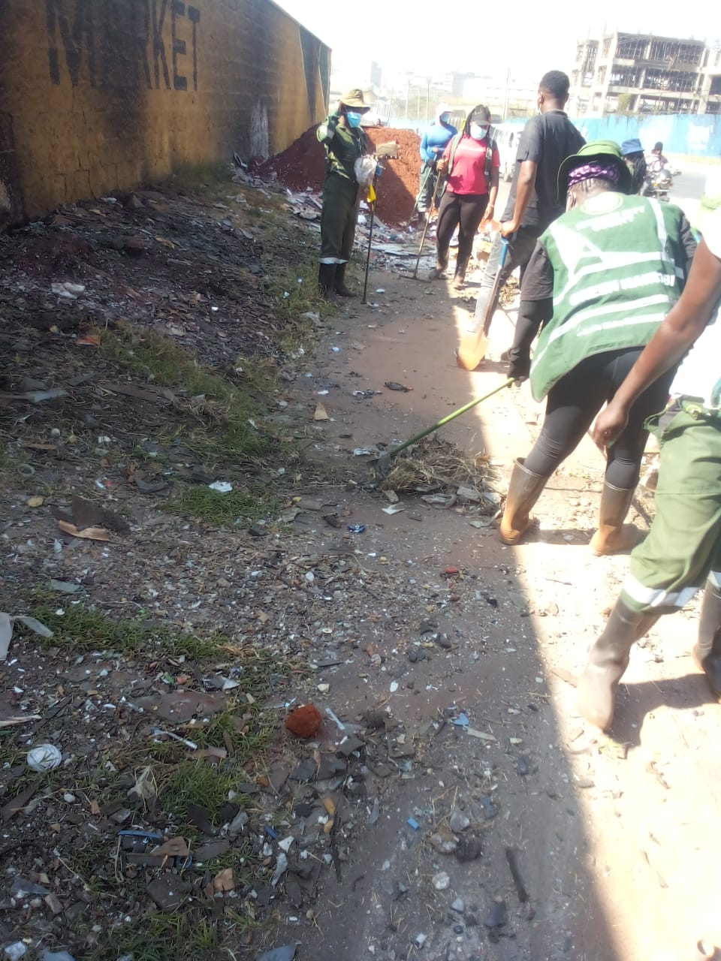
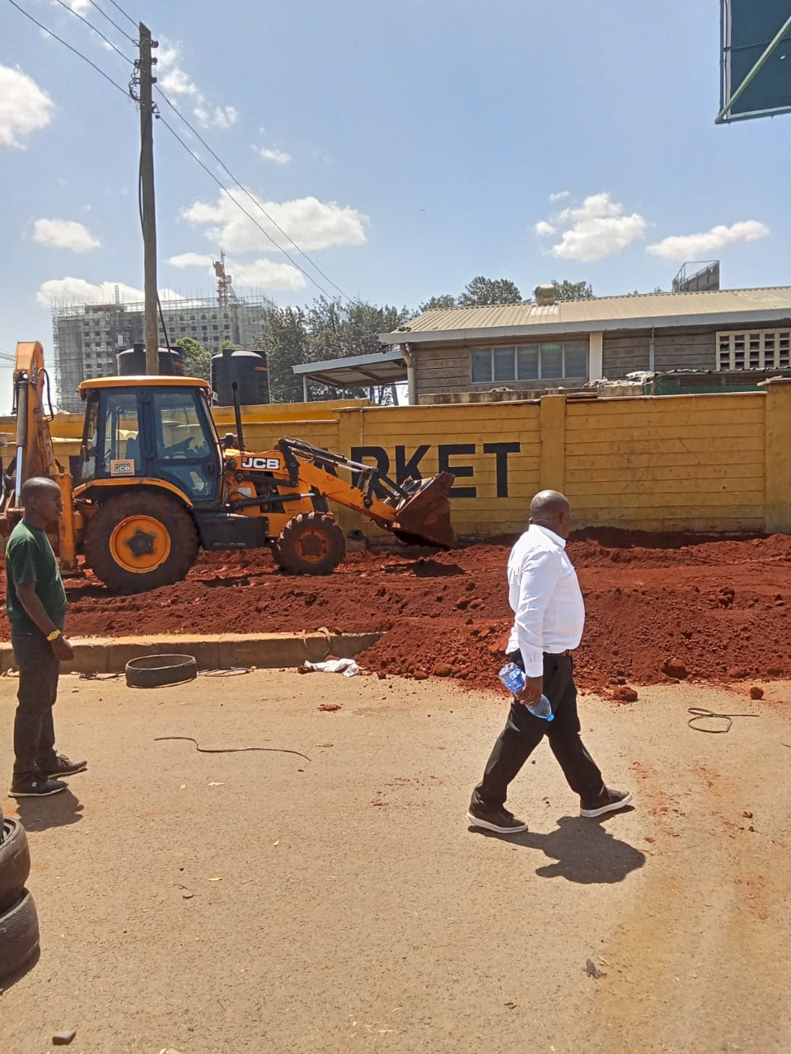
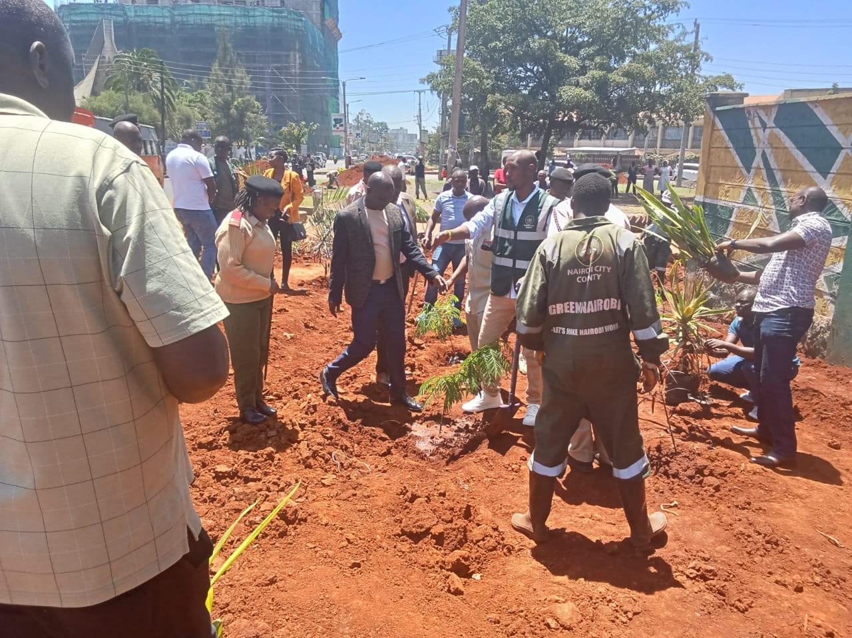
Beyond the Pilot: Nairobi’s Future
Expand tree planting to more
schools and public spaces.
Extend to informal settlements and high-risk areas.

Slide 11
Beyond the Pilot: Nairobi’s Future
Develop Nairobi Heat Action Plan by 2026.
Target funding in green infrastructure funding.
Build a resilient, livable Nairobi through green infrastructure.

Slide 12
Join Us in Cooling Nairobi
Support the citywide scale-up of green school zones.
Involve in community-driven climate education.
Help develop and adopt a formal Heat Action Plan.
Let’s build a greener, cooler, and more resilient city—together.

Slide 13
THANK YOU

