Slide 1
Heidelberg Action Plan:
Data-Platform for “Cool Places”
3 Best-Practice Examples of Climate Adaptation
Dr. Raino Winkler, Dr. Joachim Fallmann

Slide 2
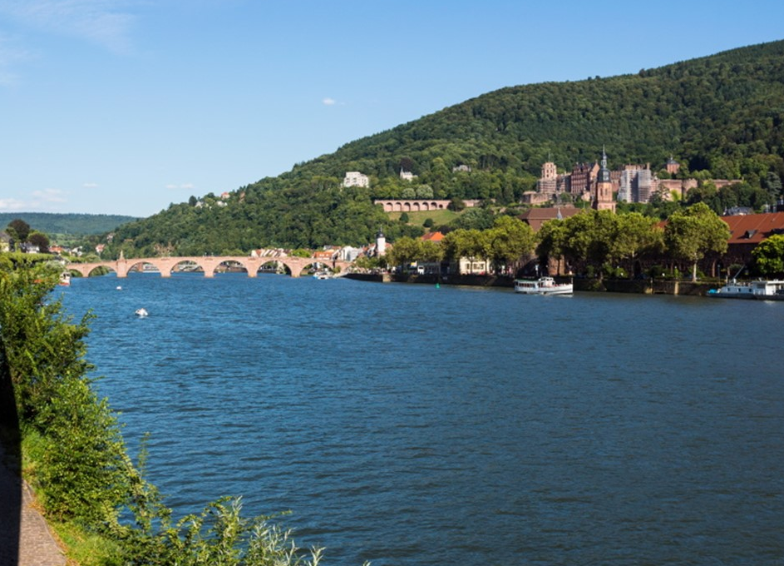
Urban Climate database & HD Climate Scanner
(1)
City of Heidelberg
Lead: Environmental Dept.
University Heidelberg
Landscape/Urban Planning Dept.
GEO-NET inc.
Best Practice
Examples &
Outreach
(2)
Timeline
Identify colleagues & define locations for best practice examples
Collect datasets , retrieve data, hire consulting office
Cross-dept. Harmoni-zation, publication of tool and dataset
Exhibition, include tools in city planning process, info-plates
Publication of outcome via press release
Approach and strategy: Try to involve all part. from an early stage, constant feedback
Challenges: technical issues, council approval needed, financial issues
Solutions: allow perspectives of all participants, communication, feedback, funding
Success factors: cross dept. communication, press release, exhibition, innovation
Upscaling and vision: redefine urban space according to best-practice examples,
official HD green building standard
Notes:
Name of the municipality, your pilot and the participating institutions
Timeline with the starting situation and the important steps/milestones
Your approach and strategy
The challenges you faced and your solutions on it
Success factors
The way you upscale the pilot
Your vision for the future

Slide 3
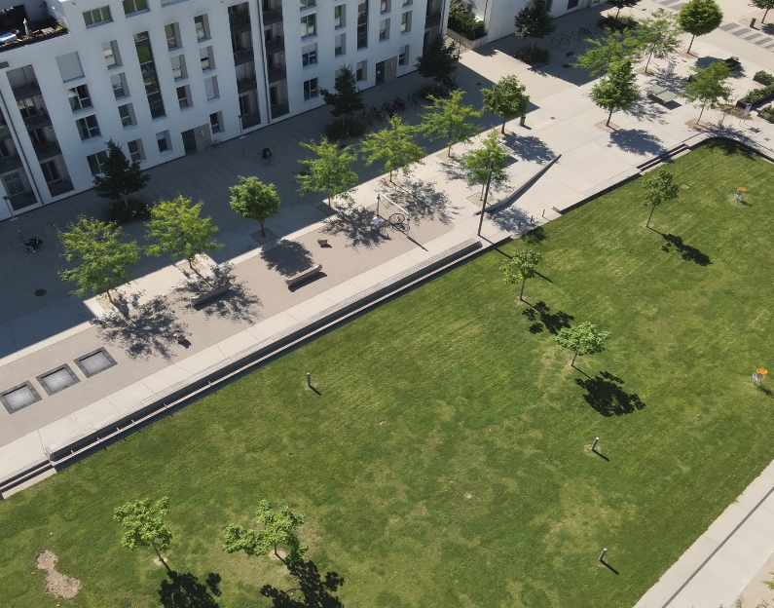
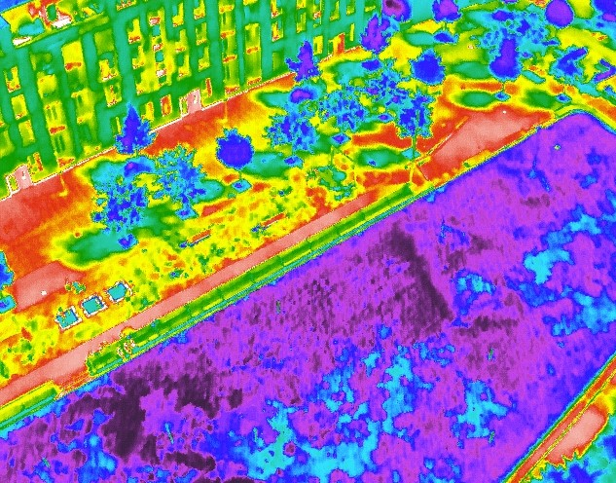
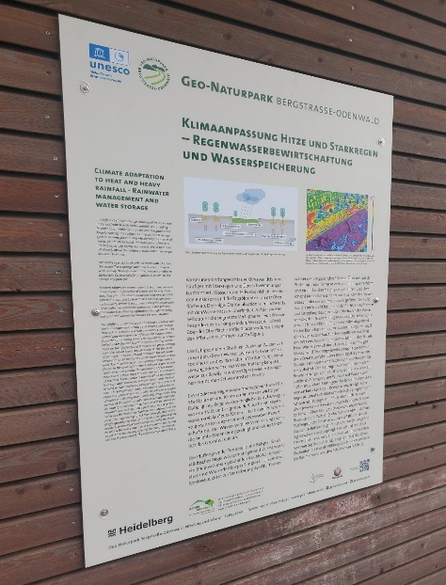
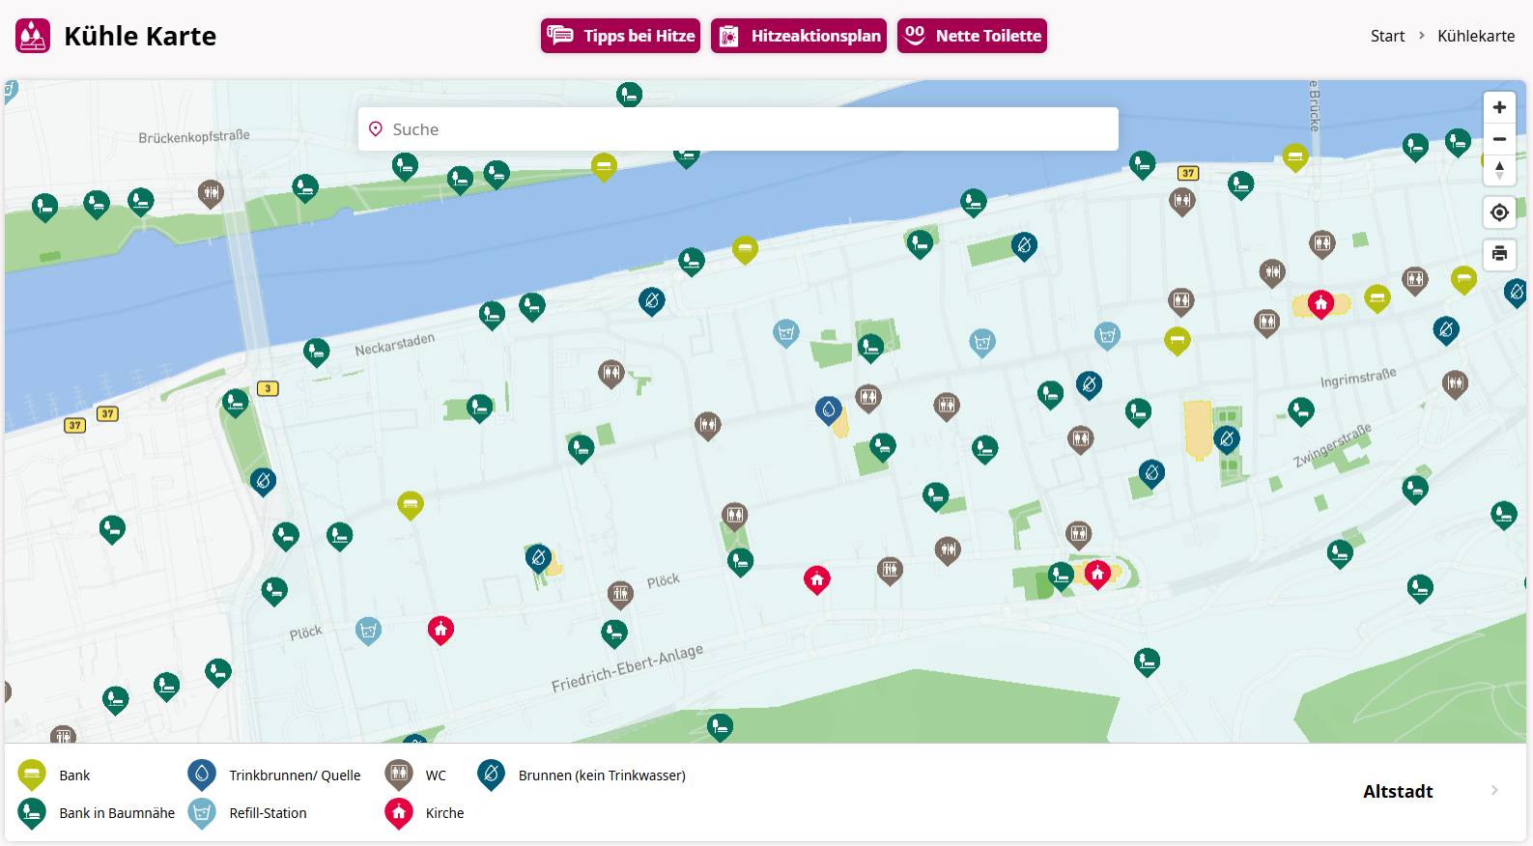
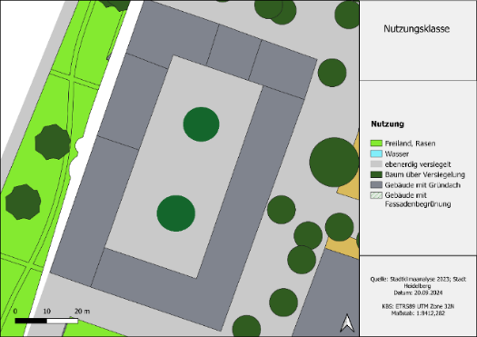
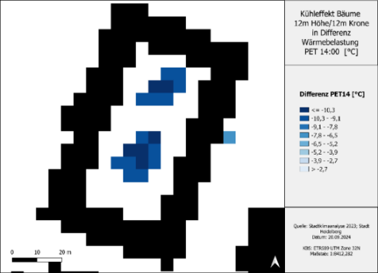
Best Practice
Art Exhibition
Info Plate
„Cool Places“
Climate Scanner
Example: Tree planting on courtyard

