Slide 1
MOMBASA MUNICIPALITY
URBAN HEAT ISLAND PROGRAM

Slide 2
Presentation outline
urban heat island mapping
Urban heat island sensitization
Urban heat island launch
Urban heat island training
Greening program

Slide 3
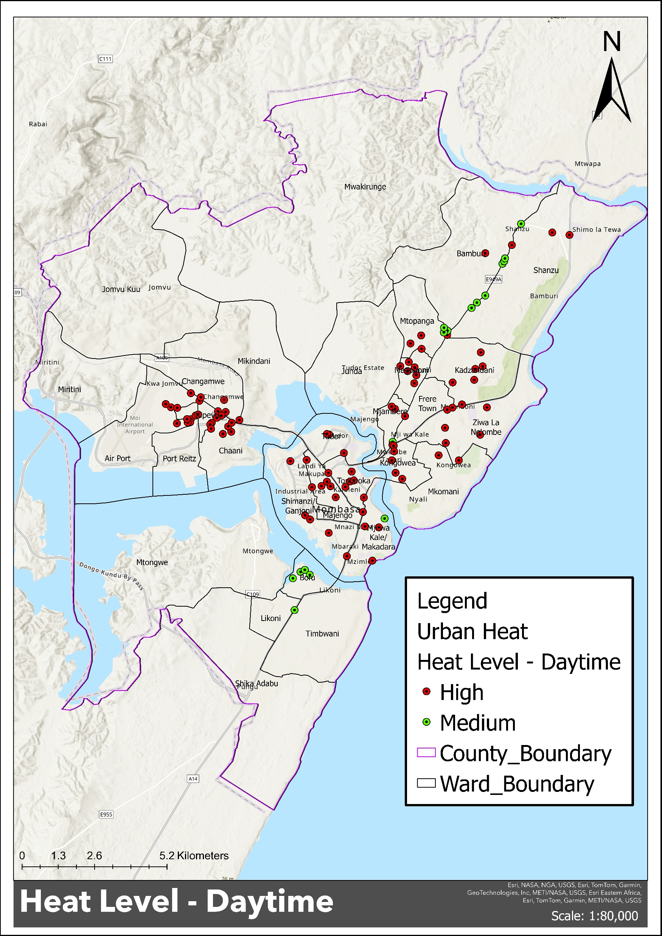

Slide 4
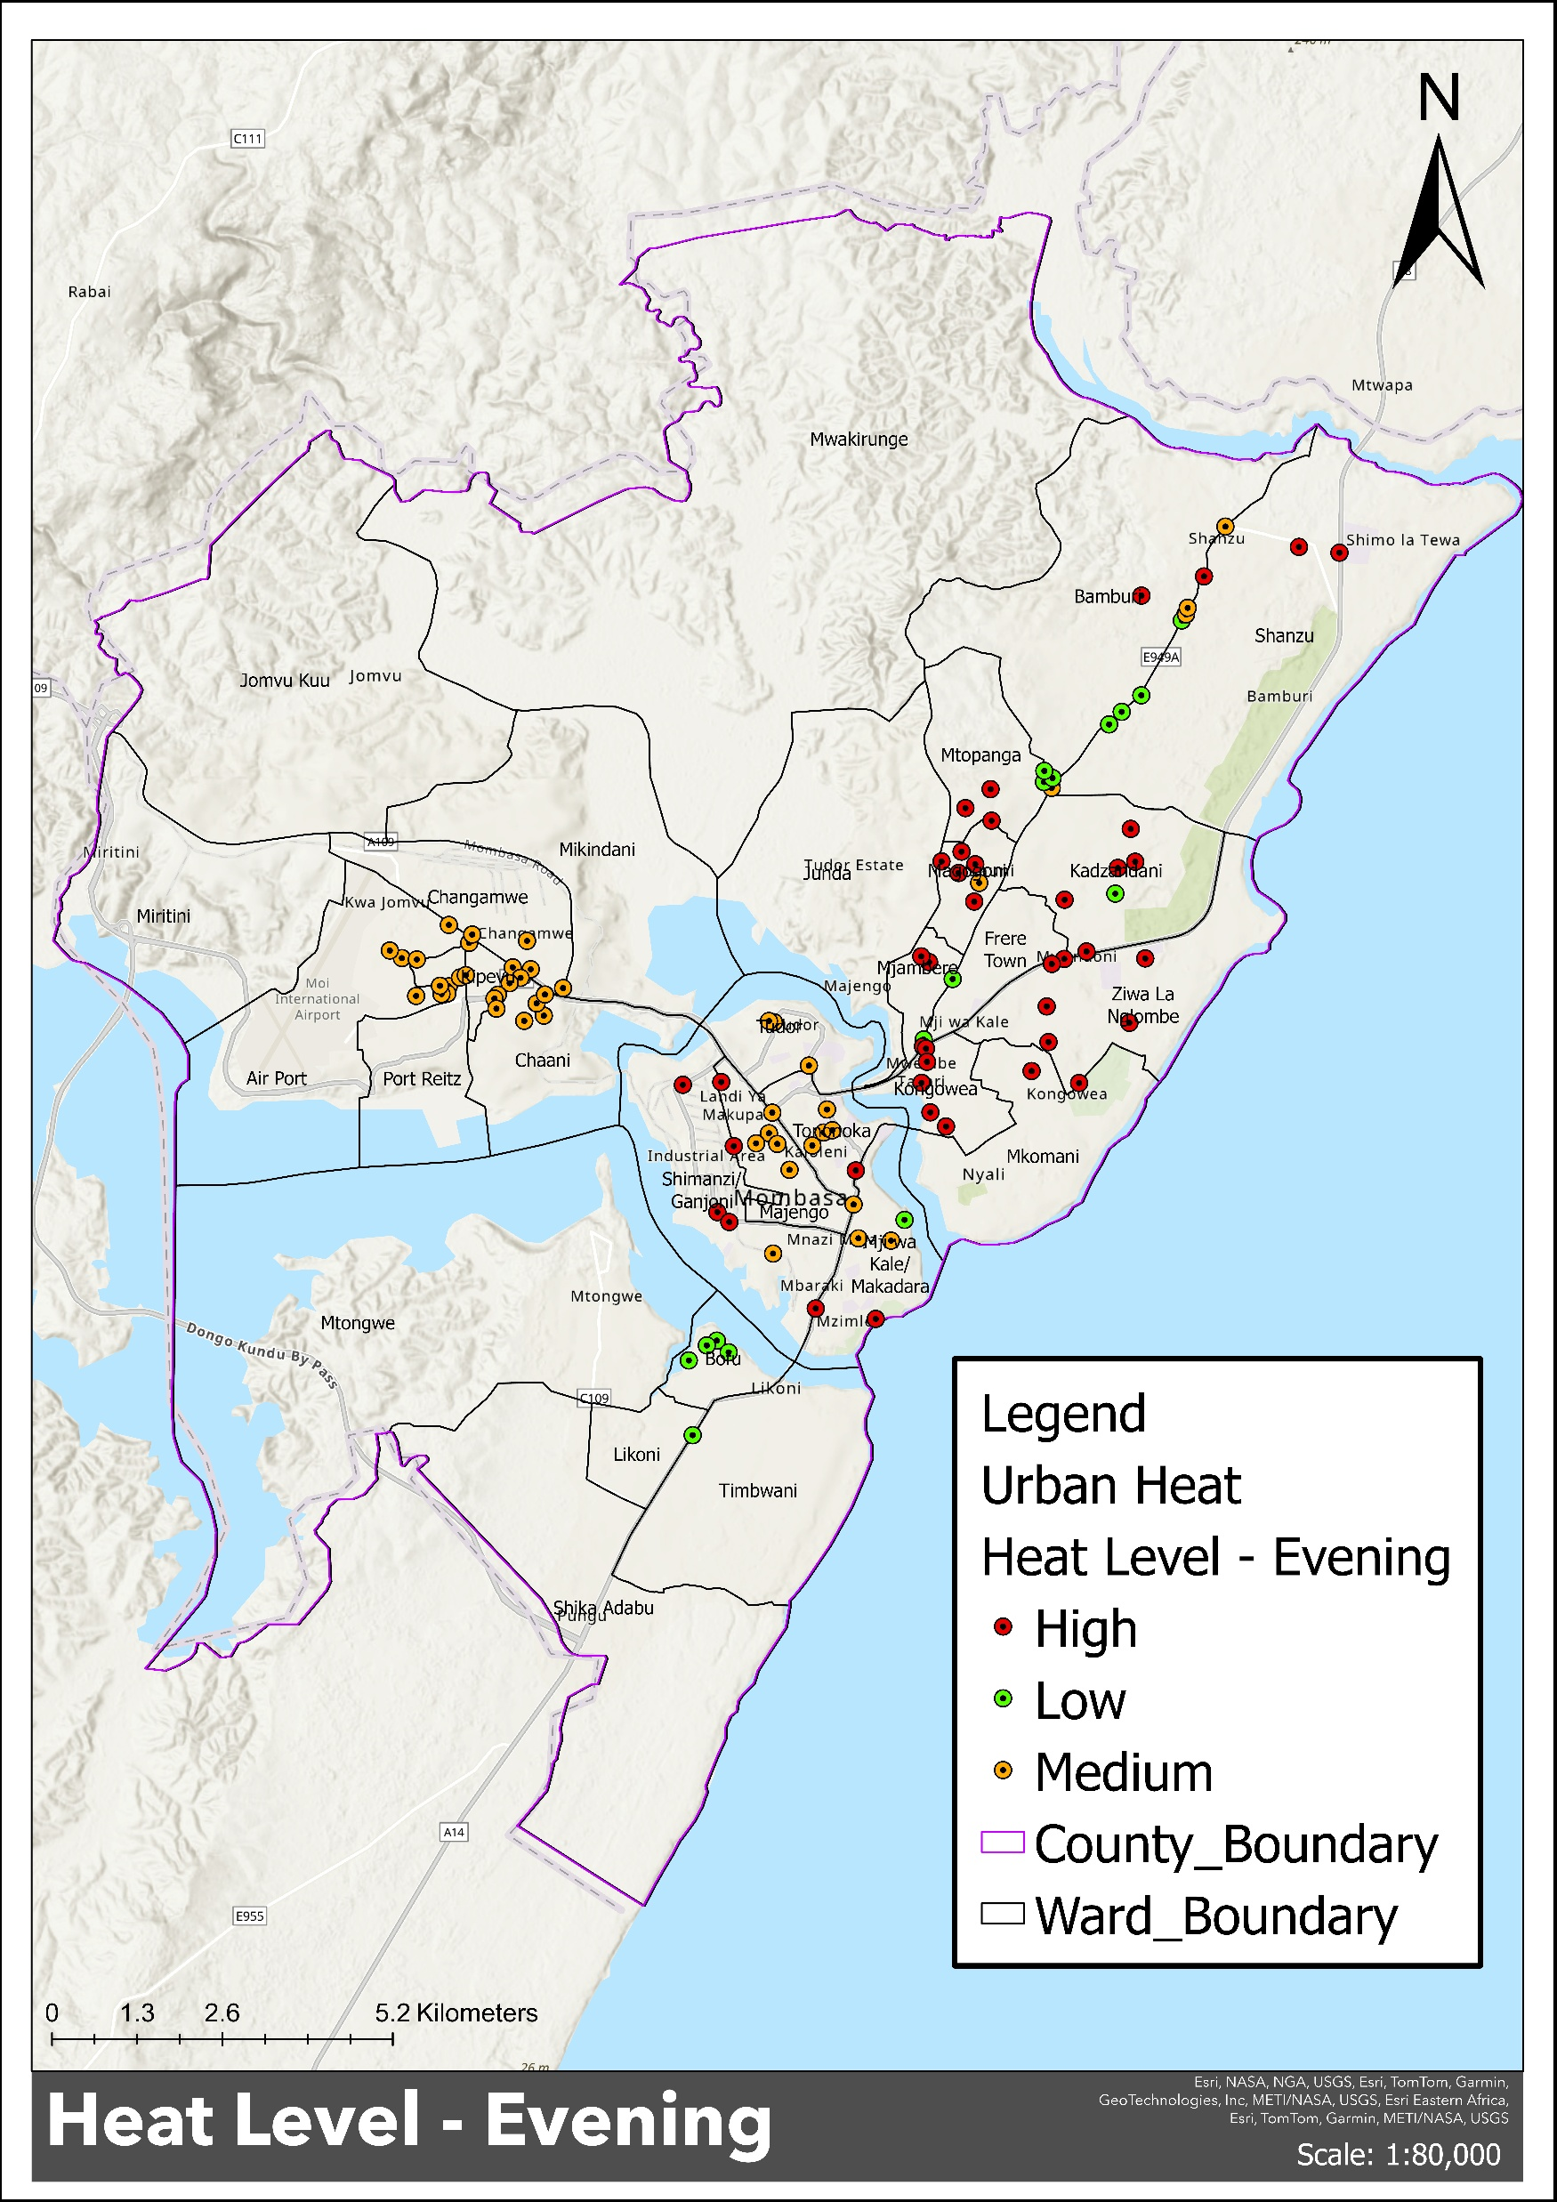

Slide 5
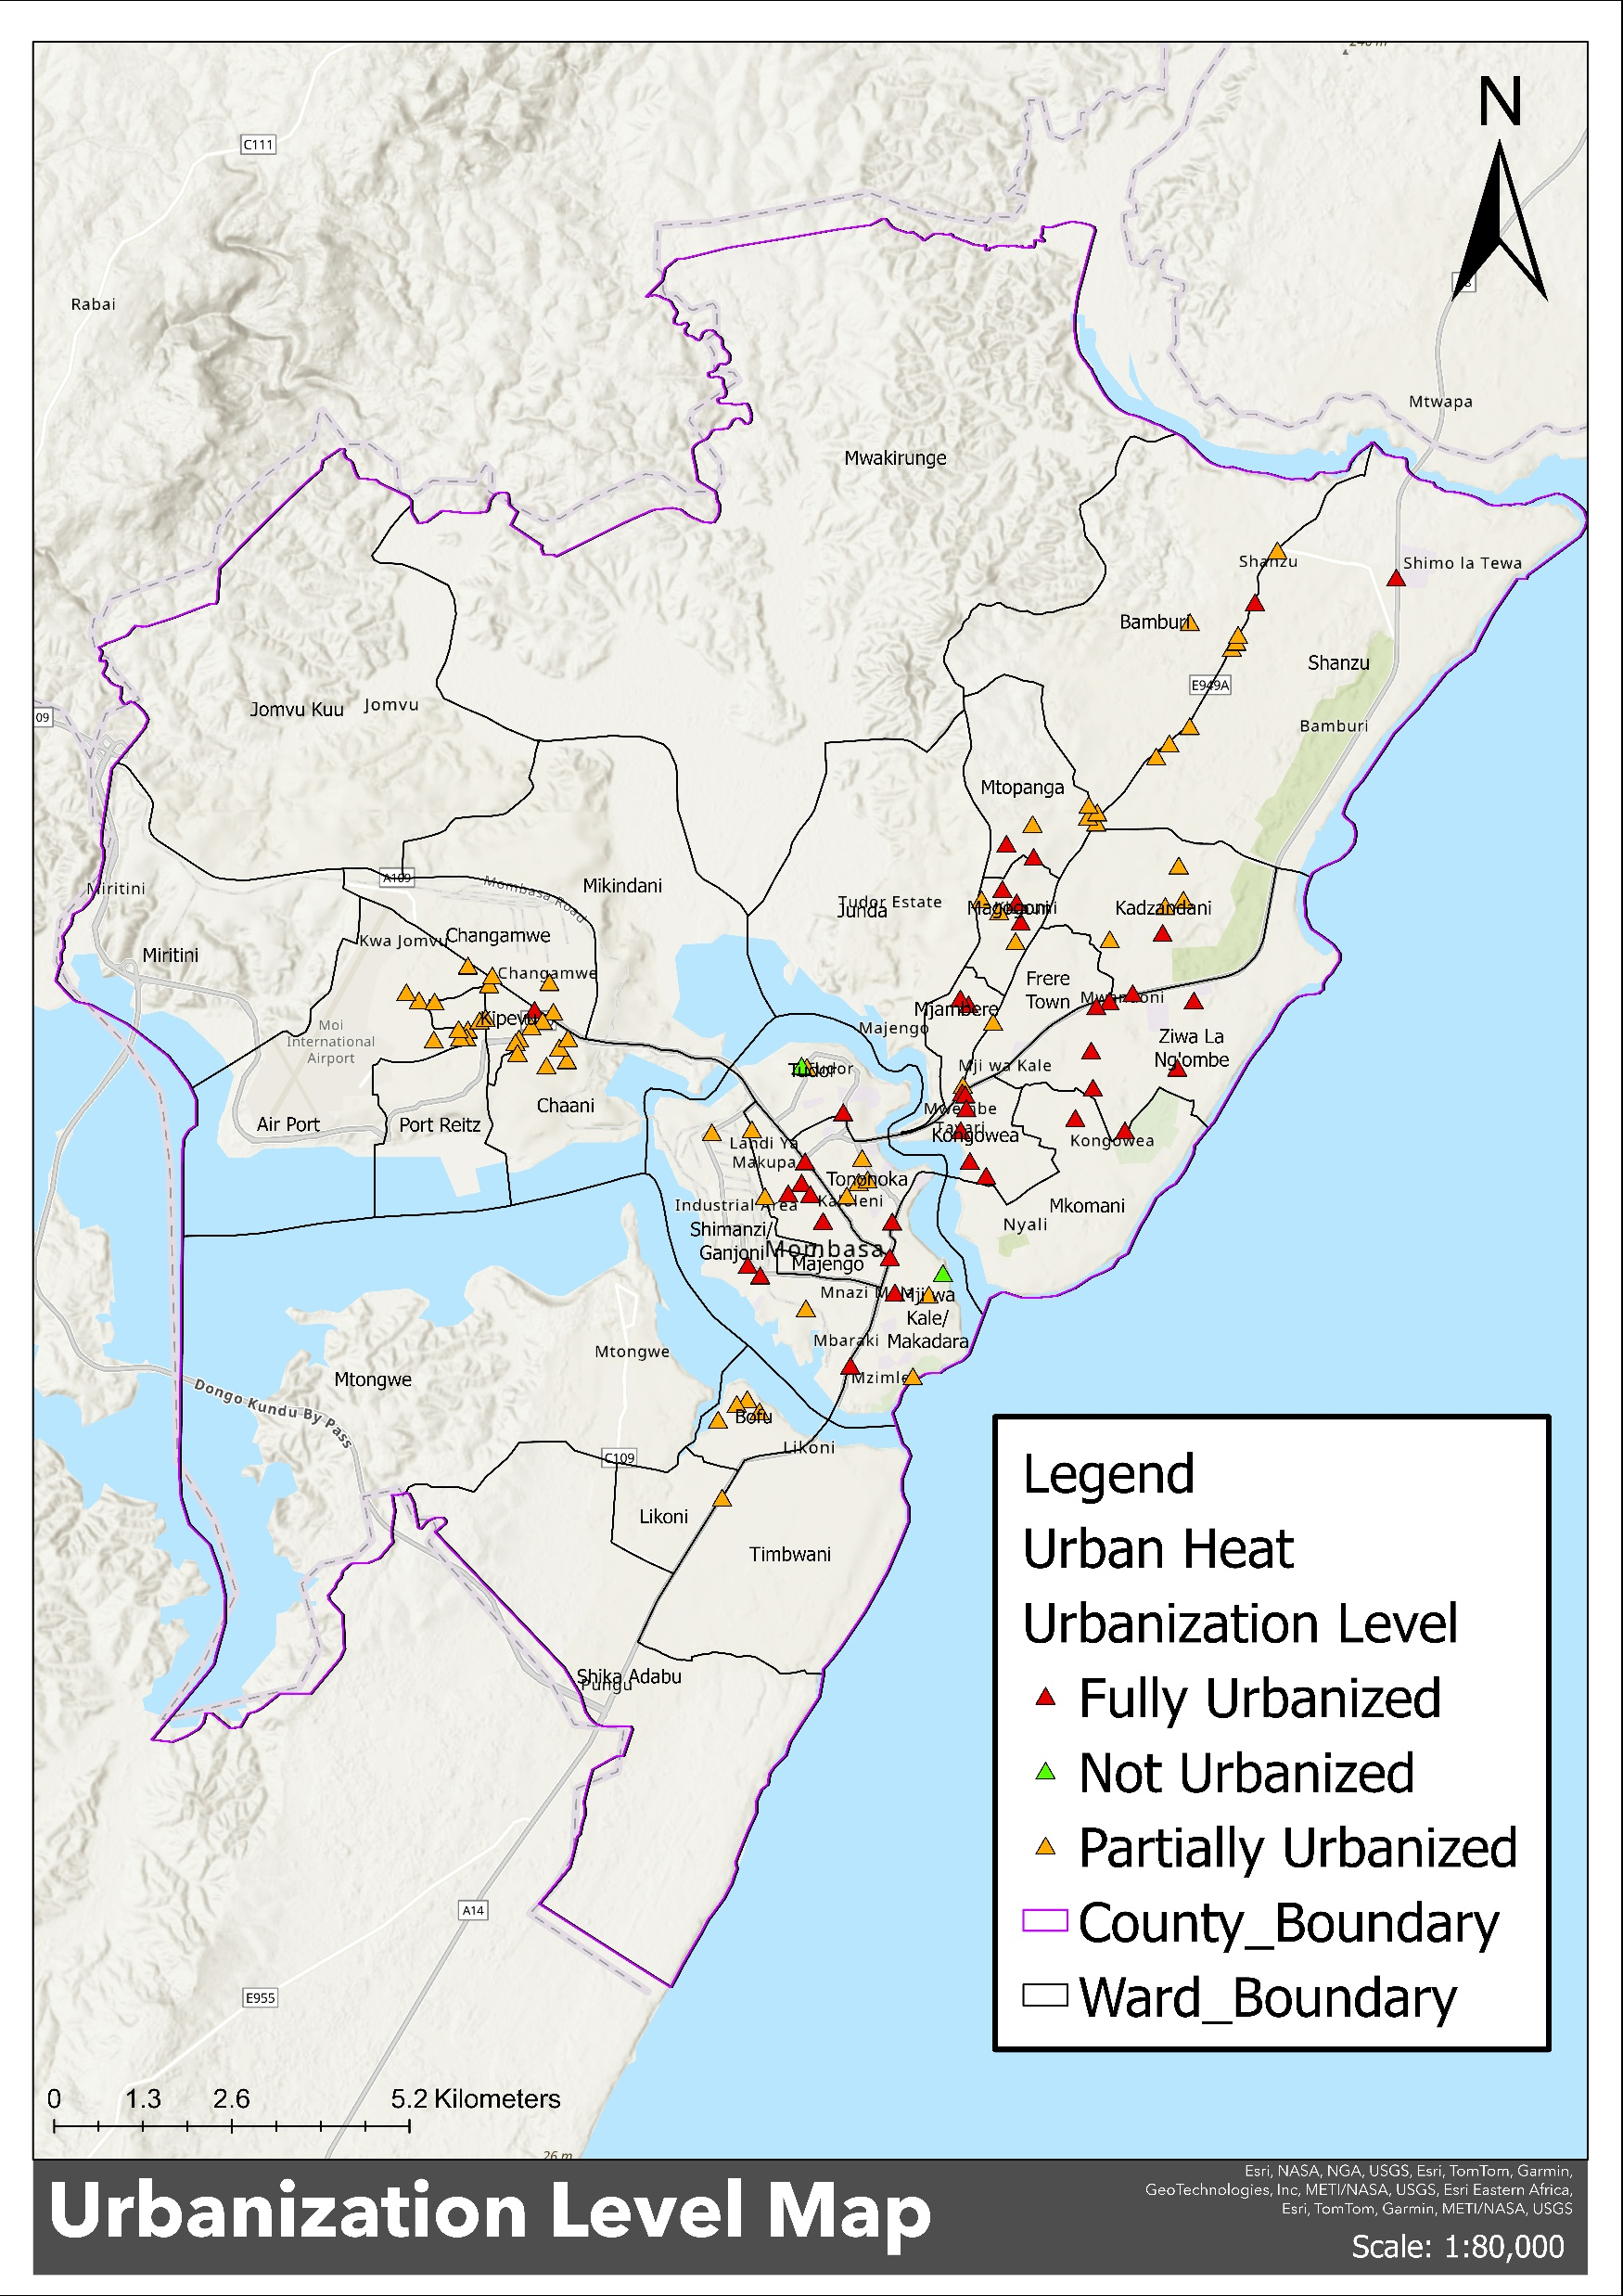

Slide 6
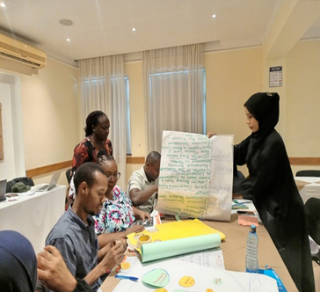
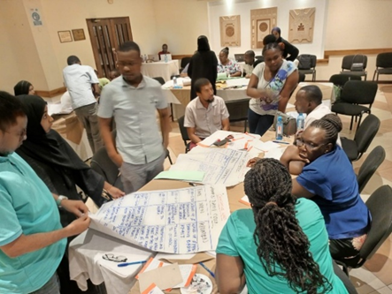
Climate change officer training

Slide 7
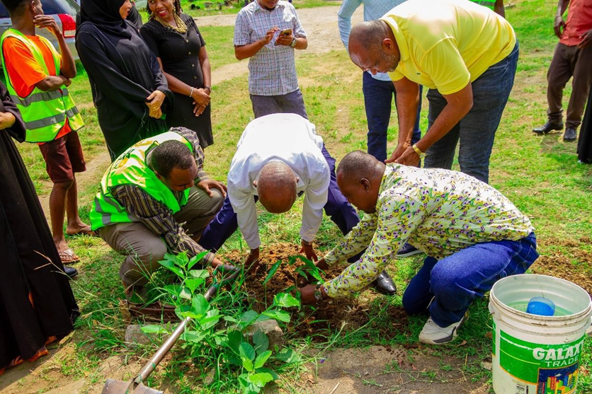
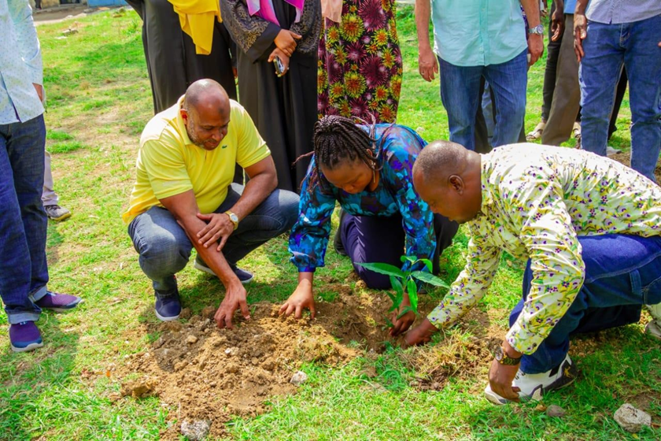
Launch of urban heat island

Slide 8
Call for Action
Development of Urban heat strategy
Capacity building on urban heat island
Financial resources to support urban heat island program implementation.
Needs for knowledge sharing and peer learning on urban heat island

