Slide 1
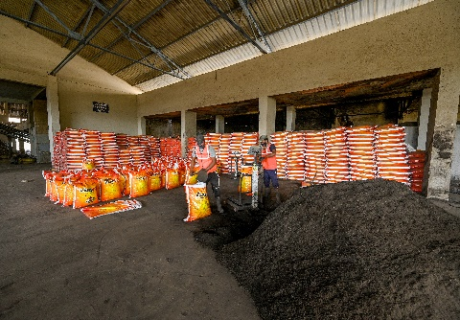
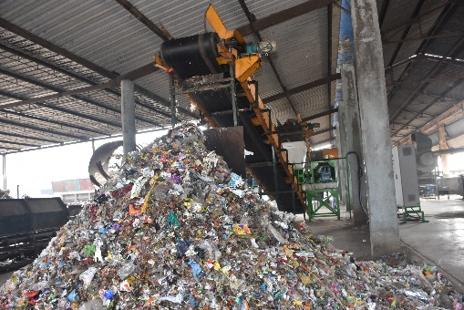
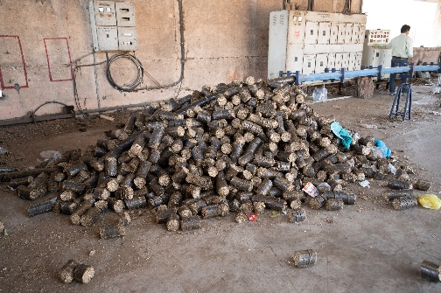
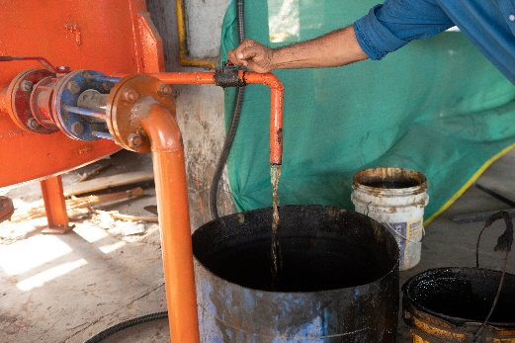
Moving Towards Circular Economy
Sustainability Through Transforming Waste into Products
By
Col. Suresh Rege (Retd) , Director
Nashik Waste Management Pvt. Ltd.
At Coimbatore on 04.09.2023

Slide 2
Mailhem Group’s Legacy of Converting Waste (MAIL) to Gold (HEM)
Mailhem’s Experience
Biogas to Green Fuel/Power/CBG
NWMPL’s Experience
Integrated Solid Waste Management
Vegetable Market Yard waste
Pharmaceutical waste
Leather shavings waste
Starch effluents
Press mud and Distillery Effluent
Co-digestion of one or more substrate from above
Mechanical Recycling Facility
Aerobic Windrow Composting
RDF
Plastic to Fuel/ Granules
Dead Animal Incineration
Biomass briquetting
Leachate treatment plant
Bio mining/Bioremediation
Capping of Legacy Waste
Scientific Landfill/Bioreactor Landfill
Kitchen waste
Canteen Food Waste
Slaughter-house Waste
Cattle Dung
Poultry waste
Agro Waste
Dairy waste

Slide 3
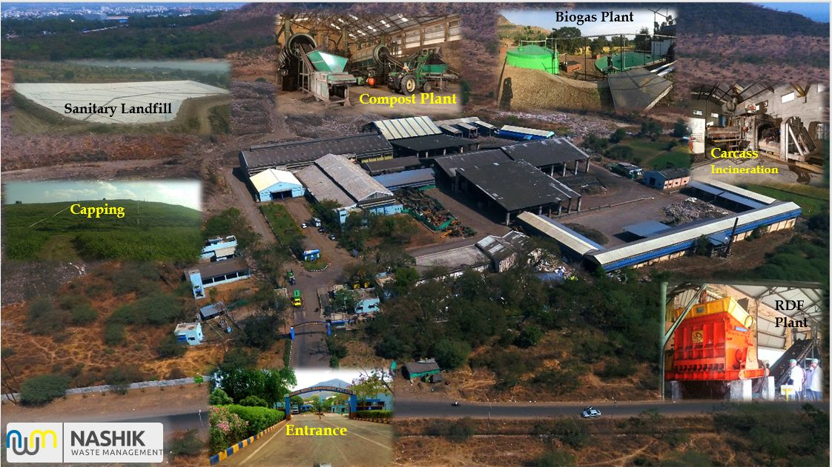
Our 600 TPD Integrated Solid Waste Management’s Plant, Nashik

Slide 4
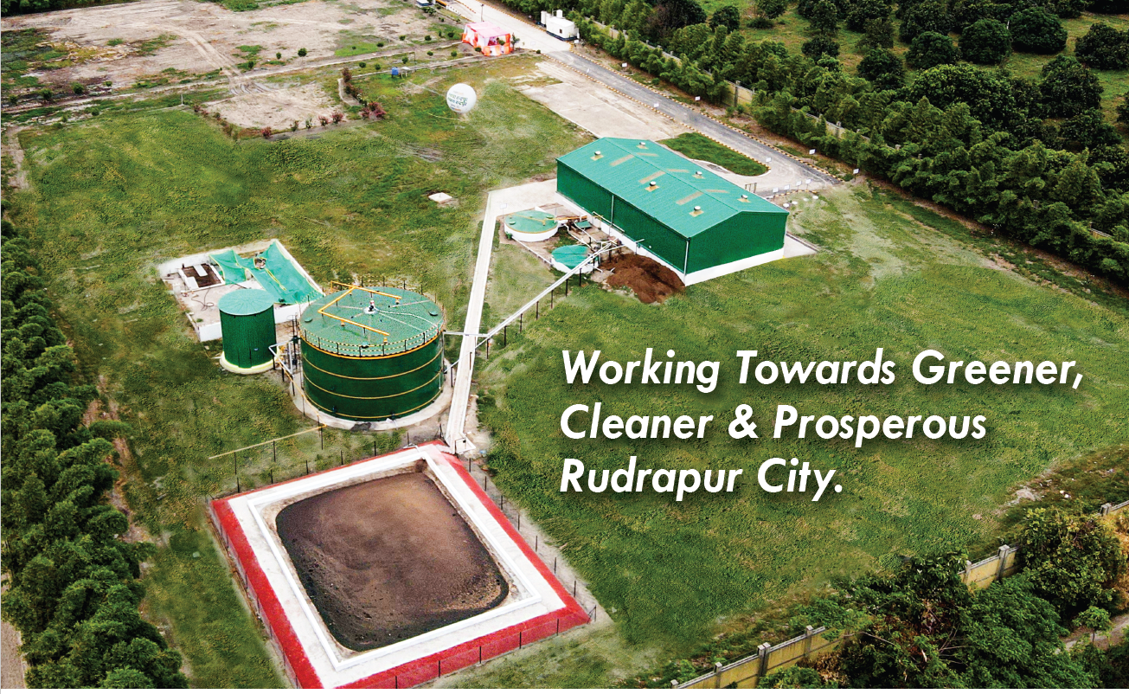
Our 20 TPD Compressed Biogas Plant at Rudrapur, Uttarakhand

Slide 5
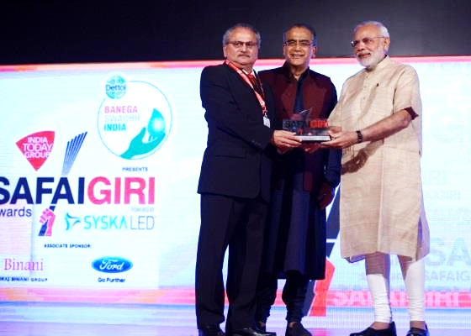
Our Group’s Awards and Accolades
“Garbage Guru” Award, 2015
- A Testimonial to Our Vision of delivering Quality Products.

Slide 6
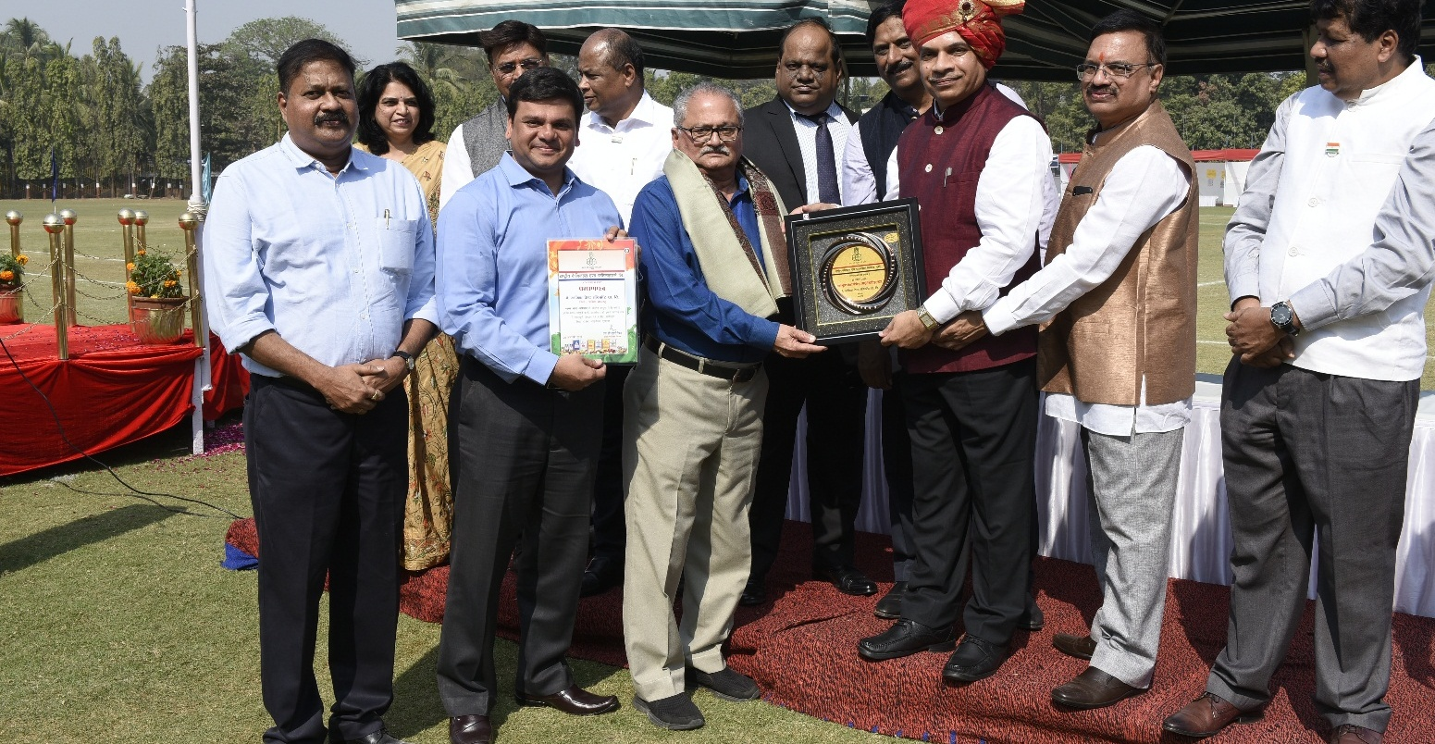
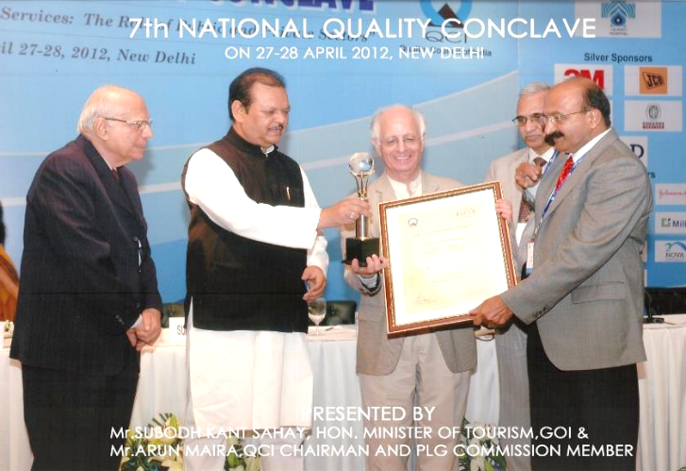
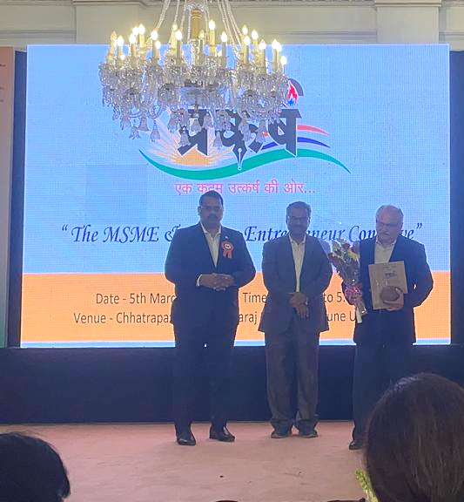
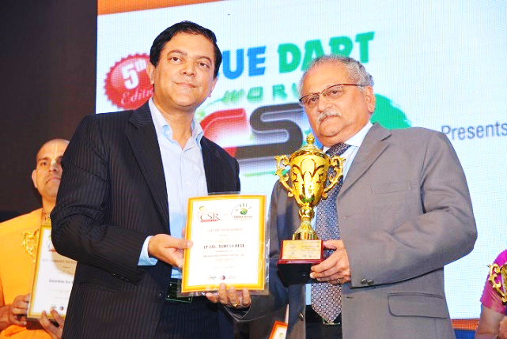
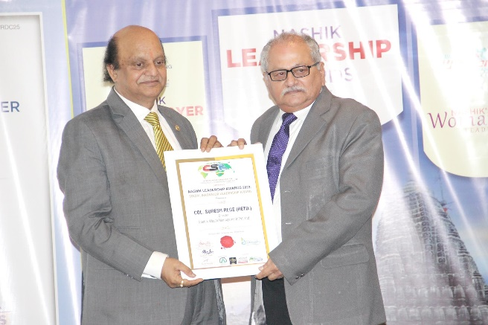
Our Group’s Awards and Accolades
“Best Supplier - City Compost”
by Rashtriya Chemical & Fertilizer Limited (RCF) – a Mini Ratna PSU
QCI Award, 2012
Lifetime Achievement Award, 2016
World CSR Congress
Life Time Achievement Award 2023
at Savitribai Phule Pune University
Social Innovator Leadership Award 2023

Slide 7
City Municipal Solid Waste (MSW) Symbiosis
with Circular Economy

Slide 8
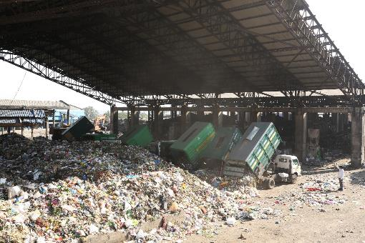
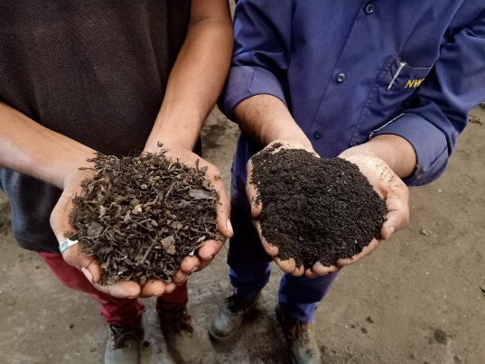
What Needs to be done to Achieve It
Target “MSW” as a “RESOURCE”
Convert “MSW (Resource)” into “USEFUL PRODUCTS”

Slide 9
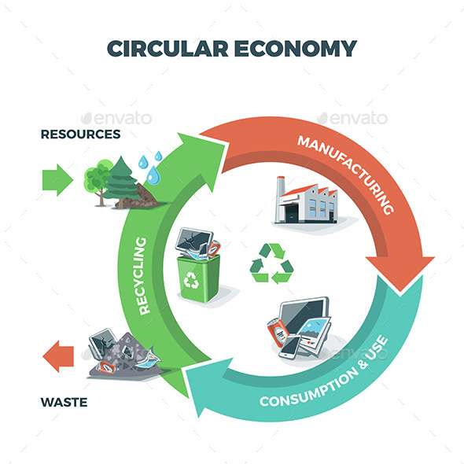
City MSW Symbiosis Circular Economy
Reject of one entity becomes an appropriate economical input of another entity and we avoid environment becoming a sink for polluting rejects
LINEAR ECONOMY
RESOURCES
Zero Waste
Future
Processing
MANUFACTURING
City MSW
CONSUMPTION & USE
RECOVER
WASTE

Slide 10
Good Practices at Nashik Leading to
Circular Economy

Slide 11
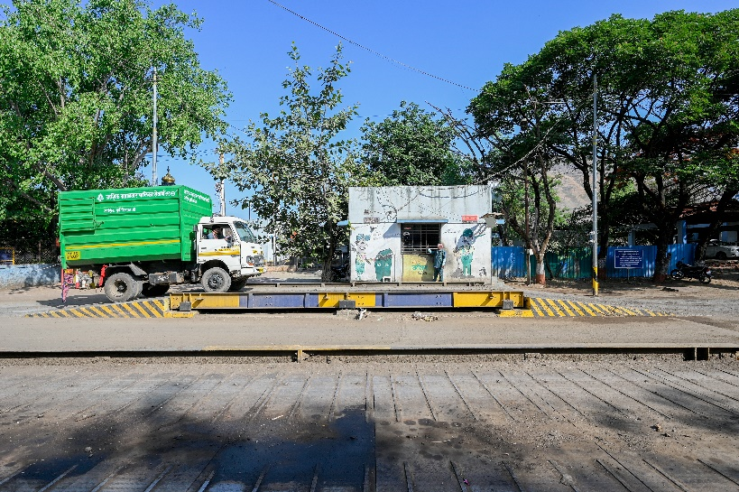
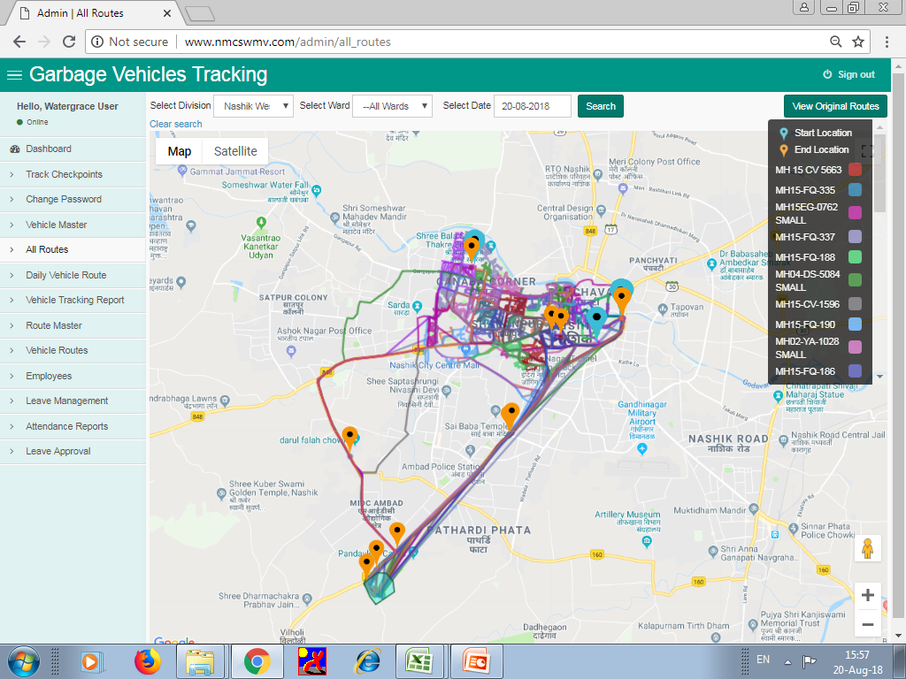
Good Practices at Nashik leading to Circular Economy
Door to Door Collection & Transportation

Slide 12
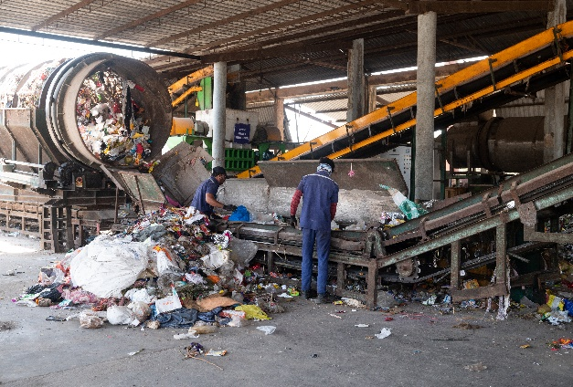
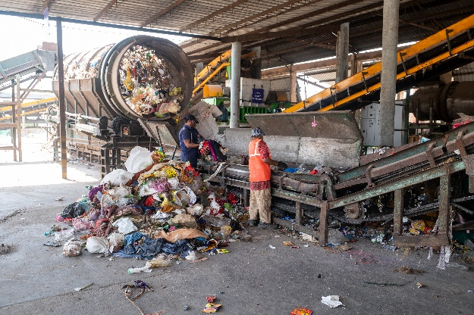
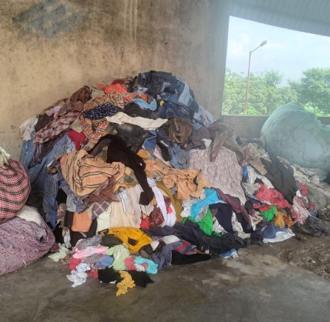
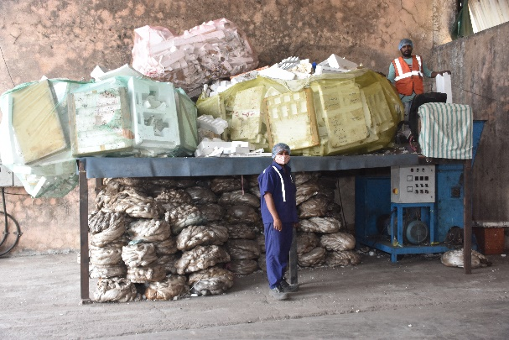
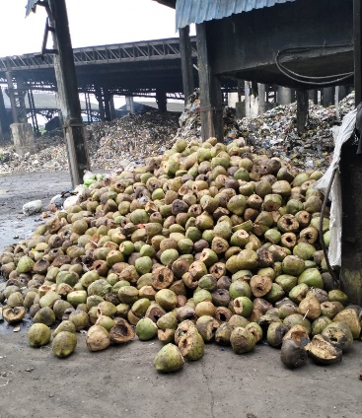
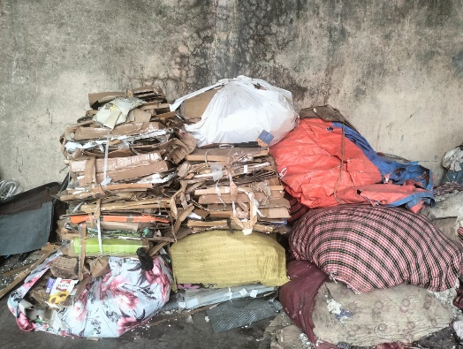
Good Practices at Nashik leading to Circular Economy
Segregation
Unloading
Segregation
Segregated Material
Rags
Thermocol
Cardboards
Coconut Shells

Slide 13
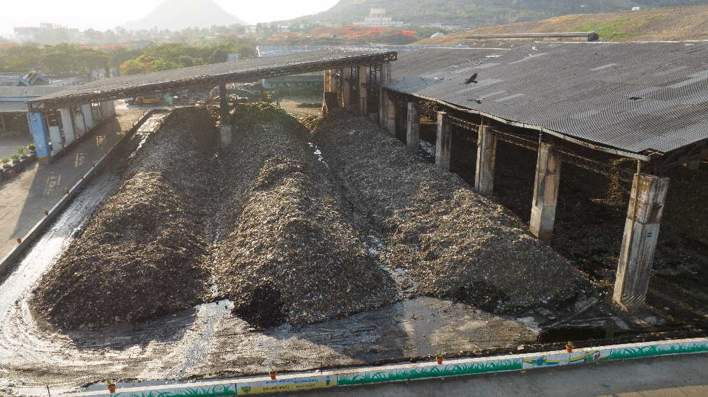
Good Practices at Nashik leading to Circular Economy
Composting

Slide 14
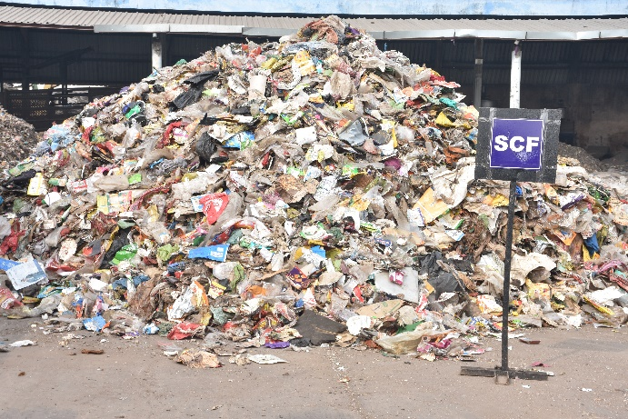
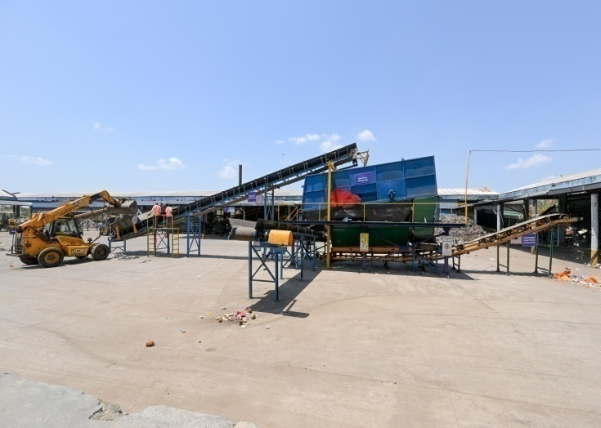
Good Practices at Nashik leading to Circular Economy
Segregated Combustible Fraction (SCF)
Refuse Derived Fuel (RDF)
SCF
Processing
RDF

Slide 15
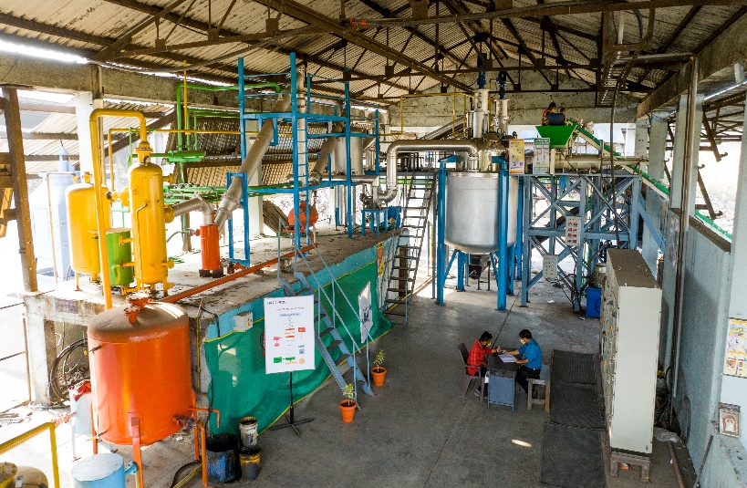
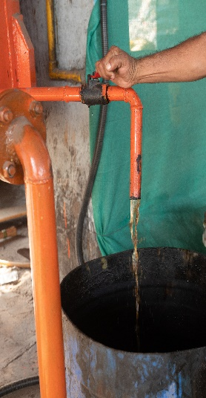
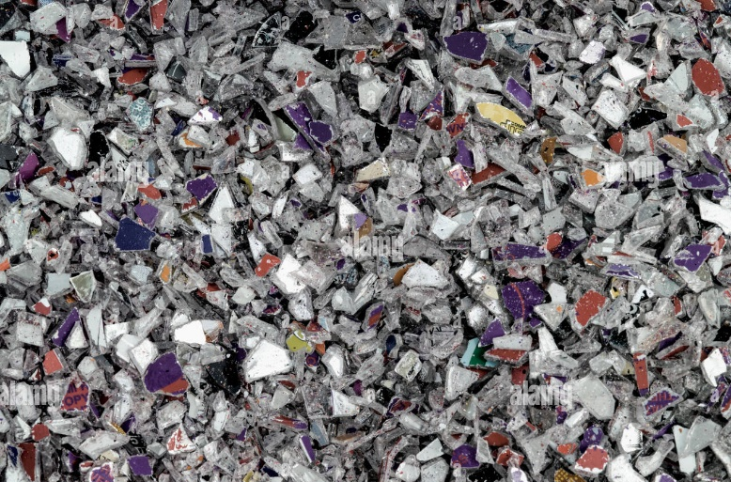
Good Practices at Nashik leading to Circular Economy
Plastic To Fuel & Granules

Slide 16
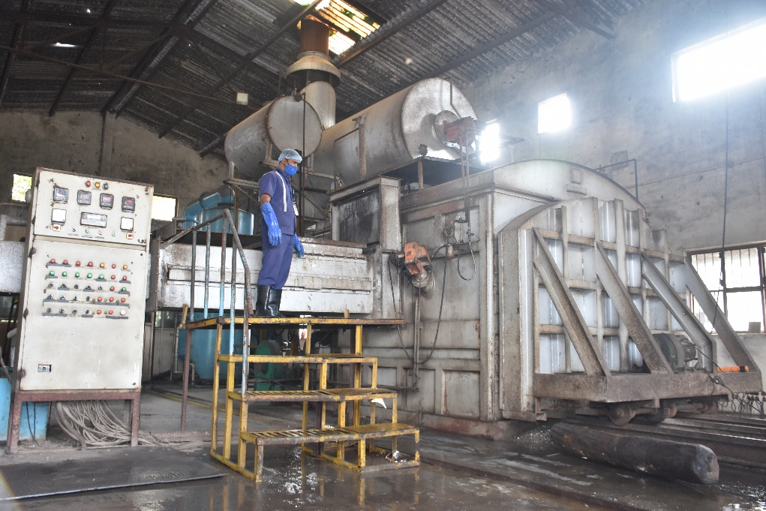
Good Practices at Nashik leading to Circular Economy
Dead Animal Incineration

Slide 17
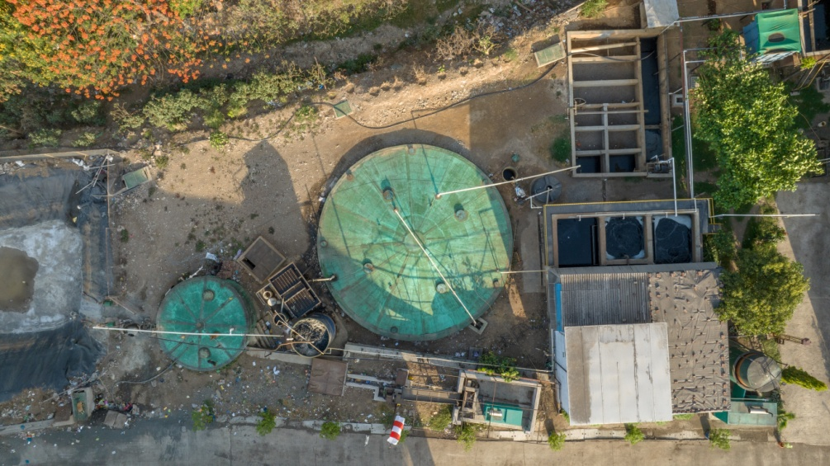
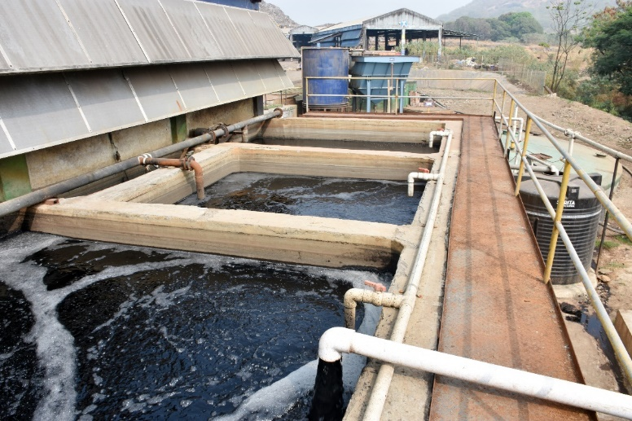
Good Practices at Nashik leading to Circular Economy
Leachate Treatment Plant

Slide 18
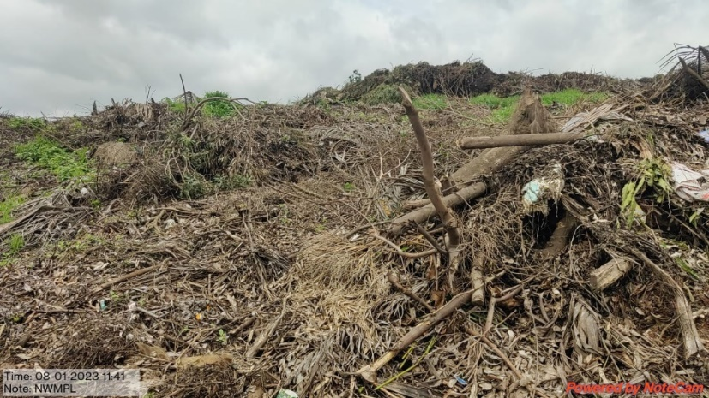
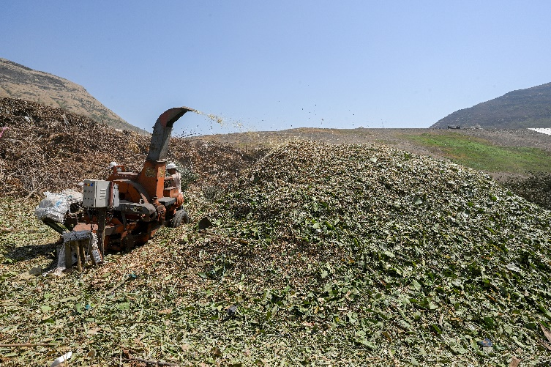
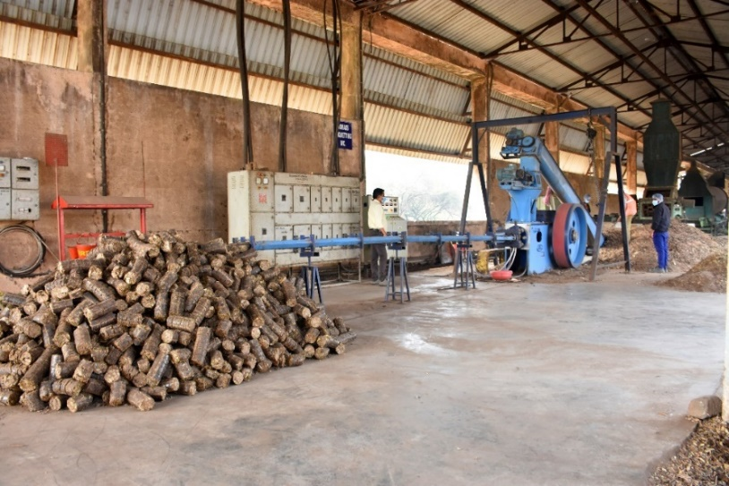
Good Practices at Nashik leading to Circular Economy
Briquetting Plant

Slide 19
Good Practices at Nashik leading to Circular Economy
ABOUT BIOMETHANATION

Slide 20
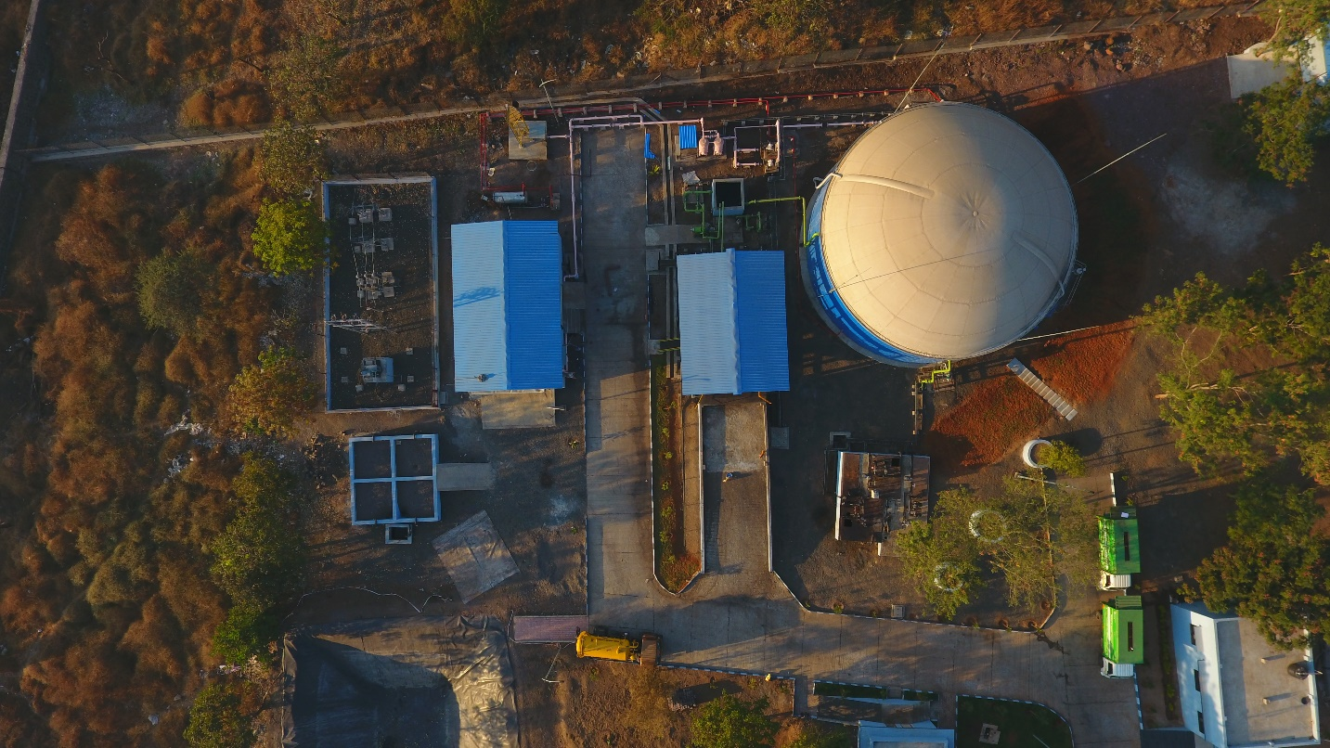
Good Practices at Nashik leading to Circular Economy
Waste To Energy (Biogas) Plant
Based on Septage Waste

Slide 21
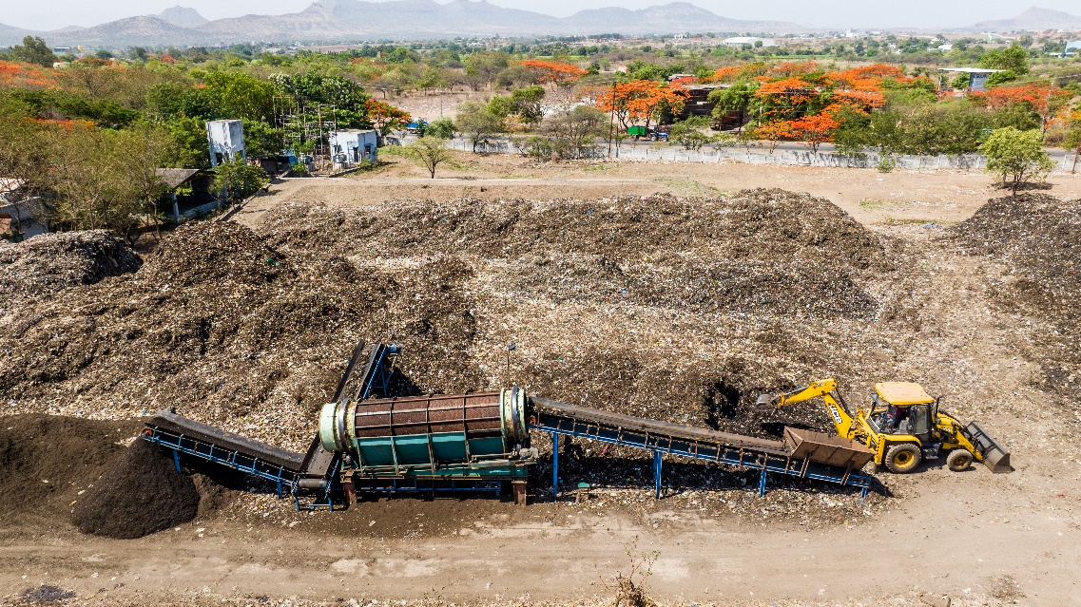
Good Practices at Nashik leading to Circular Economy
Biomining of Legacy Waste

Slide 22
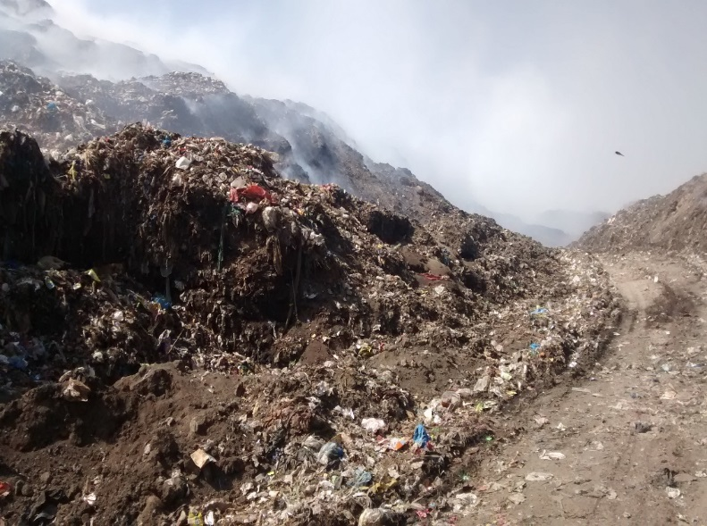
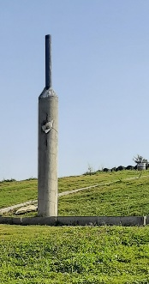
Good Practices at Nashik leading to Circular Economy
Before Capping
After Capping

Slide 23
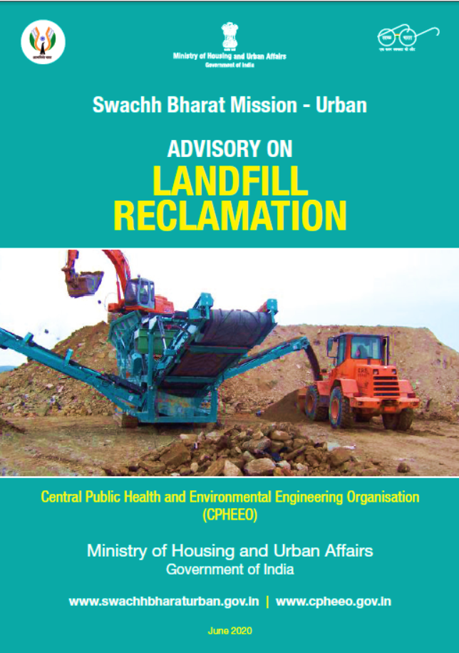
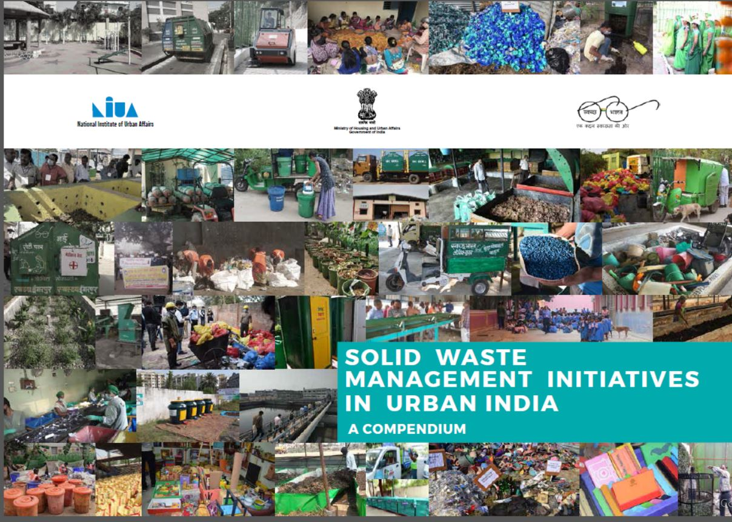
Recognition by Swachh Bharat Mission & MoHUA

Slide 24
Nashik Waste Management Video
Nashik Waste Management Video – CLICK HERE

Slide 25
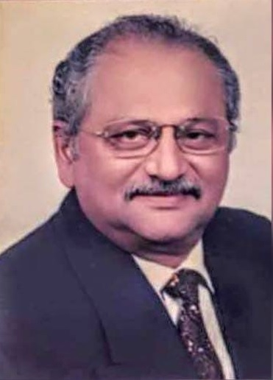
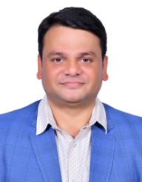
Thank You
Thank You
Col Suresh Rege (Retd)
Director
+91 93704-65019/ 9372738233
sureshrege@nwmpl.co.in
The Nashik Waste Management Plant is recognized as a Model Integrated Municipal Solid Waste Management plant by the Maharashtra Urban Development Mission Directorate and Very well appreciated by the Director of Swachh Bharat Mission
Sameer Rege
Director
+91 93733-39159
sameerrege@nwmpl.co.in
Thank You
Nashik Waste Management Private Limited
Ground Floor, Dhananjay Plaza, Old Mumbai-Pune Hwy, Bavdhan, Pune, Maharashtra 411021
URL : www.nwmpl.co.in

