Slide 1
Action for Cool Cities: Pathways for carbon reduction in buildings and improvement of outdoor thermal comfort Module 2: Ideation and Prototyping
ورشة عمل تطوير أفكار ونماذج المشاريع
عمان – الأردن
7-9 آذار 2023

Slide 2
Workshop Opening
افتتاح الورشة

Slide 3
كلمة افتتاحية Opening Speech
أ. ريكاردا مايسنر – مديرة مشروع المدن الرابطة
Ms. Ricarda Meissner
Senior Programme Manager, Connective Cities

Slide 4
كلمة افتتاحية Opening Speech
كريستينا هاجينيدر – مديرة قطاع البيئة والتغير المناخي في الوكالة الألمانية للتعاون الدولي
Christiana Hageneder
Environment & Climate Cluster - GIZ Jordan

Slide 5
كلمة افتتاحية Opening Speech
م. أكرم خريسات – مدير مرصد عمان الحضري
Eng. Akram Khreisat
Amman Urban Observatory Manager

Slide 8
Ways of working together - topics & formats
CONNECTIVE CITIES acts as mediator between supply and demand of expertise upon request by the members.
CONNECTIVE CITIES can facilitate a direct exchange on in depth topics worldwide
What do we offer?
Collegial exchange | International expertise |
Development of solutions | Linking with financing
What is our goal?
Develop concrete solutions to local challenges
and/or facilitate municipal exchange of expertise

Slide 9
Ways of working together - topics & formats
Timeline 2023
Q1
Q2
Q3
Q4
Deep Dive Heat Islands
LP Sustainable construction (Potsdam)
LP Watersensitive urban development (StEB Köln)
LP Evacuation (Feuerwehr Köln)
LP Cool Cities (MENA, WG in SSA & SEE)
LP Flood Management for RIUD (SSA)
LP Sustainable Infrastrucutre & Renewable Energy (SEE)
Climate Protection Plans
Sustainable Tourism
Municipal Energy Partnerships
Urban Biodiversity
Circular Economy in Waste Management
Knowledge & City
Heidelberg
Resilience in times of war
Flood Management Global WG
Circular urban development
Mannheim

Slide 10
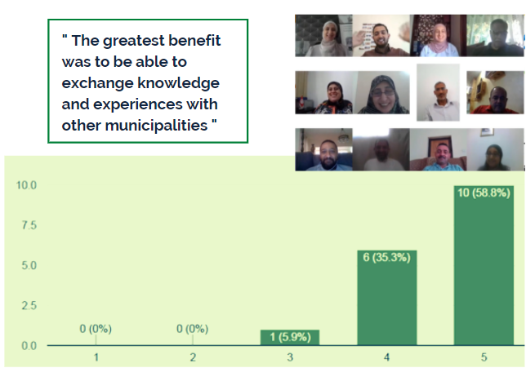
Network in MENA: More than 100 municipalities with around 300 members
?
SWM & circular economy
Social
Entrepreneurship
Biodiversity & Env. protection
Energy Efficiency
?
LED
Digitali-sation
Cool Cities
Crisis management
?

Slide 11
Action for Cool Cities: Pathways for carbon reduction in buildings and improvement of outdoor thermal comfort
تعميم الاعتبارات المناخية في التخطيط الحضري للبلديات لخفض انبعاثات الغازات الدفيئة في المباني وتحسين الراحة الحرارية في المساحات الحضرية
floods in urban areas
Carbon emission from buildings
Sustainable building
material
Land management
for climate adaptation
(GI, RE projects)
Green
Economy
Carbon emission from transportation
Thermal comfort in outdoor areas
(mircoclimate)

Slide 12
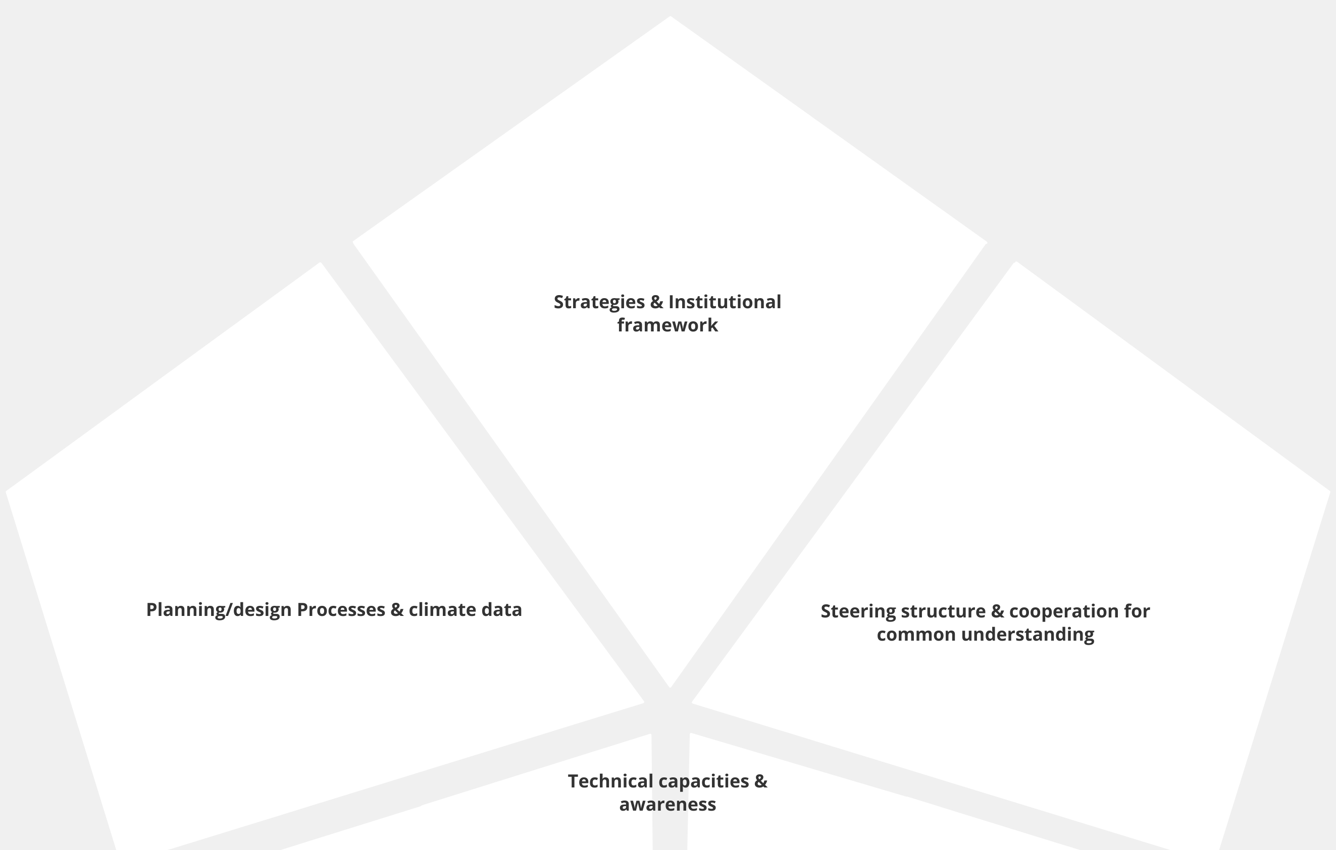
Understanding & Observation
فهم وجهات النظر المختلفة وتحليل سياق التنفيذ المحلي
الإستراتيجية والهيكل المؤسسي
عمليات التخطيط والبيانات المناخية
التعاون والهيكل التوجيهي
القدرات التقنية ورفع الوعي

Slide 13
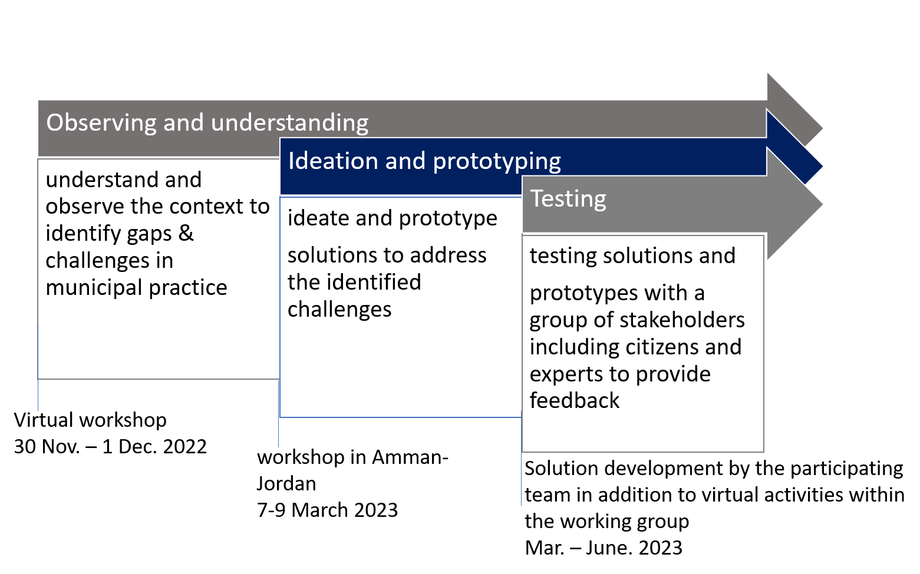

Slide 14
Designing climate-responsive outdoor public spaces and promoting engagement of citizens
Ideation and prototyping of solutions by the participating municipalities within the thematic fields
Steering Structure: Interdepartmental Communication framework/platform in municipalities
Optimizing existing building and urban design regulations by introducing key performance indicators and improving in-house capacity
municipality as a regulator and implementer: budget analysis and strategies for cost recovery of climate action measures

Slide 15
Peer advisory and experience exchange
(internal)
External technical advisory
Feedback & evaluation of prototypes (internal & external)

Slide 16
Participants who couldn‘t attend the workshop in Amman will be briefed and included in the process

Slide 17
Day 1 – Mar 7th, 2023 – Opening and Kick off the Prototyping Journey
Time | Activity | Where | Who |  | Additional Details
09:30 – 10:00 | Opening and Welcoming Speech | Venue | Ricarda Meissner- Connective Cities Christiana Hageneder- Environment & Climate Cluster- GIZ Jordan Akram Khreisat – Amman urban observatory | Ricarda Meissner- Connective Cities Christiana Hageneder- Environment & Climate Cluster- GIZ Jordan Akram Khreisat – Amman urban observatory
10:00 – 10:30 | Connective Cities progress and achievements and objectives of this workshop |  | Dr. Muna Shalan | Milestones reached and the objective of this conference
10:30 - 11:00 | Introduction to the prototyping journey (roadmap) |  | Maisam Otoum - moderator Dr. Shady Attia - Sustainable Building Design Lab University of Liège | Maisam Otoum - moderator Dr. Shady Attia - Sustainable Building Design Lab University of Liège
11:00 – 11:15 | Coffee Break
11:15 – 12:00 | Grouping and Pitching Ideas within Groups | Venue | Moderatos + Groups | 4 Groups, what? Why? How? - includes feedback on pitching
12:00 – 13:30 | Group Activity I: Process Flow Diagram (Stages) |  | Moderatos + Groups | Introduction + Identifying Principal Stages
13:30 – 14:45 | Lunch Break
14:45 – 16:00 | Group Activity II: Process Flow Diagram (Actions/Inputs) | Venue | Moderatos + Groups | Identifying the Actions and the Inputs
16:00 – 16:15 | Coffee Break
16:15 – 17:00 | Group Activity III: Process Flow Diagram (Responsibilities/Resources) | Venue | Moderatos + Groups | Identifying Responsibilities and Resources (inc. funding sources)

Slide 18
Day 2 – Mar 8th ,2023 – Prototype Building, Advisory, and Validation
Time | Activity | Where | Who | Additional Details
09:30 – 10:15 | Recap from Day 2 | Venue | Moderatos + Groups | Going over the flow diagram in groups to get feedback
10:15 – 11:15 | Envisioning the final prototype |  | Moderatos + Groups | Illustrating how the final prototype should look like when put into operation
11:15 – 11:30 | Coffee Break
11:30 – 13:00 | Validation Session I: with Experts | Venue | Subject Matter Experts | From Jordan and/online
13:00 – 14:15 | Lunch Break
14:15 – 15:30 | Validation Session II: with Target Beneficiaries | Venue | Groups | By phone, by online meetings, etc.
15:30 – 15:45 | Coffee Break
16:15 – 17:00 | Validation Summary and Iterations to Flow Diagram | Venue | Groups | Adapt the flow diagram to address the validation learnings
17:30 – 19:00 | HTU Site Visit | King Hussein Business Park | Eng. Maysoon Khreisat | Tour into the Edge-certified HTU Building

Slide 19
Day 3 – Mar 9th, 2023 – Final Prototype Presentations
Time | Activity | Where | Who | Additional Details
09:30 – 10:00 | Opening and Recap from Day 3 | Venue | Moderatos + Groups | Going over the Validation Experience
10:00 – 11:45 | Prototype Presentations Round I & 2 |  | Groups 1 & 2 | Freestyle (the way groups decide to present) – including Q&A
11:45 – 12:30 | General Feedback and Next Steps |  | Dr. Muna Shalan | Indicating how to test the prototypes
12:30 – 14:00 | Lunch Break

Slide 20
Ideation and Prototyping Roadmap
Day 1
Day 2
Day 3
Sorting out the Ideas
Validation Stages
Presenting the Prototype
Presenting within the group
Identification of flow diagram stages
Identification of Inputs/actions
Identification of Responsibilities and Resources
Laying out the Assumptions
Validation with Experts
Validation with the Beneficiaries
Seeing an example firsthand
Preparing the prototype
Receiving Feedback
Discussing Next Steps
Final Projects Prototypes

Slide 21
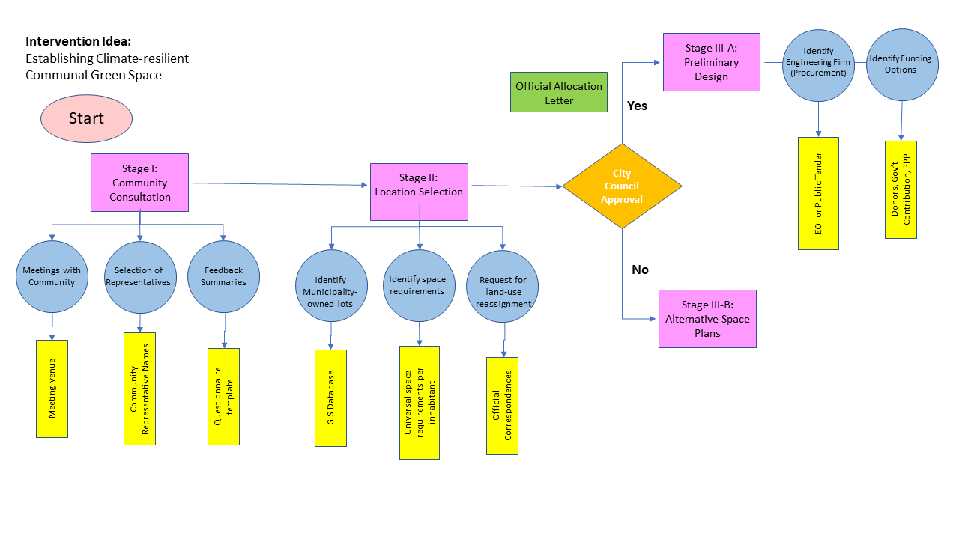
Process Flow Diagram
A project management process flowchart is a graphical aid, designed to visualize the sequence of steps to be followed throughout the project management process
Primary Questions to address in a Flow Diagram:
What are the primary stages of the project?
What are the actions for each stage?
What inputs (resources) are need to be available for each action?
Who is responsible for completing each action?
How long should each action take?
Which stage/action is dependent on another?
What are the potential roadblocks or bottlenecks in this process?
What are the final outcomes of this process?

Slide 22
Process Flow Diagram
Intervention Idea:
Establishing Climate-resilient Communal Green Space
Start
Official Allocation Letter
Yes
City Council Approval
Stage I:
Community Consultation
Stage II:
Location Selection
Stage III-A:
Preliminary Design
Meetings with Community
Selection of Representatives
Feedback Summaries
Identify Municipality-owned lots
Identify space requirements
Request for land-use reassignment
Identify Engineering Firm (Procurement)
Identify Funding Options
No
Meeting venue
Community Representative Names
Questionnaire template
GIS Database
Official Correspondences
Universal space requirements per inhabitant
Stage III-B:
Alternative Space Plans
EOI or Public Tender
Donors, Gov’t Contribution, PPP

Slide 23
Process Flow Diagram
START
STAGE
A primary stage for designing and implementing a project
ACTION
An Action required to pass a certain stage
INPUT
Input resources that are critical to complete an action
DECISION GATE
A key decision gate that has a major role in the success of the project
DOCUMENT
A key document that has a major role in the success of the project
ASSUMPTION
Assumptions that are made along the flow diagram

Slide 24
Process Flow Diagram
STAGE
A primary stage for designing and implementing a project
To decide the primary stages of your project, think of:
What are the primary milestones that are necessary to have a completed project
What Milestones are relevant to our own municipality vs. those relevant to external entities
Examples:
Land use re-assignment
Finalized GIS database for inter-departmental coordination on new projects
Energy efficiency building codes draft completed

Slide 25
Process Flow Diagram
ACTION
An Action required to pass a certain stage
To decide the actions are necessary for your project, think of:
What are the key actions that are necessary to fulfill a certain stage
What actions are needed to mitigate the risks of not completing a certain stage
Examples:
Preparation of layout plans
Holding a meeting with GIS department
Review of existing inter-departmental communication

Slide 26
Process Flow Diagram
INPUT
Input resources that are critical to complete an action
To decide on the inputs for the project, think of:
What key resources (technical, financial, logistical, HR) required to fulfill an action
How critical these resources are to complete the action (and when)
Examples:
Technical staff to survey the urban park lot
Budget to cover site visits and meetings with the community
New staff re-assignment to manage coordination

Slide 27
Process Flow Diagram
DECISION GATE
A key decision gate that has a major role in the success of the project
To decide what decision gates are critical, think of:
What city/government related decision has an influence on the success of the project
How do these decisions affect the project continuation
Examples:
City council approval on land allocation
Mutual agreement with building developers on new requirements for energy efficiency in buildings
New funding made available for project implementation

Slide 28
Process Flow Diagram
DOCUMENT
A key document that has a major role in the success of the project
To decide documents are important, think of:
What primary documentation/approvals are necessary to have from governmental authorities
What primary documentation is necessary to keep a record of passed milestones
Examples:
Signed letter from authorities for land allocation
New approved organogram for the new department
Preliminary design of the new urban space

Slide 29
Process Flow Diagram
ASSUMPTION
Assumptions that are made along the flow diagram
In each step towards creating a certain project idea or prototype, we need to state certain assumptions that helped us plan the stages, actions, inputs, etc.
Therefore, we need to always state those statements as part of our prototype (either assumptions that help to approach the end goal, or those that work against it)

Slide 30
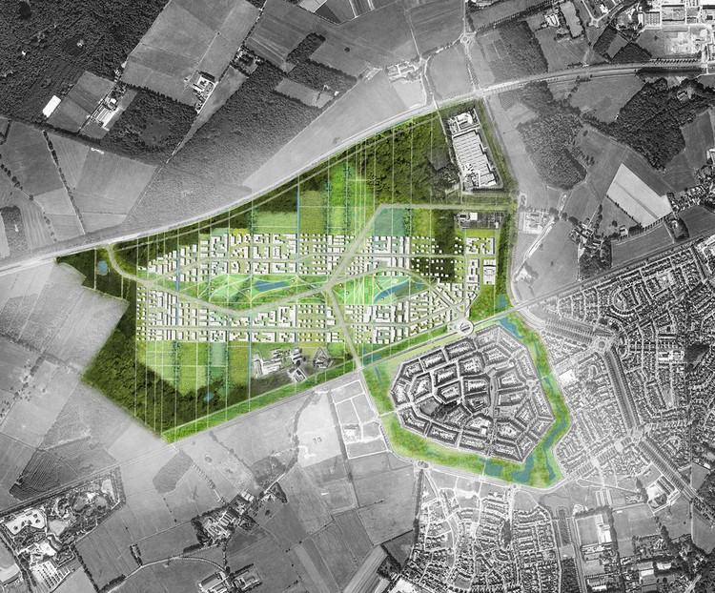
Envisioning the Final Prototype
Infrastructure Elements
Human Elements [impact]
Climate Responsive Elements [impact]

Slide 31
Group 1: Designing climate-responsive outdoor public spaces and promoting engagement of citizens (EN)
Group 2: Designing climate-responsive outdoor public spaces and promoting engagement of citizens (AR)
Group 3: Steering Structure: Interdepartmental Communication framework/platform in municipalities
Group 4: Optimizing existing building and urban design regulations by introducing key performance indicators and improving in-house capacity to drive change
Structural and Strategic Actions:
Strategic City or Urban Master Plan including Land Uses Plan
Environmental City or Urban Master Plan
Climate Change and Sustainability Experts or Unit (In-house)
GIS Experts or Unit (In-house)
Reporting Unit (UN SDG, UNFCCC United Nations Framework Convention on Climate Change)
Urban Observatory and Monitoring Units
Resilience Plan (Flooding, Drought, Desertification, Fires, Heat waves, Power outages…)

Slide 32
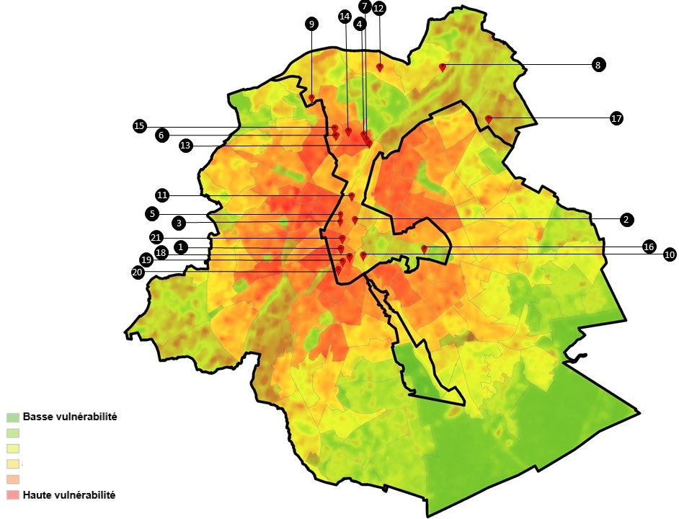
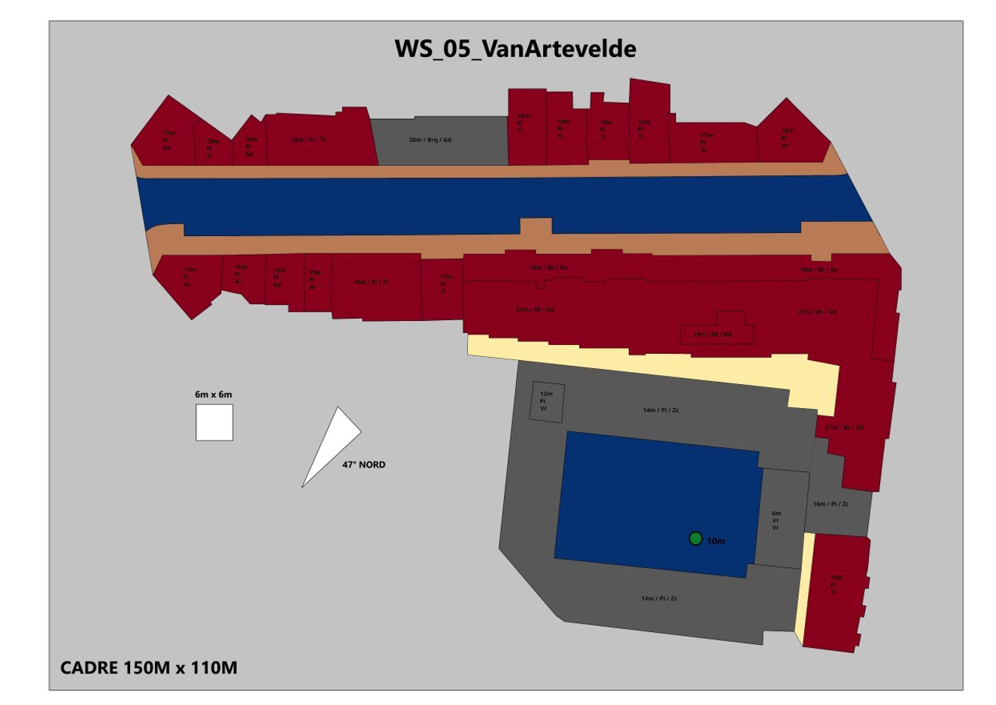
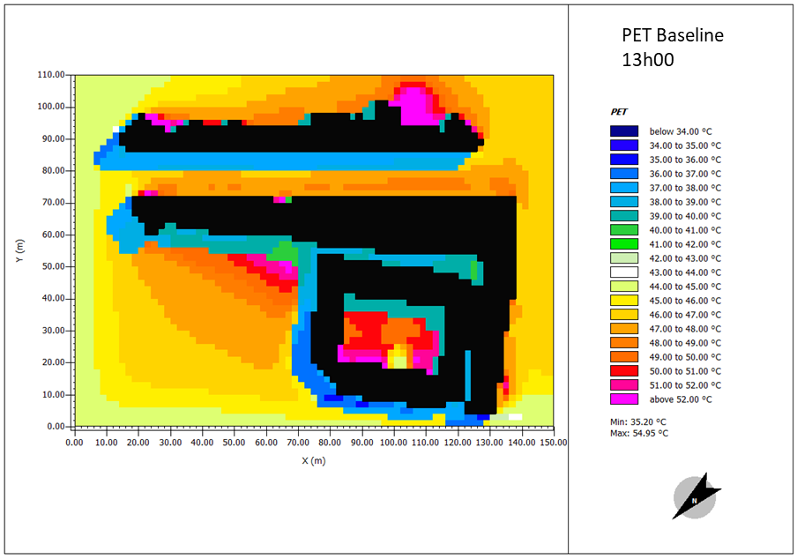
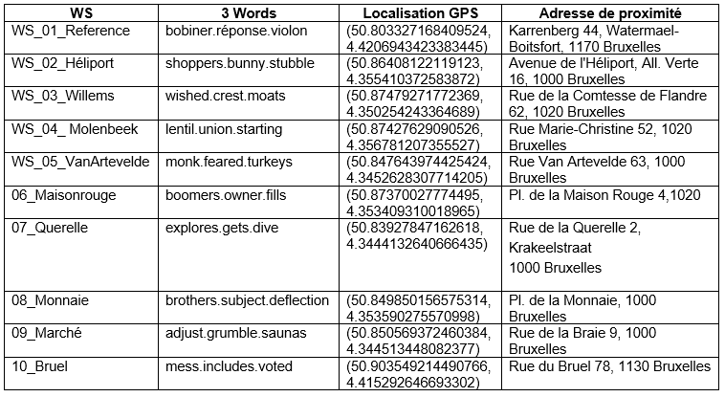
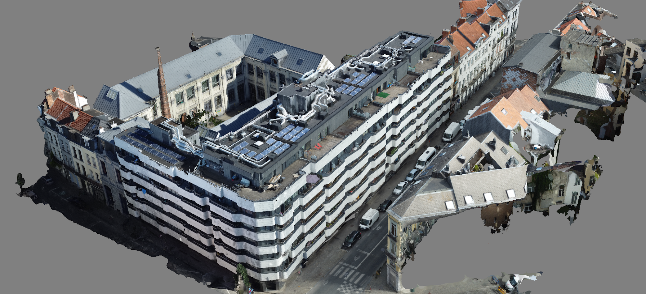
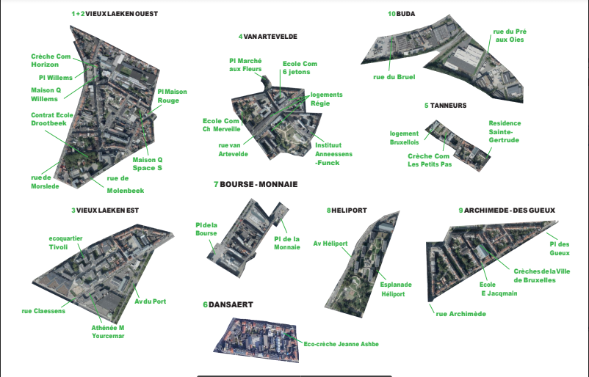
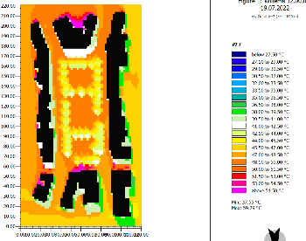
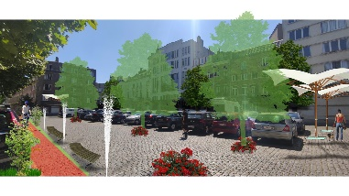
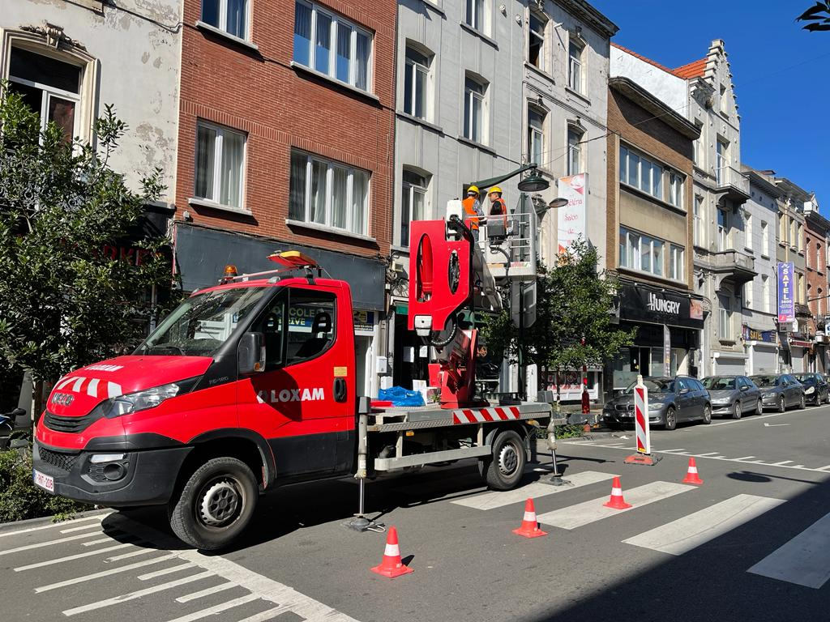
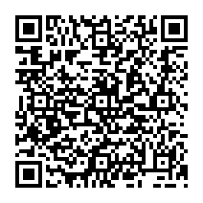
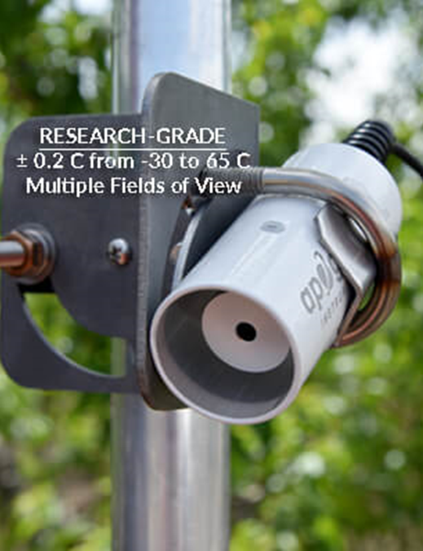
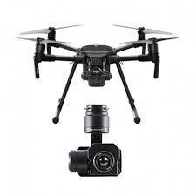
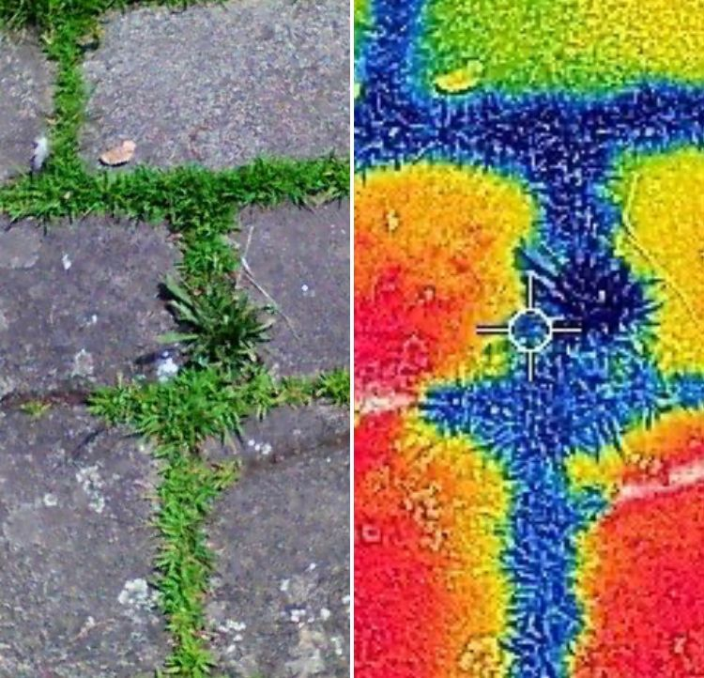
Validation: Simulation
Satellite Mapping
ENVI-met
64 Core Workstation
3D Models
UHI Hot Spots
Evidence-based Design
Plan Measure Evidence
Collage
Monitoring
Survey
Drone
Thermal Imaging
PET

Slide 33
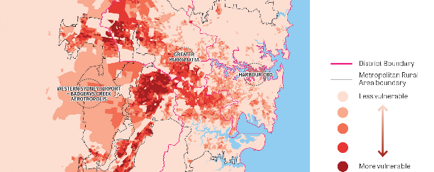
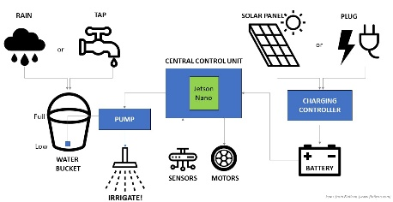
Validation: Water Budget
Heatwaves Vulnerability
Mapping
Optimal Control Alg.
64 Core Workstation
Optimal Irrigation
and Cooling
Algorithm Validation
Parks Cool Island Effect
AI Module for Irrigation
Sydney Olympic Park
Monitoring
Digital Twin
Weather Stations
50 Low-Cost Sensors
30 Weather Stations
Sources: Kineses 2016m 2022 Pfautsch: https://www.uts.edu.au/isf/explore-research/projects/new-south-wales-coolest-public-park

Slide 34
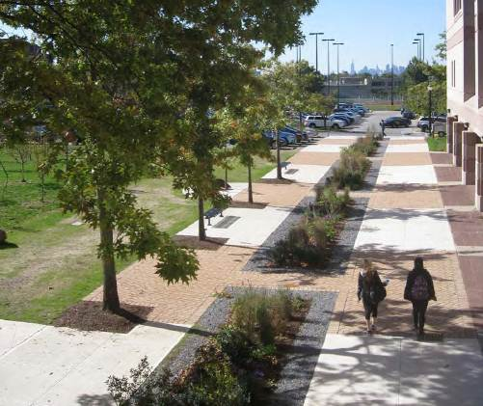
Validation: The Frog walk

Slide 35
Validation with End Beneficiaries
No. | Name | Affiliation | Contact Info | Validation Sub-topic | Feedback
1
2
3
4

Slide 36
Final Presentations
When
To March 9th @ 10:00 Sharp!
What
Presenting a High-Level project idea and approach for implementation
What
No Powerpoint Allowed!
Needs to be creative and appealing
You can use your sheets but only as a supporting material
Can be using:
Story Telling
Role Playing
Mini Video (by phone)
1 Photo Only

Slide 37
Working Groups
Group 1: Designing climate-responsive outdoor public spaces and promoting engagement of citizens (EN) | Group 2: Designing climate-responsive outdoor public spaces and promoting engagement of citizens (AR)
Kisumu | Hebron
Chililabombwe | Adrar
Sahab | Bab Amman
Zarqa | El Kef
Khan Younis | Sidi Bouzid
 | Abasan

Slide 38
Working Groups
Group 3: Steering Structure: Interdepartmental Communication framework/platform in municipalities (AR) | Group 4: Optimizing existing building and urban design regulations by introducing key performance indicators and improving in-house capacity to drive change (AR)
Hebron | Sfax
Jendouba | Jendouba
Sahab | Irbid
Jerash | Bab Amman
Al Salt | Al Dhulail
Qalqilya | Qalqilya

Slide 39
Group 1: Designing climate-responsive outdoor public spaces and promoting engagement of citizens (EN)
Group 2: Designing climate-responsive outdoor public spaces and promoting engagement of citizens (AR)
Group 3: Steering Structure: Interdepartmental Communication framework/platform in municipalities
Group 4: Optimizing existing building and urban design regulations by introducing key performance indicators and improving in-house capacity to drive change

Slide 40
Group 1: Designing climate-responsive outdoor public spaces and promoting engagement of citizens (EN)
Kisumu
Khan Younis
Group 2: Designing climate-responsive outdoor public spaces and promoting engagement of citizens (AR)
Bab Amman
El Kef
Sidi Bouzed
Adrar
كلمة افتتاحية Opening Speech
Group 3: Steering Structure: Interdepartmental Communication framework/platform in municipalities
Hebron
Jendouba
Group 4: Optimizing existing building and urban design regulations by introducing key performance indicators and improving in-house capacity to drive change
Irbid
Christiana Hageneder
Environment & Climate Cluster- GIZ Jordan

Slide 41
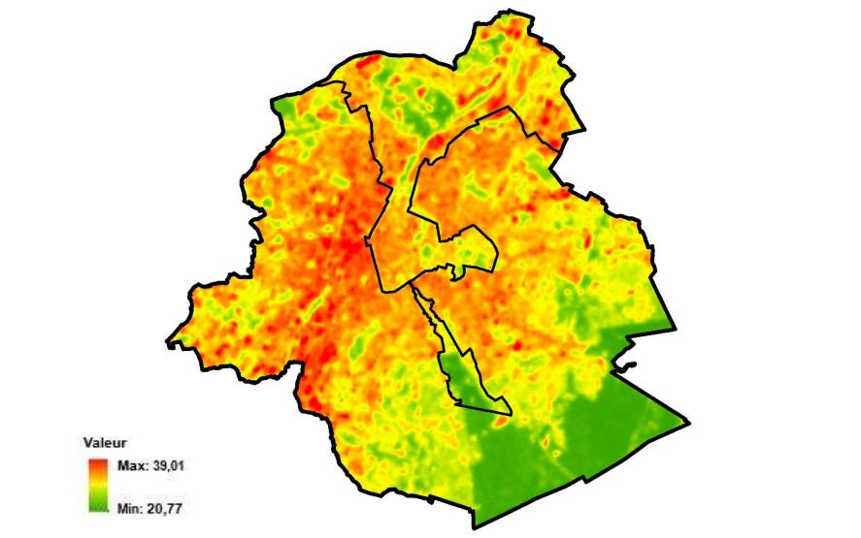
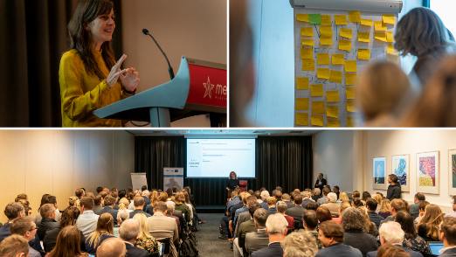
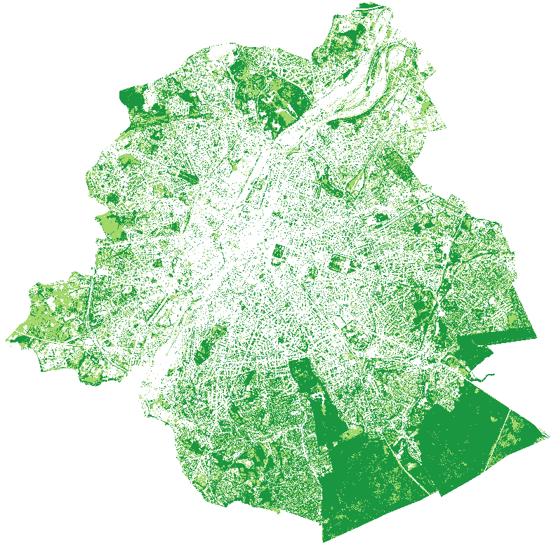
Group 1: Designing climate-responsive outdoor public spaces and promoting engagement of citizens (EN)
Natural Ventilation in relation to urban
morphology & urban trees
Vegetation of surface
Trees for Shading
Group 2: Designing climate-responsive outdoor public spaces and promoting engagement of citizens (AR)
Public consultation
Public Surveys
With KPIs and
Targets/ thresholds
Group 3: Steering Structure: Interdepartmental Communication framework/platform in municipalities
Group 4: Optimizing existing building and urban design regulations by introducing key performance indicators and improving in-house capacity to drive change
Tree Canopy Cover Indicator
10-12 squared meter per citizen according WHO
Available Water Capacity,
Soil Compaction and presence of Organic Matter
Biodiversity
Framework for
Strategic Communications
Information sharing
Institutional arrangement
Capacity development
37%

Slide 42
Observing and understanding
understand and observe the context to identify gaps & challenges in municipal practice
Ideation and prototyping
ideate and prototype
Testing
testing solutions and
prototypes with a group of stakeholders including citizens and experts → optimise
solutions to address the identified challenges
Virtual workshop
30 Nov. – 1 Dec. 2022
workshop in Amman-Jordan
7-9 March 2023
Solution development by the participating team in addition to virtual activities within the working group
Mid May 2023
Mid June 2023

Slide 43
Testing
target audience: quantitative and qualitative feedback:
Stakeholders have the interest in mind → make sure to back up your decision with evidence (real data)
Evaluate the test results and implement changes
Successful prototype testing is an iterative process

Slide 44
Enjoy your afternoon!

