Slide 1






WELCOME TO
Arch. Maysoon Al-Khuraissat
​M.Arch, LEED AP, USGBC Faculty,
IFC EDGE Expert, Auditor & EDGE Faculty
PA- Professional Architect- Sustainability and Green Building
HTU Industry Fellow

Slide 2

بسم الله الرحمن الرحيم
﴿هو أنشأكم من الأرض واستعمركم فيها﴾
هود، آية 61
In the Name of Allah, the Most Beneficent, the Most Merciful
(He brought you forth from the earth, and settled you therein)
Hud, 61

Slide 3
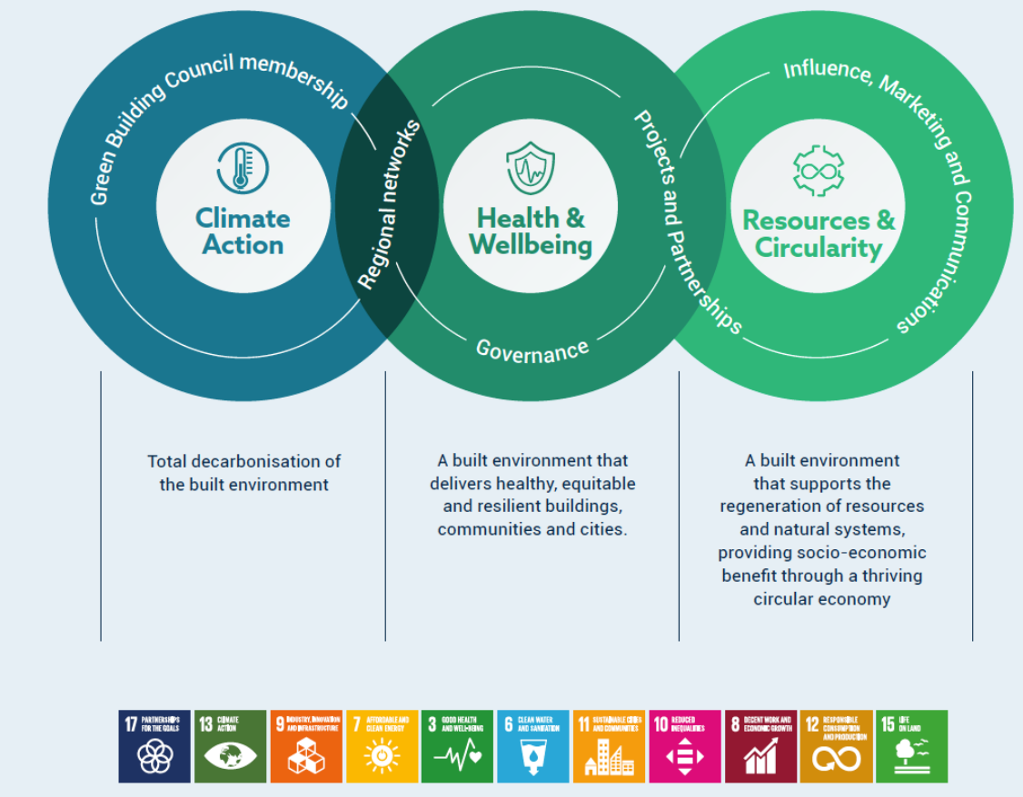
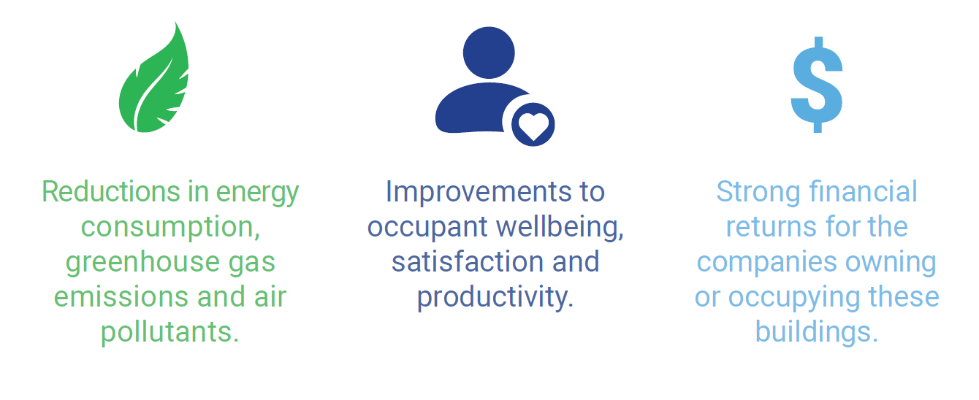

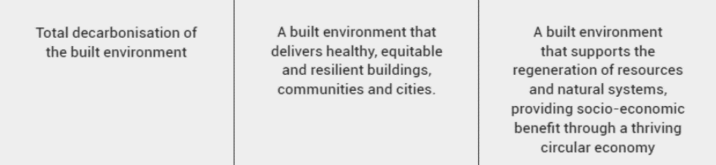
In order to have a Sustainable Future, we must hold responsibility and take actions
Planet
People
Profit
www.worldgbc.org

Slide 4
IDEAS to discuss today
How can an integrated design approach bring value to the built environment?
What are some of the essential solutions for sustainable campuses?
What is EDGE and how can its considerations reflect urban design?
How can the EDGE system enable facilities to reduce their carbon footprint through lower greenhouse gas emissions?
How can EDGE encourage more affordable green solutions in high-growth, urban areas?
IDP
Sustainable Campus
EDGE
Decarbonization
Affordable Solutions

Slide 5
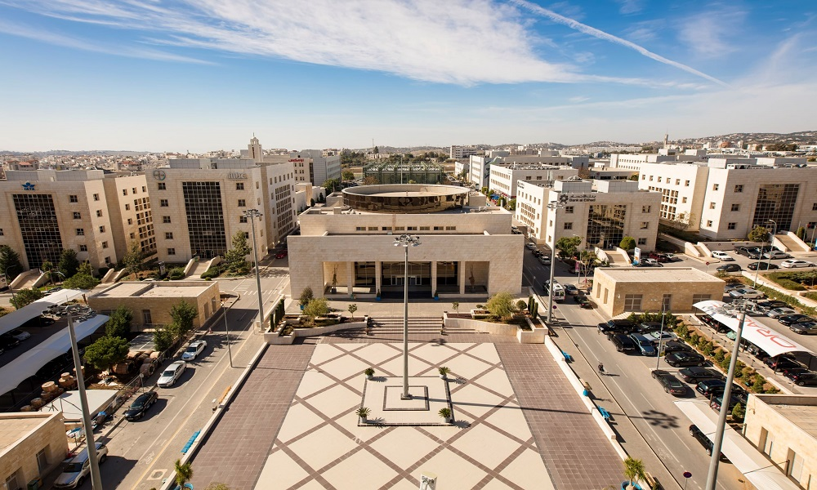
الاستدامة في مجمع الملك الحسين للأعمال
Sustainability at KHBP

Slide 6
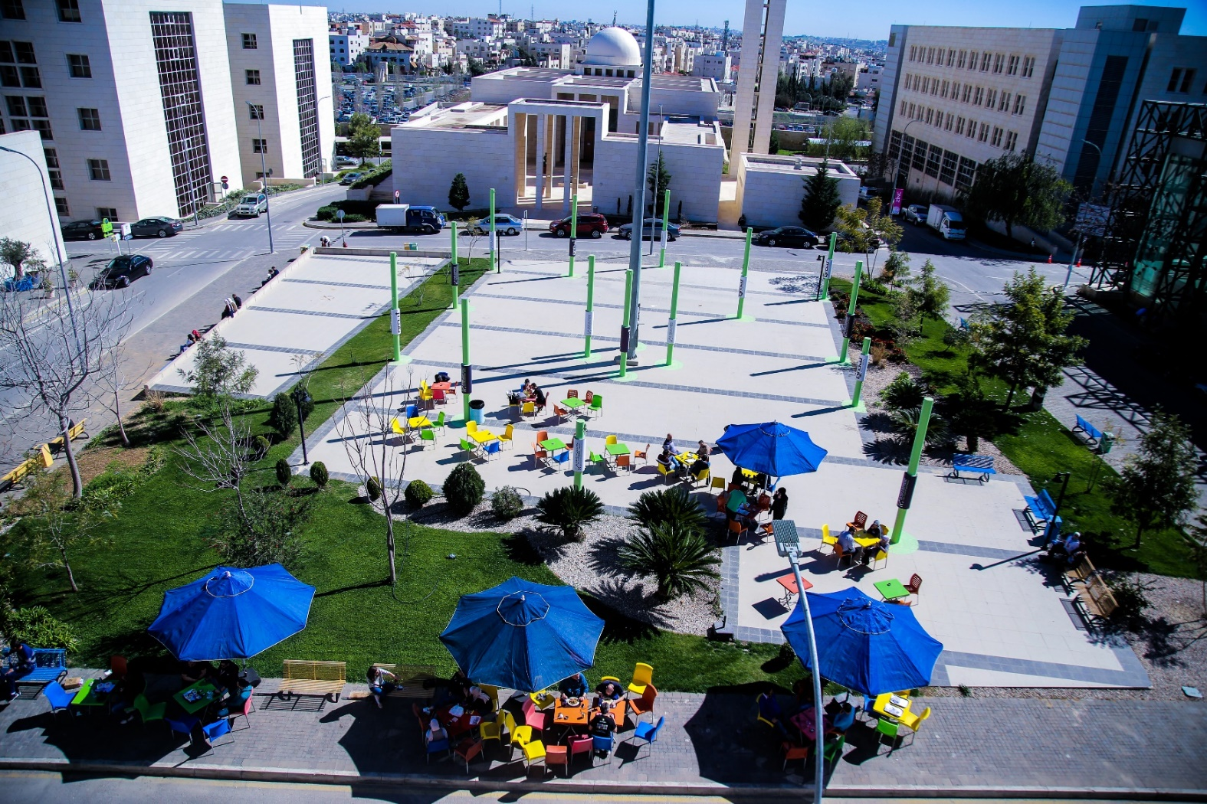
Sustainability aspects at KHBP original design
Designed to be GREEN
Designed for Walkability
Had Cycling Tracks
Have Free Shuttle Busses
Had an Electrical Charging Station
Have Efficient Exterior Lighting
Have an Efficient Irrigation System
Had a Greywater System
Have Energy & Water Efficient buildings
Have Indoor Thermal Comfort

Slide 7

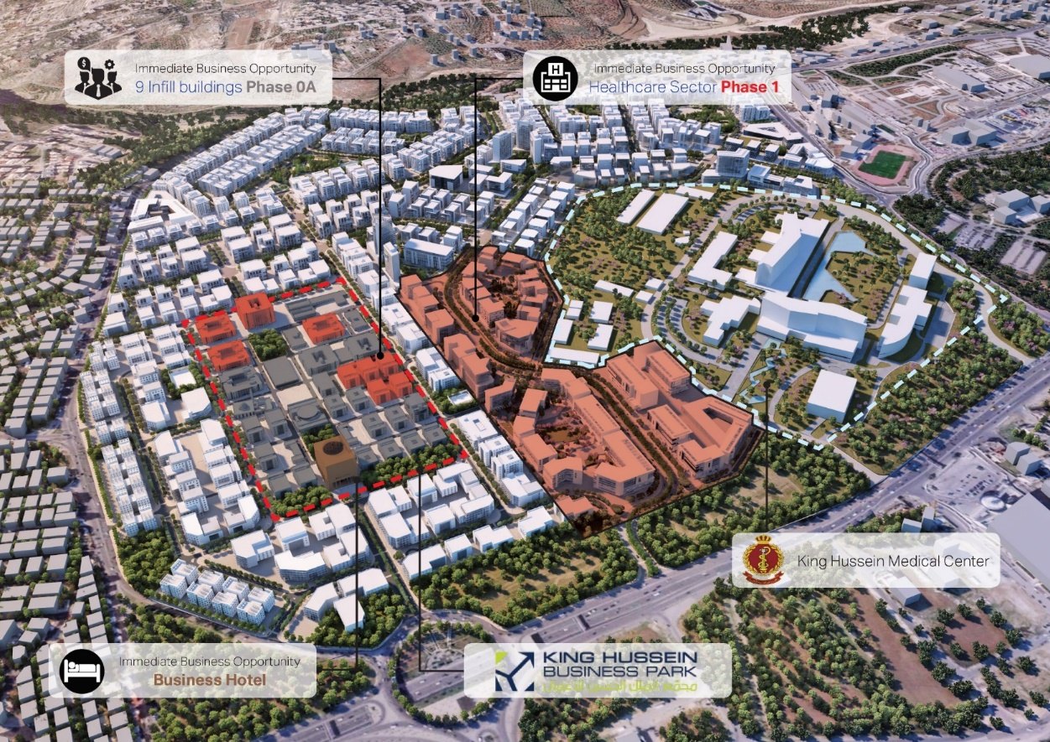

GREEN Vision for KHBP
CERTIFIED
GREEN CAMPUS
Green Building Certification for Existing Office Buildings
Green Design, Construction, and Certification for All New Buildings
Build an off-site PV Power Station to cover the campus’s electricity consumption

Slide 8
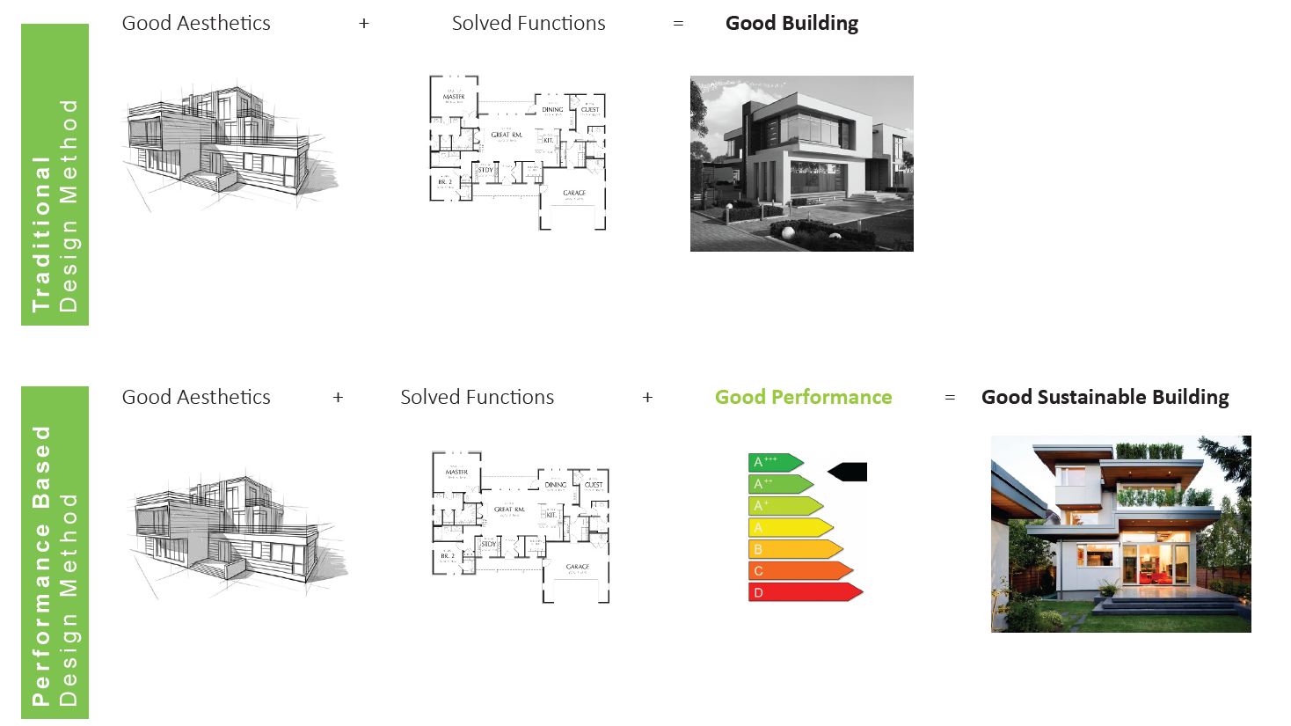
Performance Based Design

Slide 9


The Tool and the Rating System we choose
EDGE MAKES IT FASTER, EASIER AND MORE AFFORDABLE THAN EVER BEFORE TO BUILD AND BRAND GREEN.
________
EDGE is an innovation of IFC, a member of the World Bank Group.
Notes:
Thank you for your time today in allowing me to introduce EDGE.
EDGE is a fast, easy, and affordable way to build green in more than 140 countries.
Today I’ll share with you how EDGE can help you to attract more loyal customers.
You’ll see that by adopting EDGE, your company can become more competitive and demonstrate leadership in the green building space.
EDGE is an innovation of IFC, a member of the World Bank Group.

Slide 10
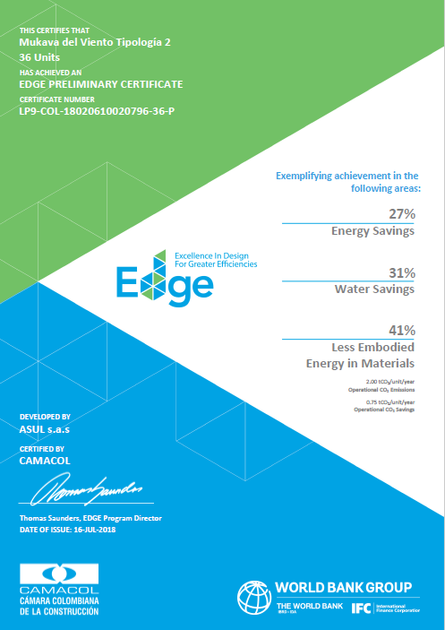
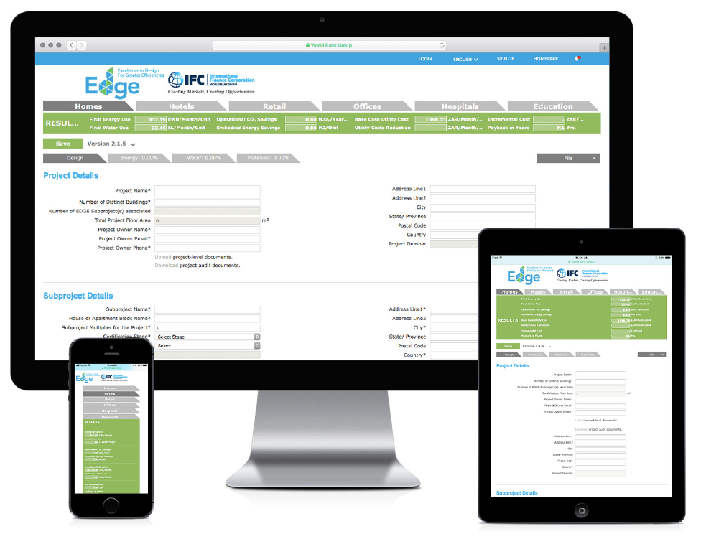
The SOLUTION IS EDGE:
A SOFTWARE,
A STANDARD,
& A GREEN BUILDING CERTIFICATION SYSTEM.
________
20%
Notes:
The solution is EDGE: a software, a standard, and a green building certification system.
EDGE recognizes the need for a measurable solution, with:
Free software for choosing the most cost-effective ways to build green.
A green building standard of 20%.
And a certification system to reward green building projects.

Slide 11
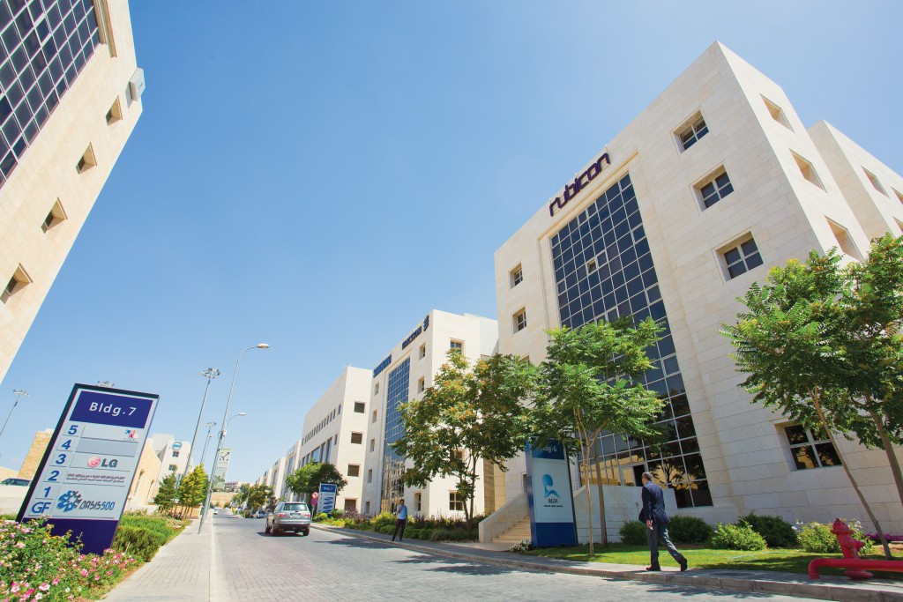
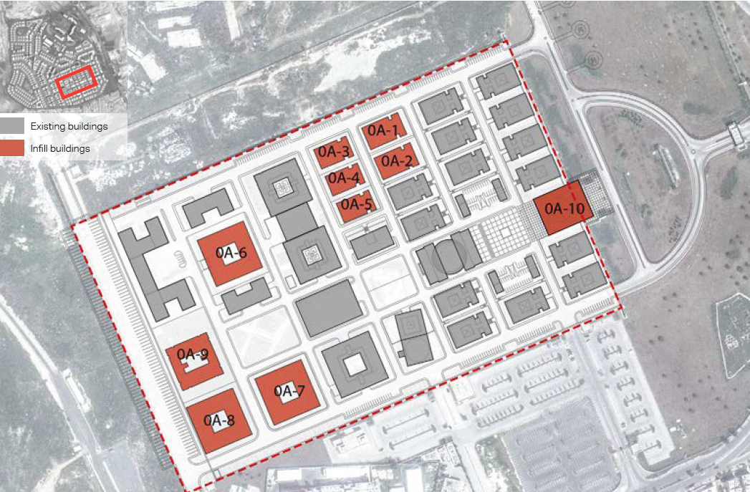
KHBP Green Campus- Phase 1
May -2018

Slide 12

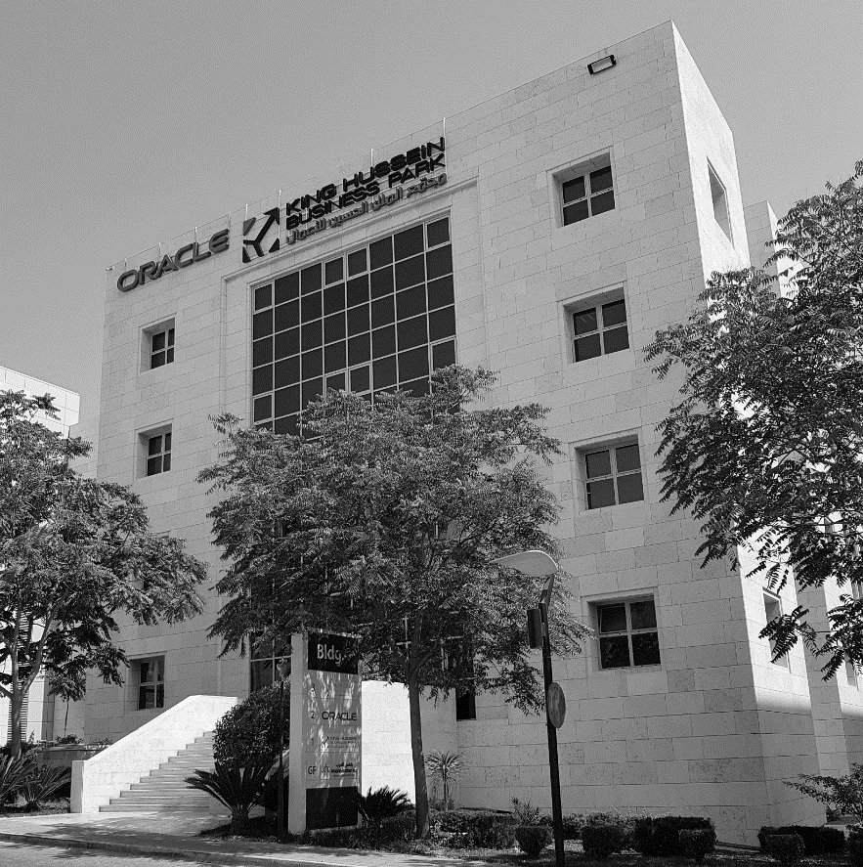
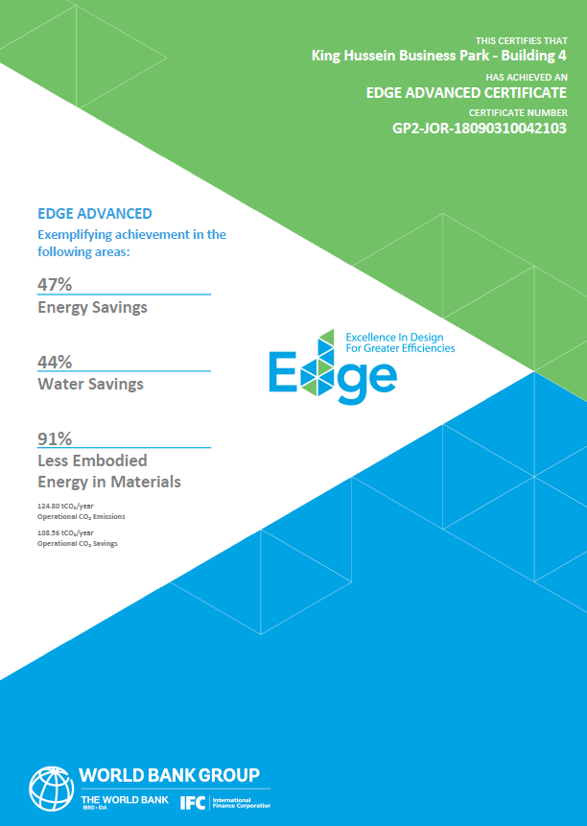
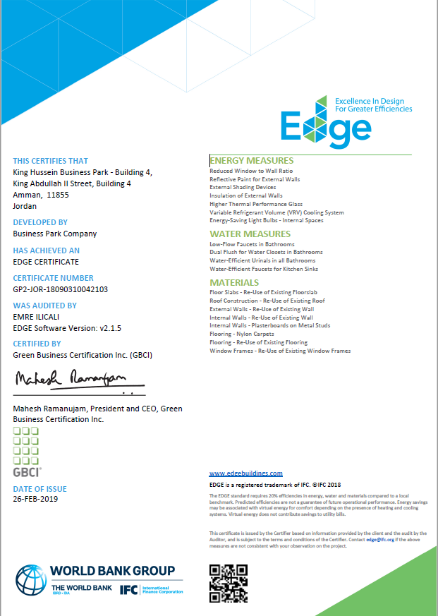
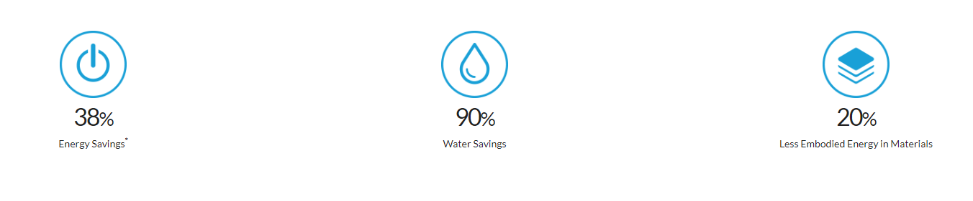
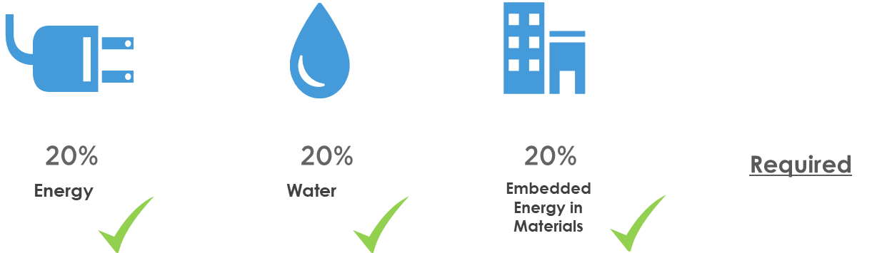
February -2019
The Start!
King Hussein Business Park
Building 4
Achieved
EDGE Advanced Certification
47%
44%
91%

Slide 13
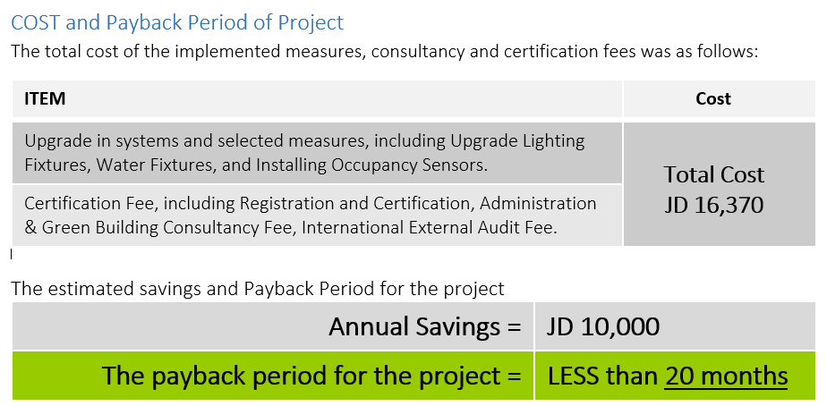
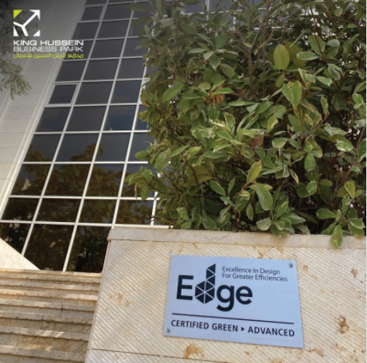
KHBP Building 4 - Positive ECONOMICAL Impact
(3,630m2)

Slide 14




KHBP Building 4 - Positive Environmental Impact
(3,630m2)
Operational CO₂ Savings= 108 tCO₂/Year
Our Green Building’s Reduction of the GHG Emissions equivalence to taking 23 Passenger vehicles driven off-road for one year.
Our Green Building’s Reduction of the GHG Emissions equivalence to the CO2 emissions from energy use for 13 homes for one year.
Our Green Building’s Reduction of the GHG Emissions to Carbon Sequestered by Planting 1,790 seedling for 10 years

Slide 15
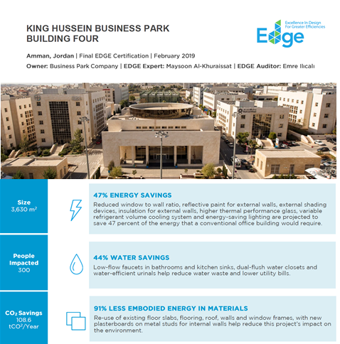




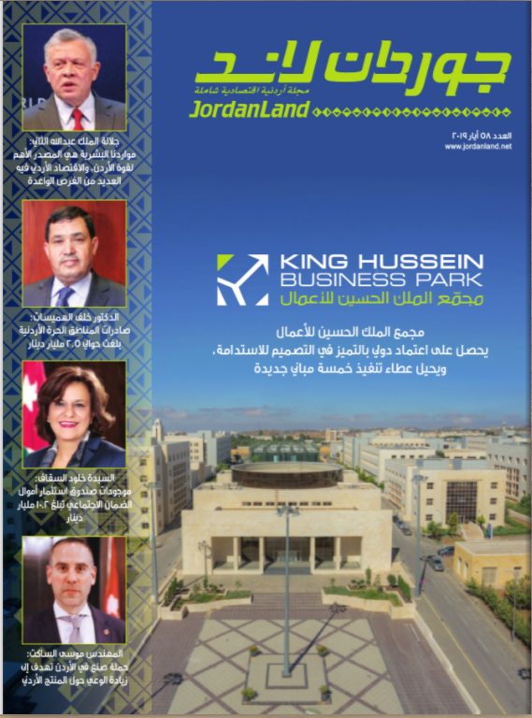
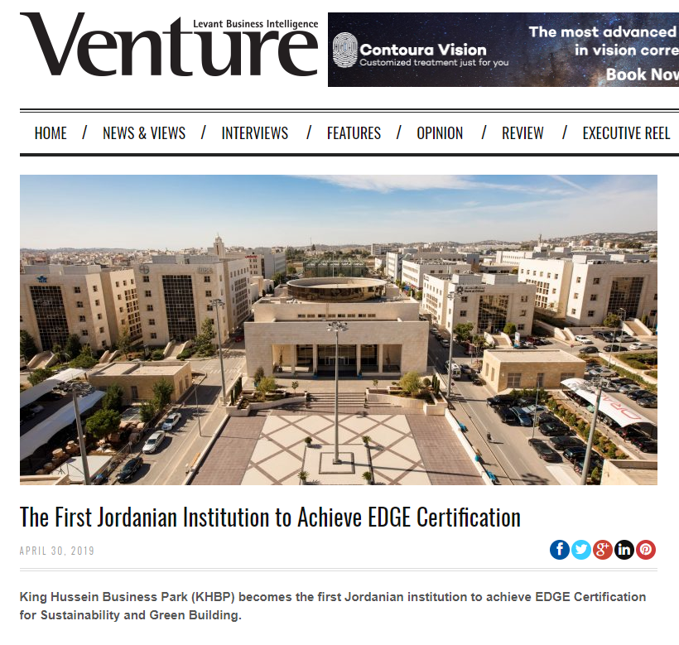
KHBP Green Achievements Featured in Media
Websites, Magazines, Social Media, Newspapers
Featured on IFC EDGE website & Media Channels
Featured in GBCI Project Study
Featured in Regional Media
Featured in Local Media

Slide 16
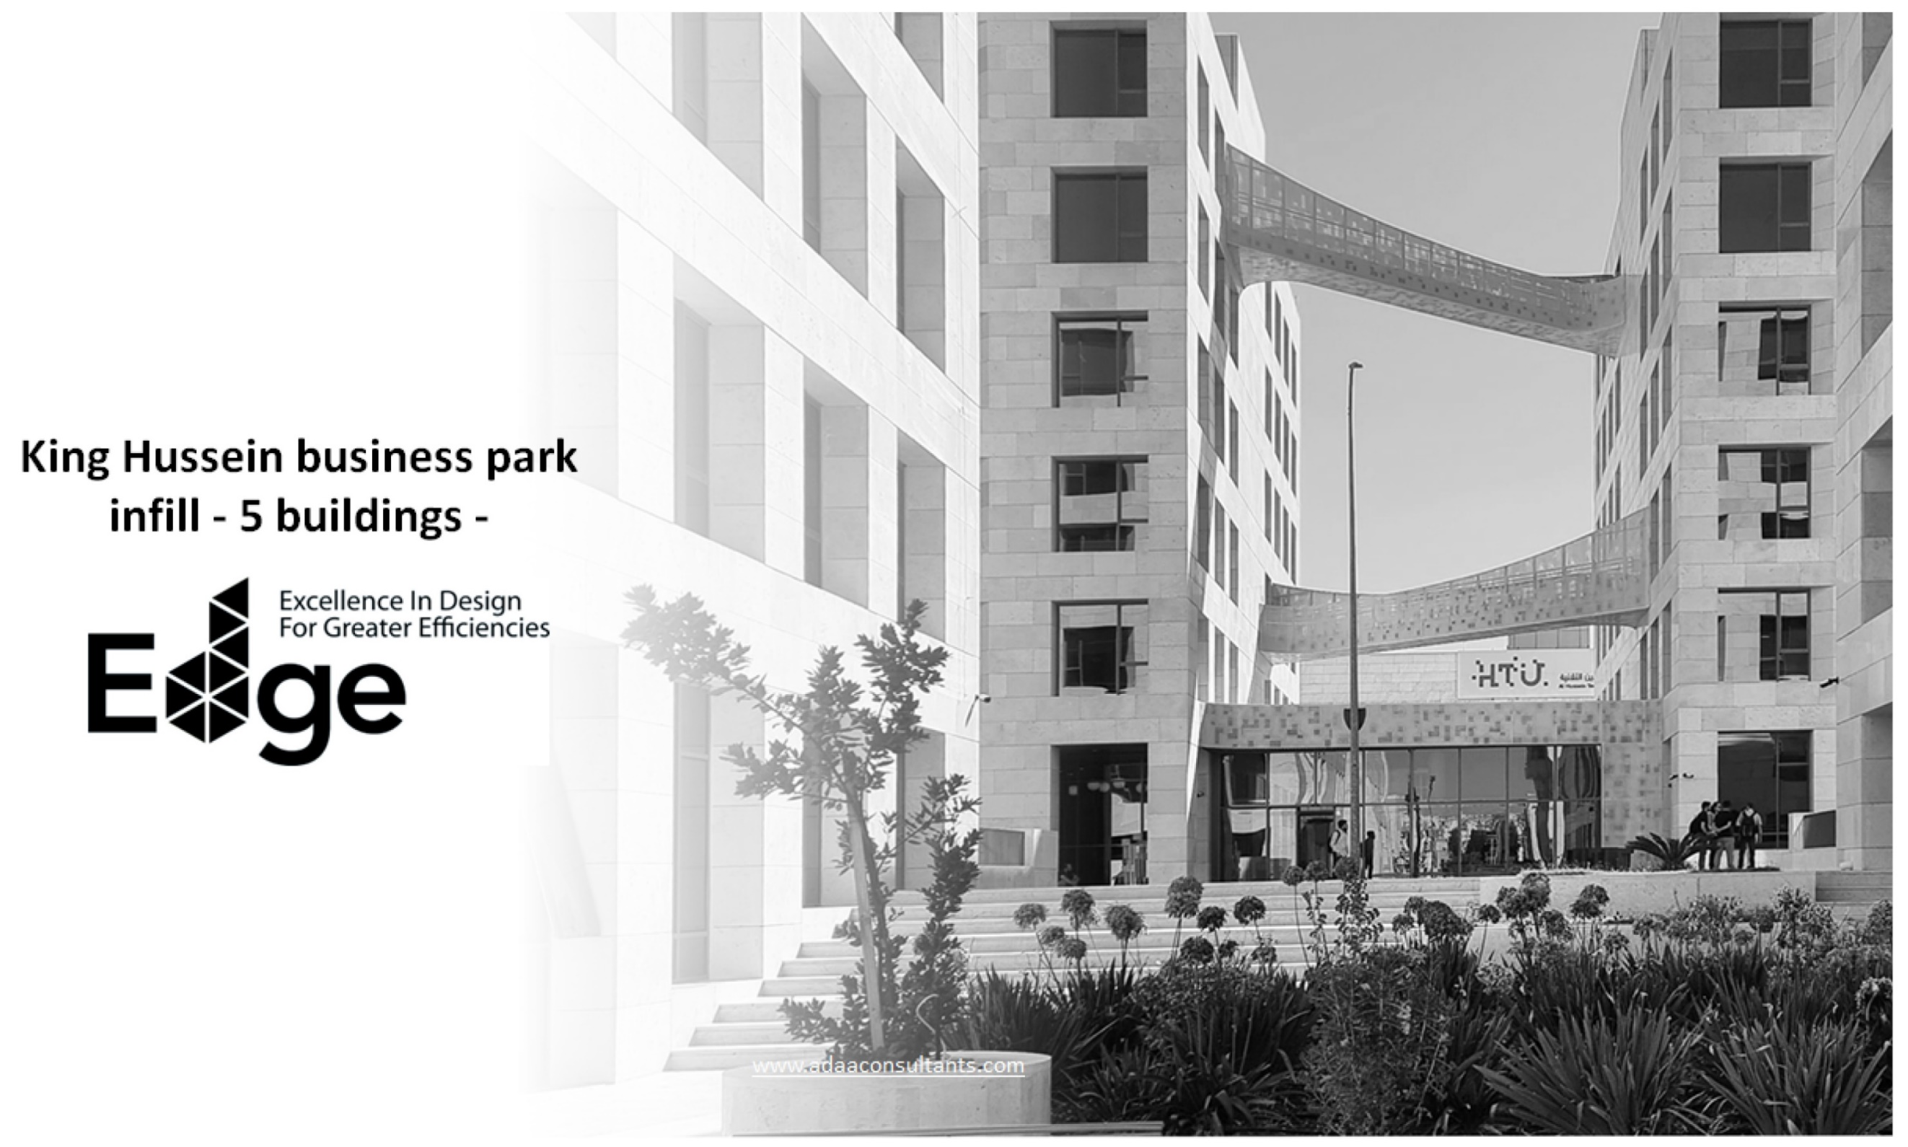
Continue
The work

Slide 17


The KHBP Campus & Infill Buildings
Infill A01-5

Slide 18
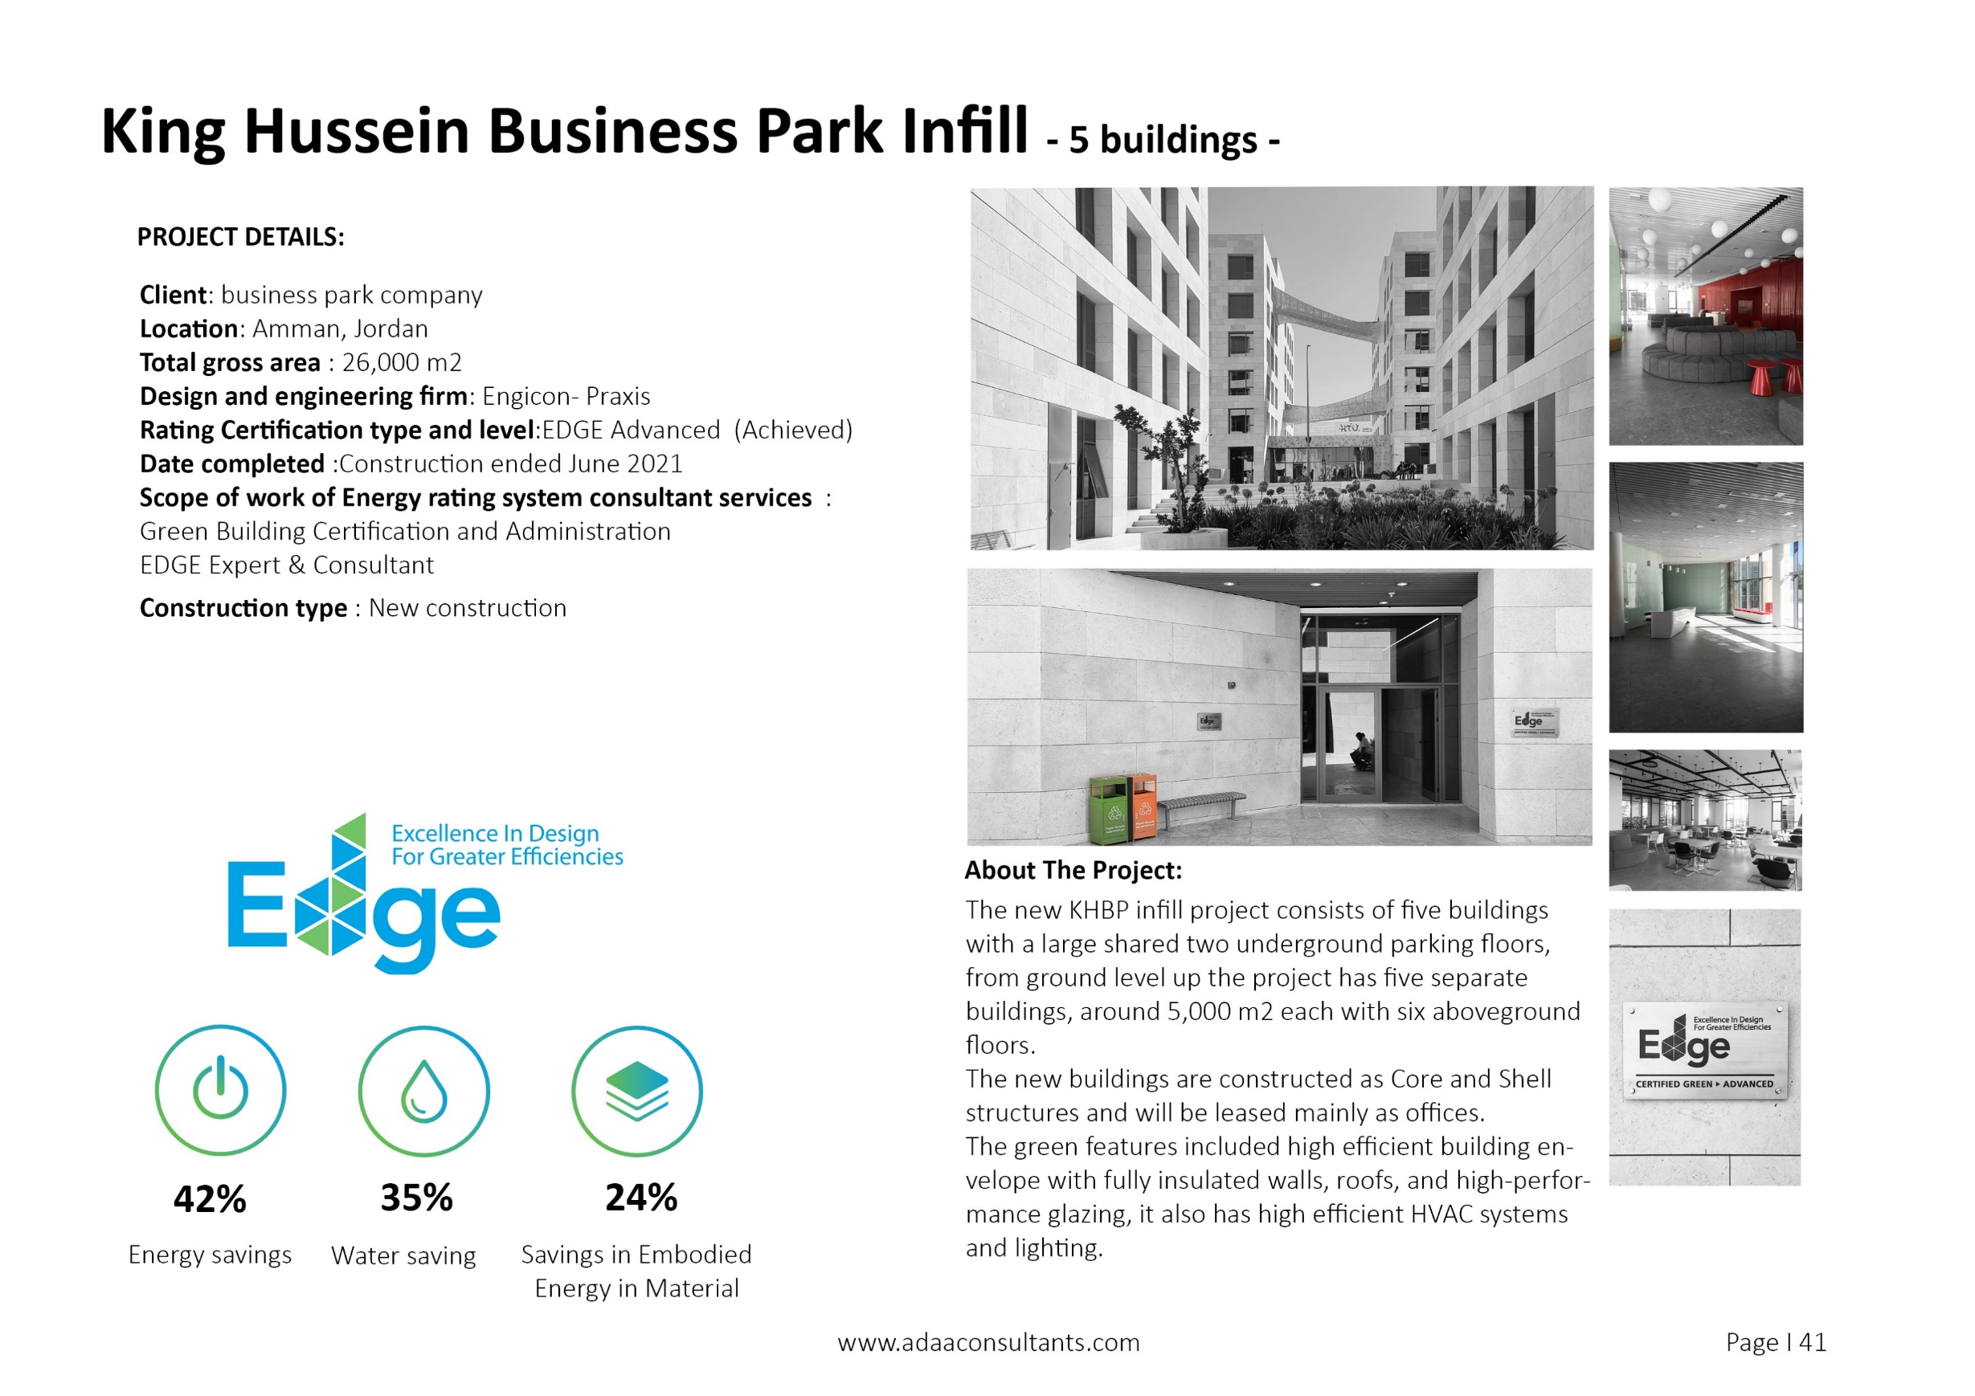

Slide 19

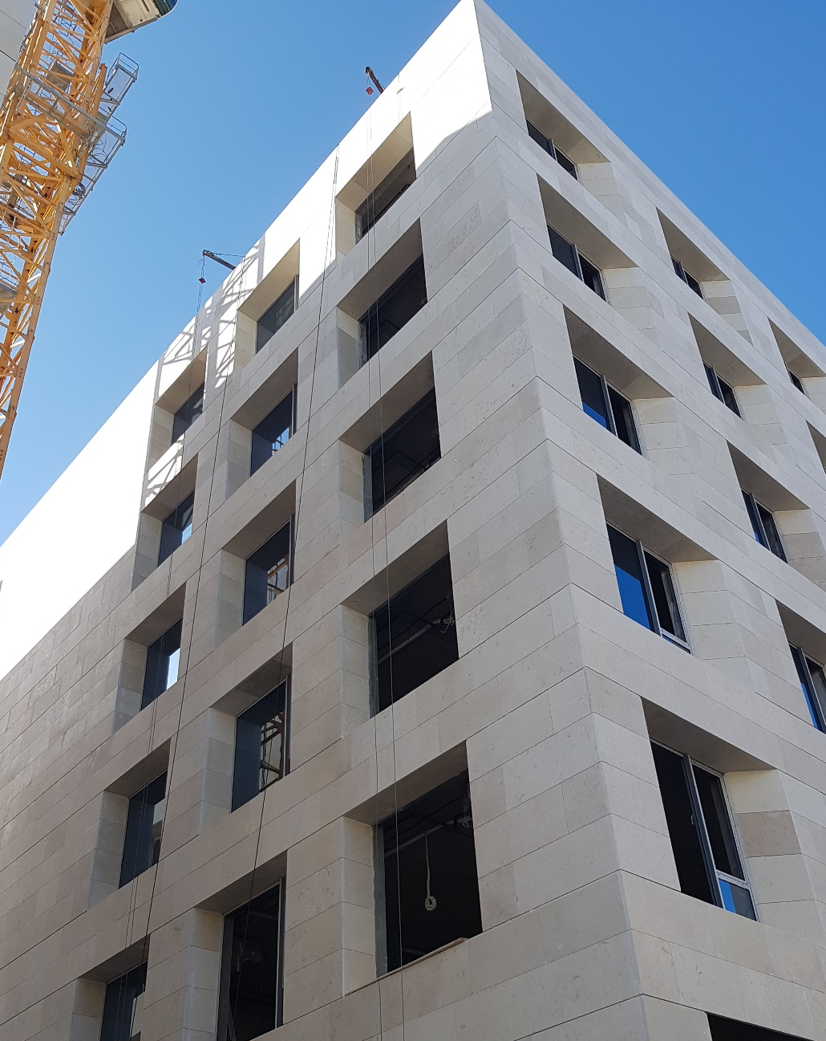
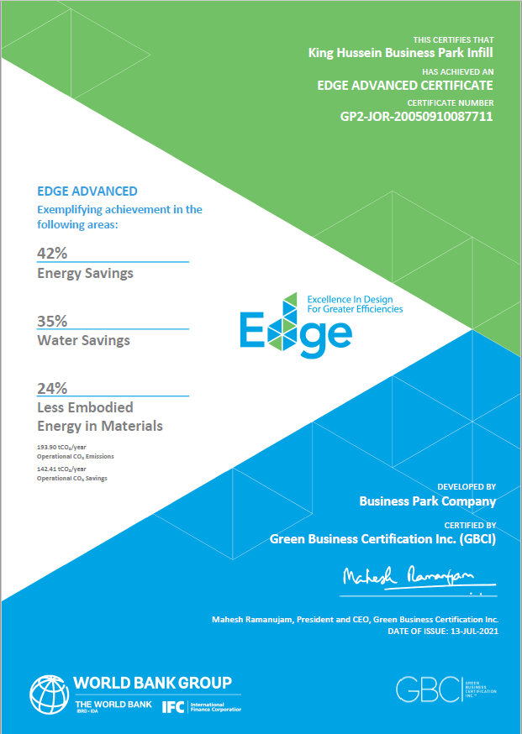
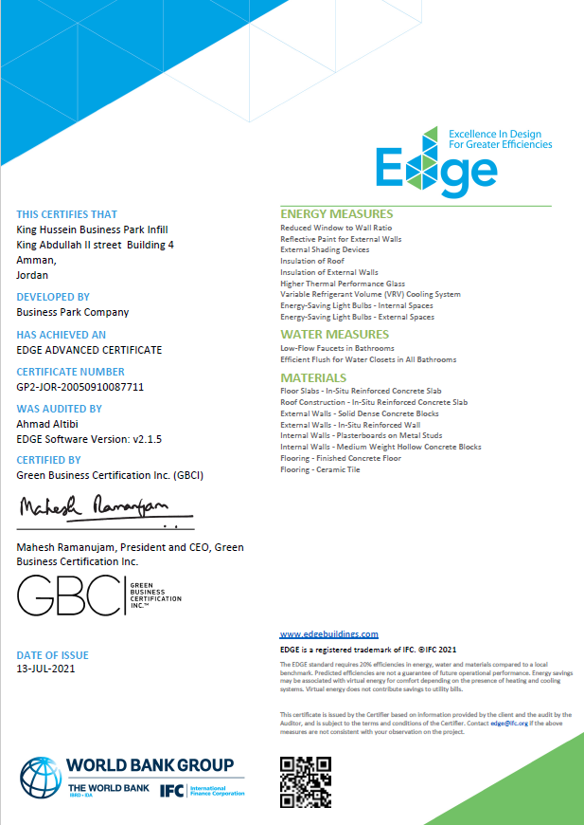
Achieved
EDGE Advanced Certification
42%
35%
24%

Slide 20
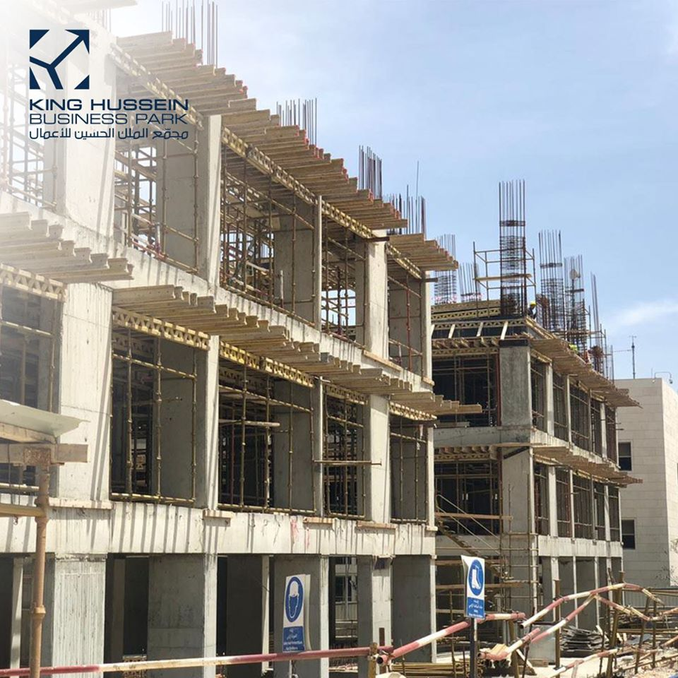
EDGE Version: V2.1.5
Typology
Offices/ Core & Shell
Efficiency Measures
19 Total Efficiency Measure

Slide 21
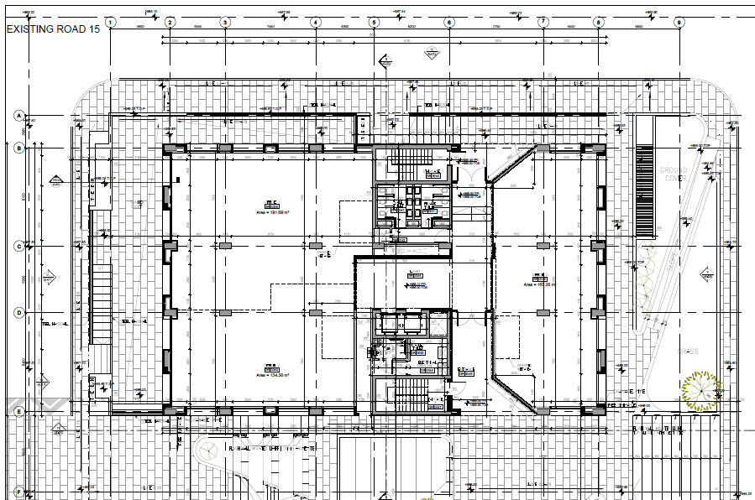
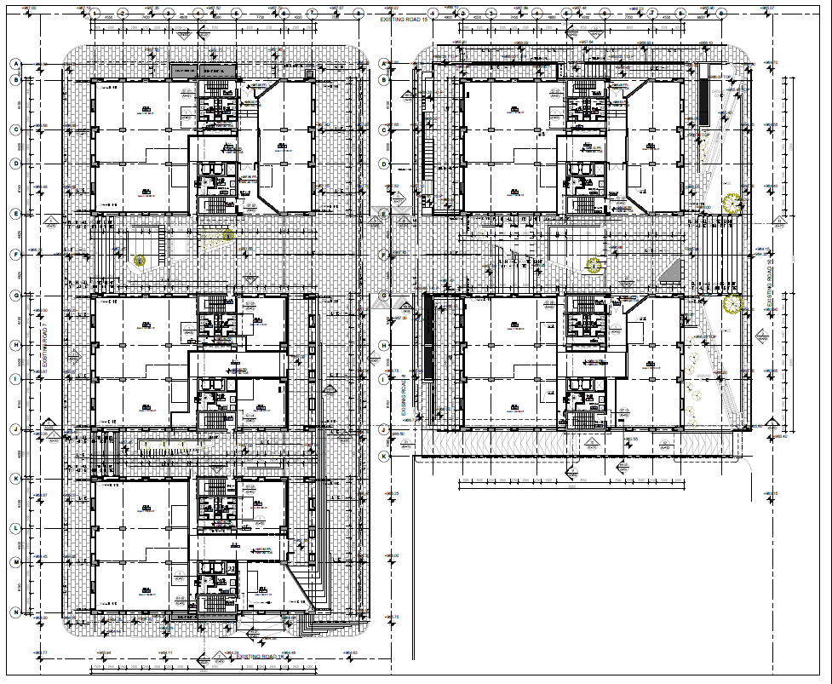
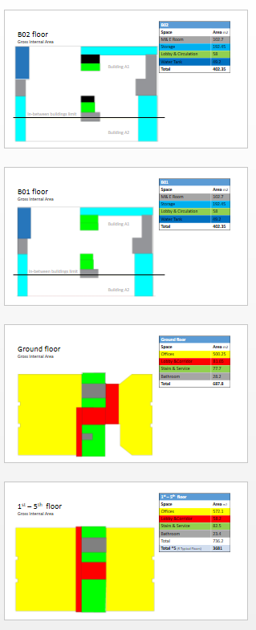
Layout- Project Level - Subproject Level
Building A01
Site Plan

Slide 22
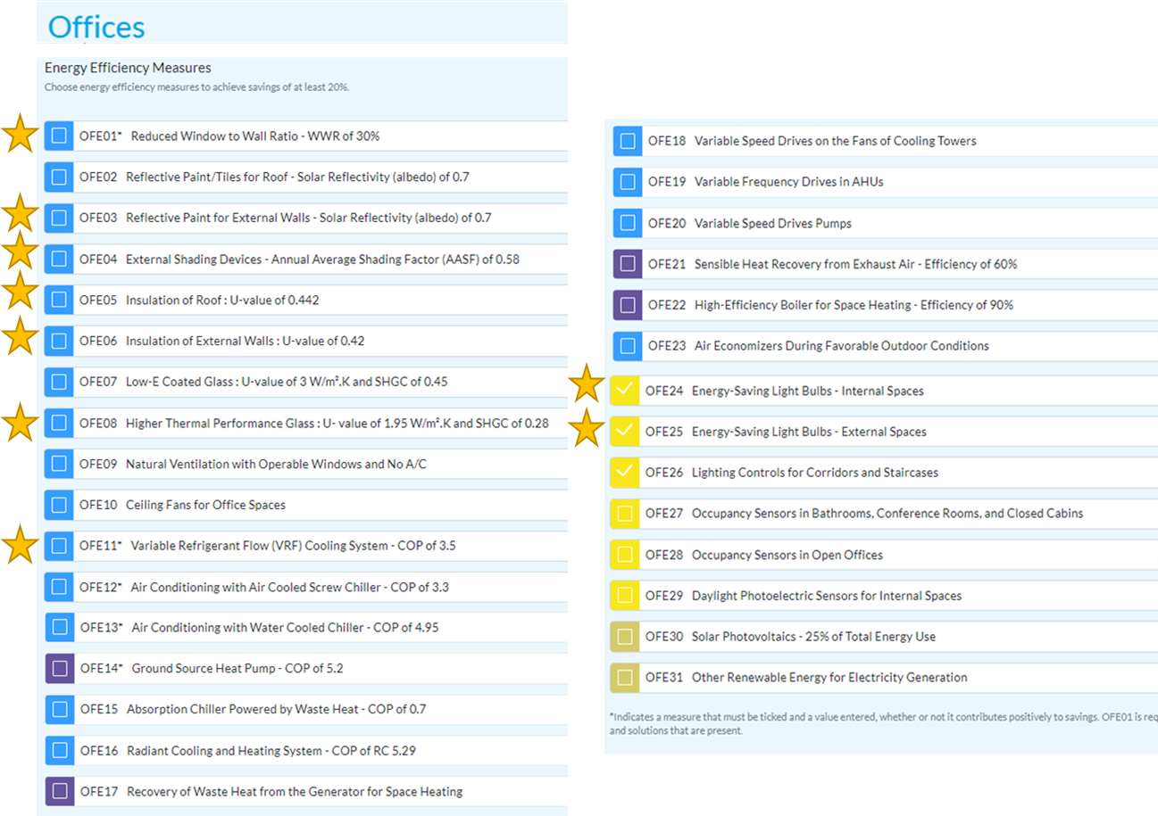
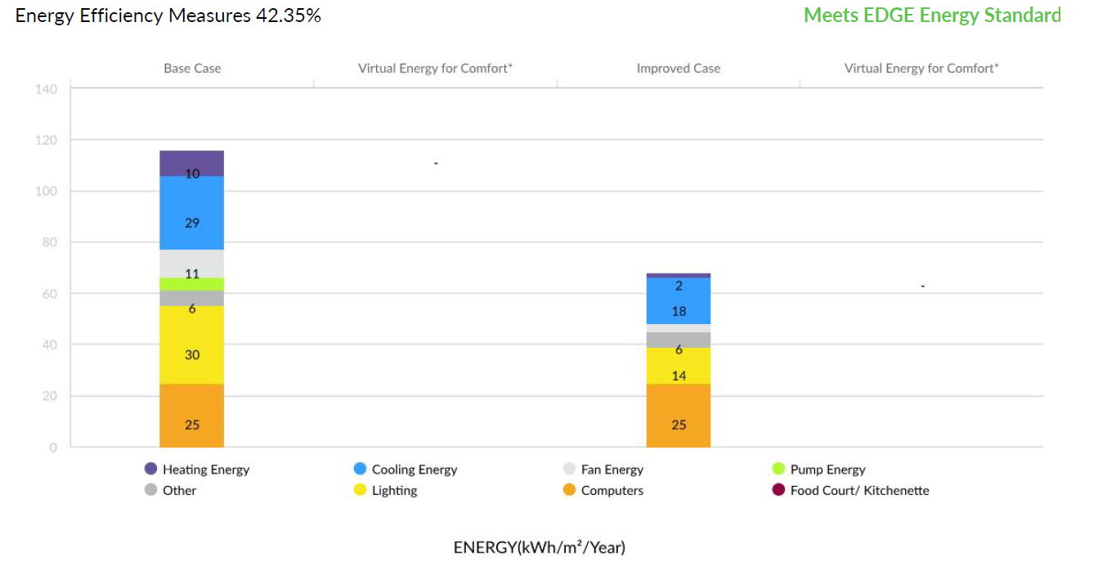
Energy Efficiency Measures
42%

Slide 23
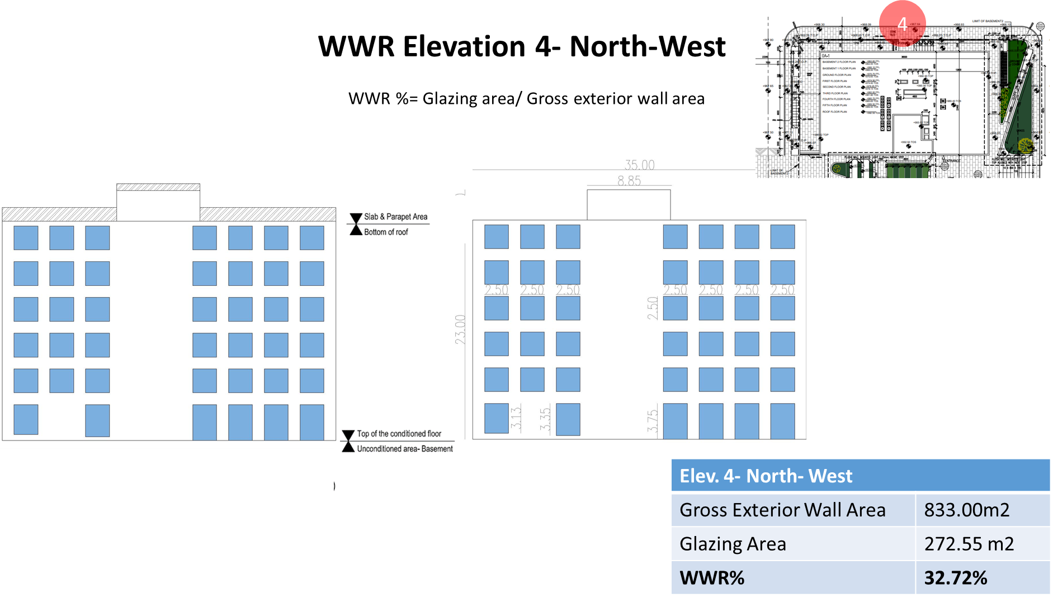
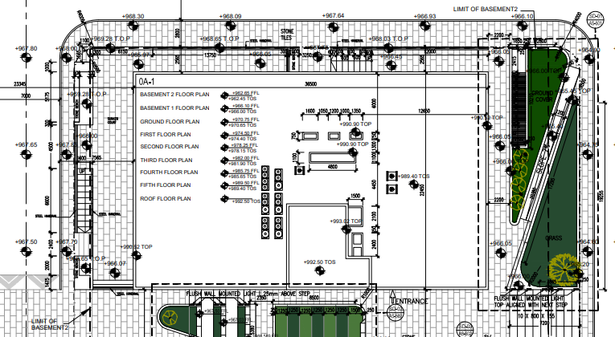
KHBP- Infill
Elevations
Window-to-Wall Ratio
4
1
3
Elevation 1-SW | 39.01%
Elevation 2-SE | 32.64%
Elevation 3-NE | 38.32%
Elevation 4-NW | 32.72%
2

Slide 24
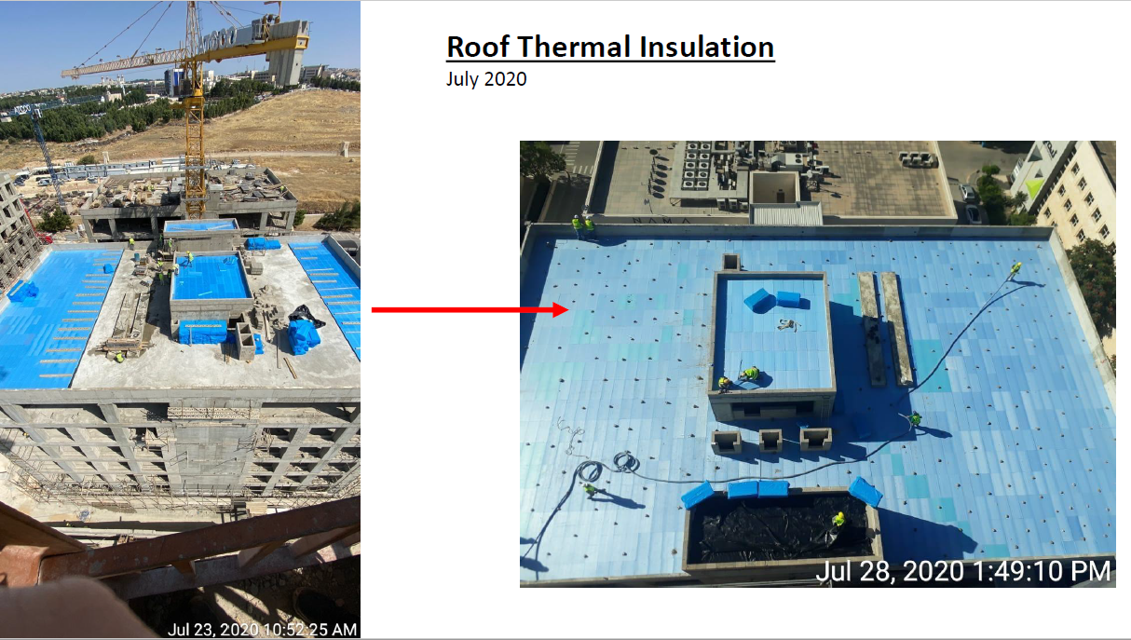
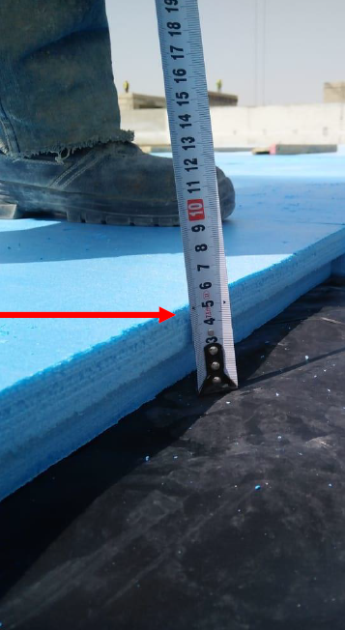

Slide 25
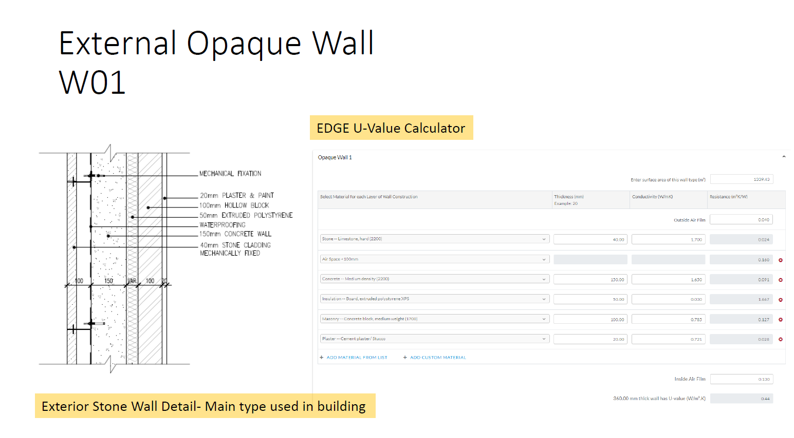
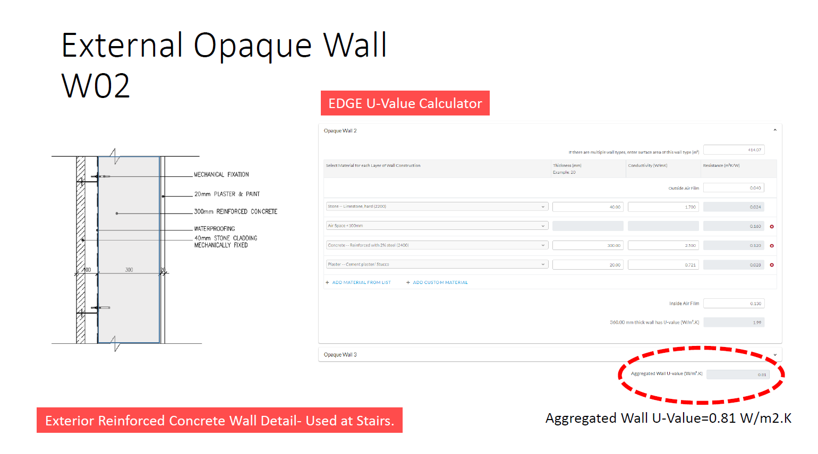
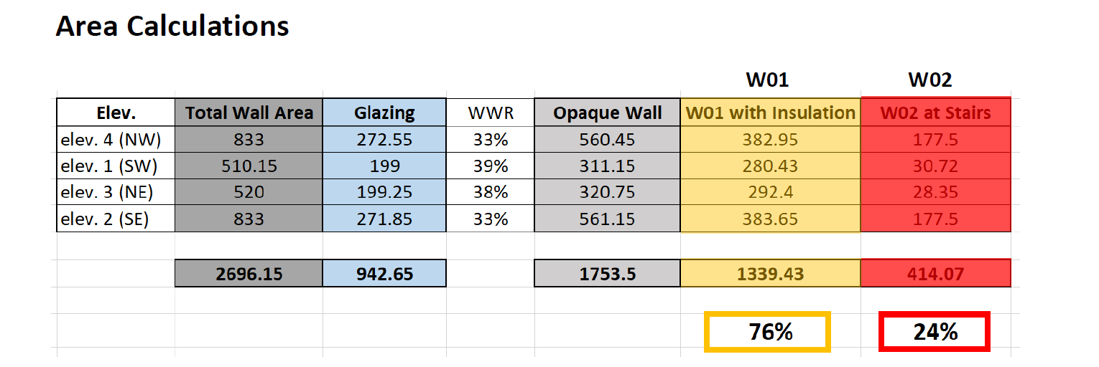

Slide 26
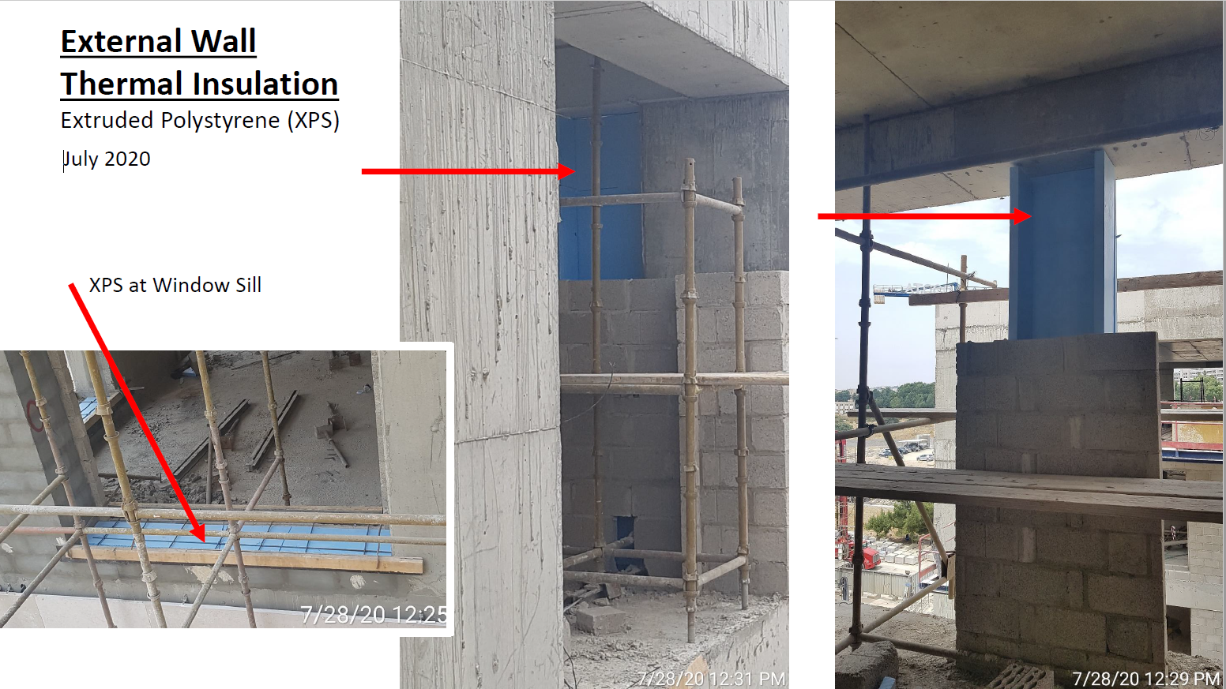

Slide 27
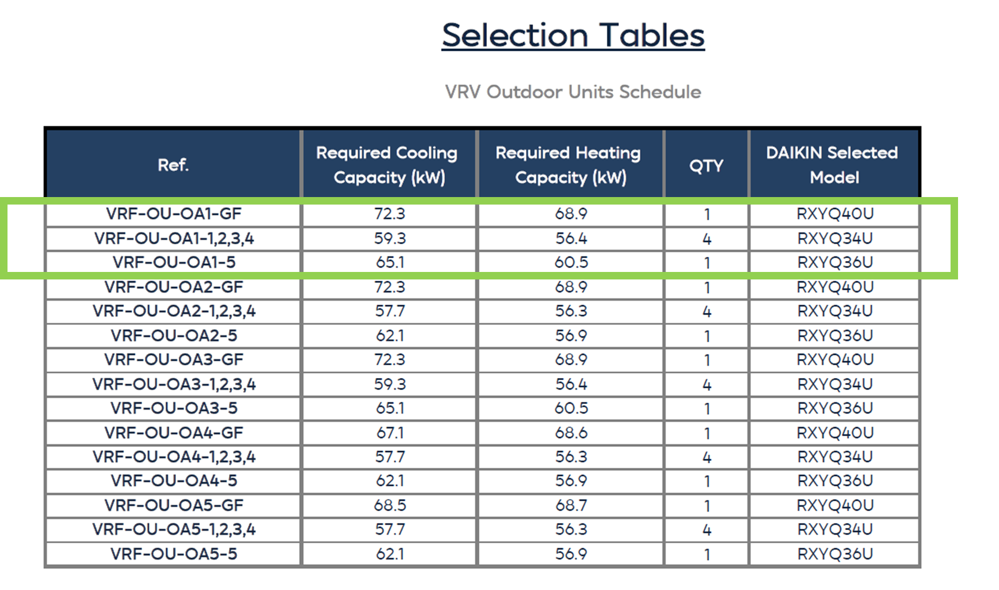
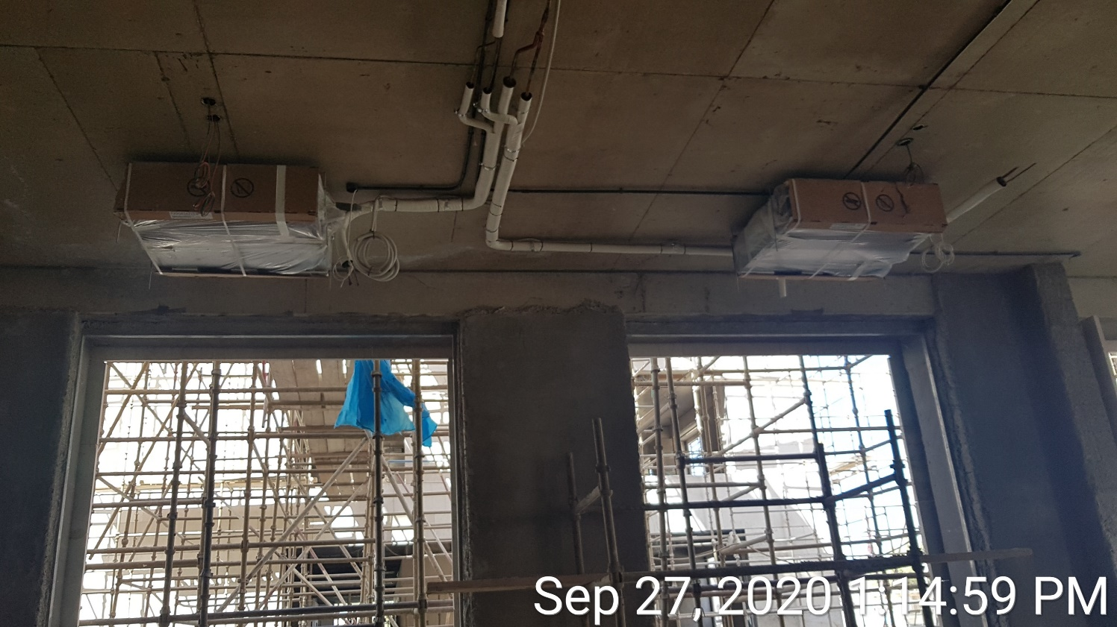
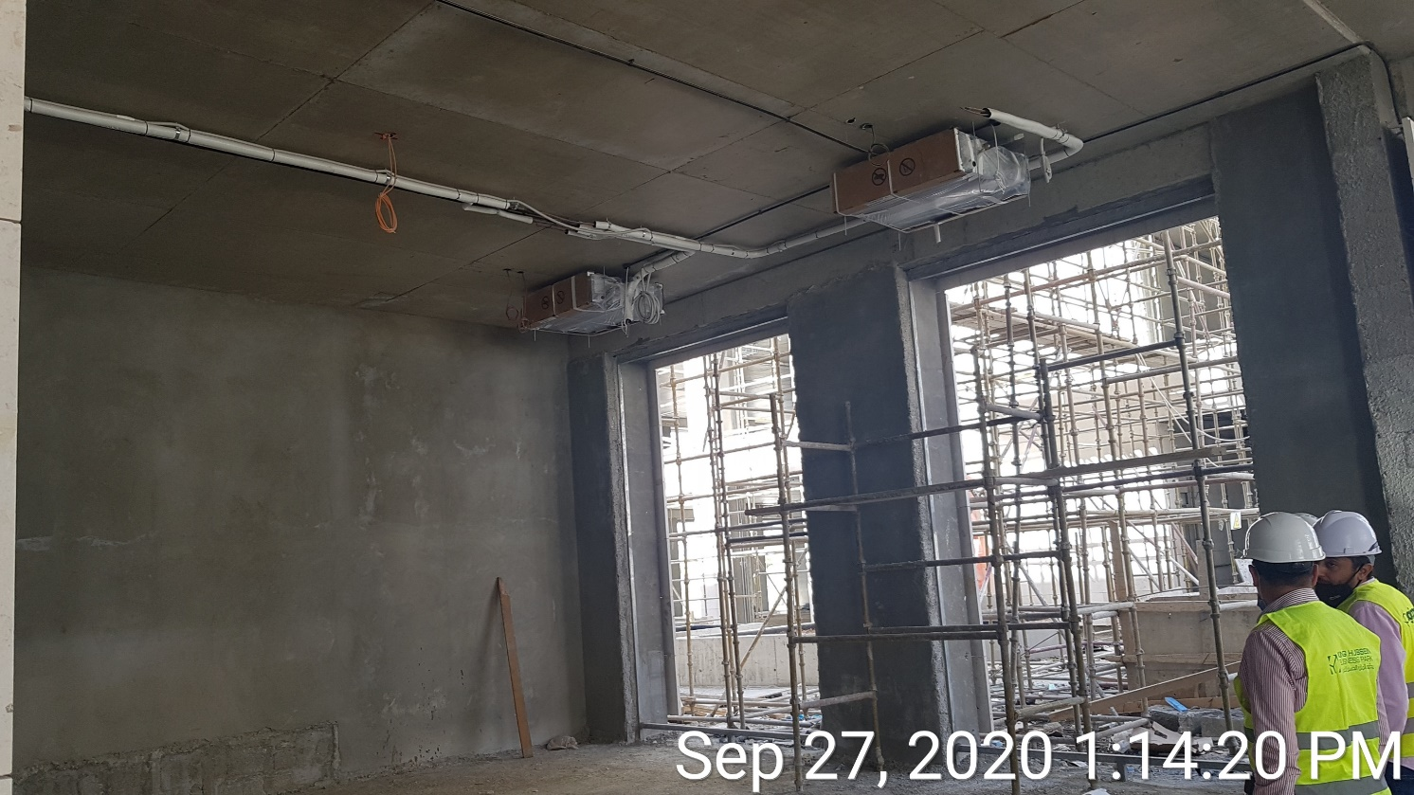
VRF Cooling System

Slide 28
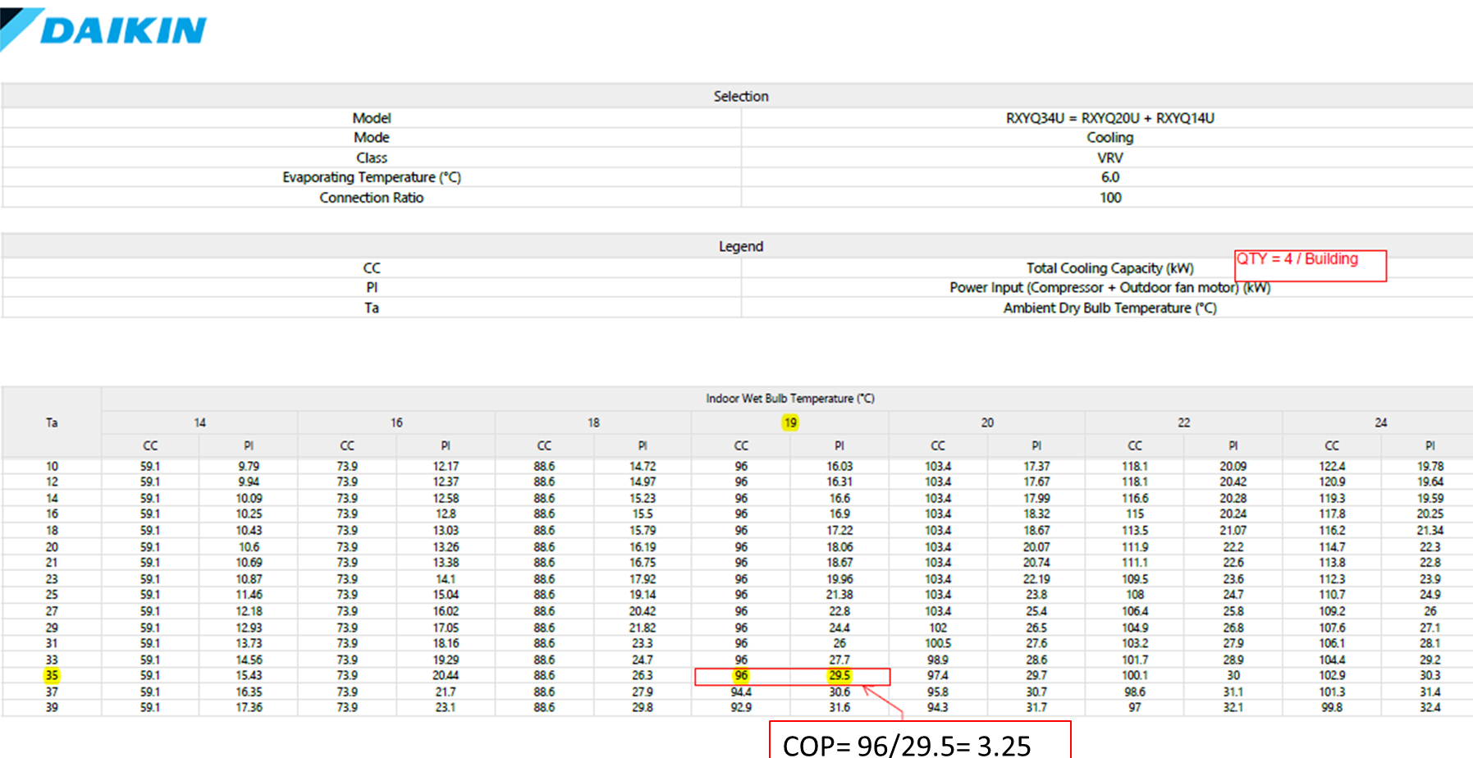

Slide 29
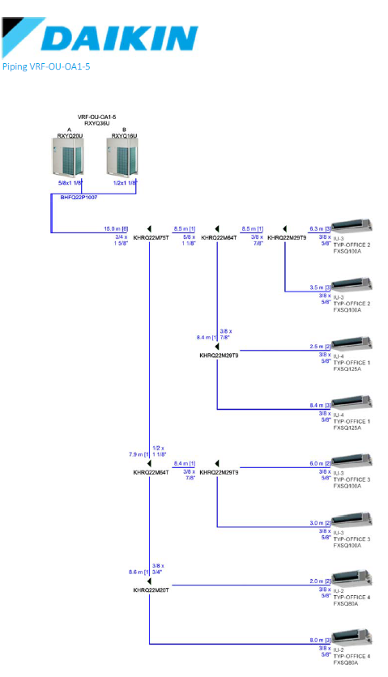
Calculated Weighted COP
COP= Total Cooling Capacity (kW)/ Power Input (kW)

Slide 30
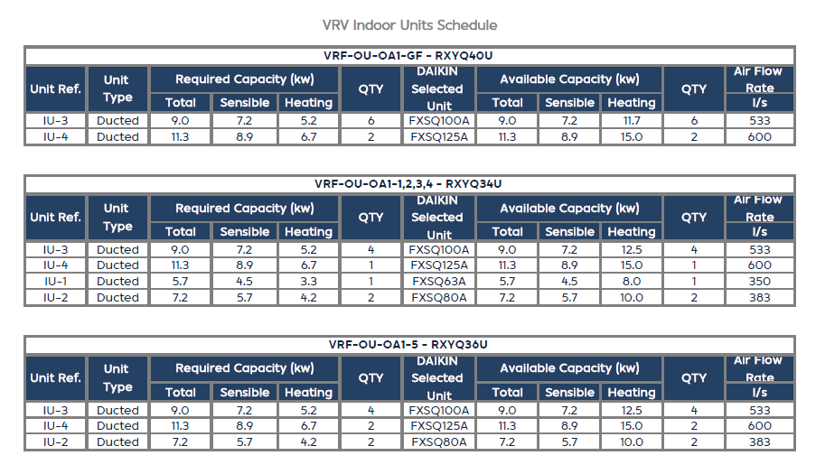
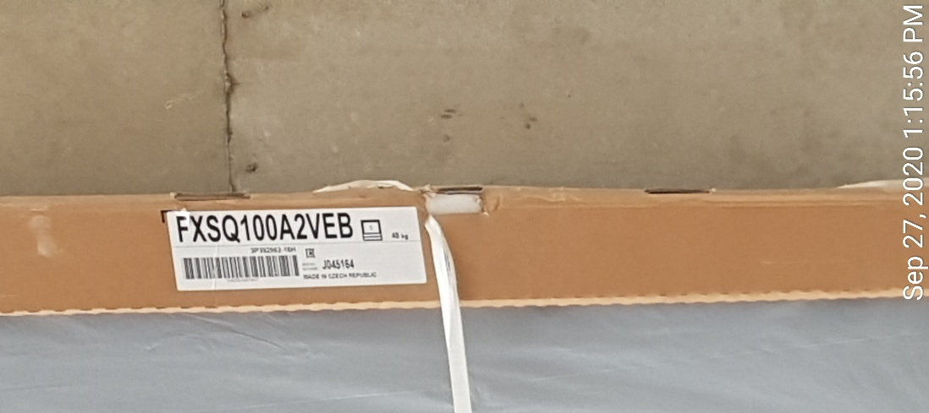
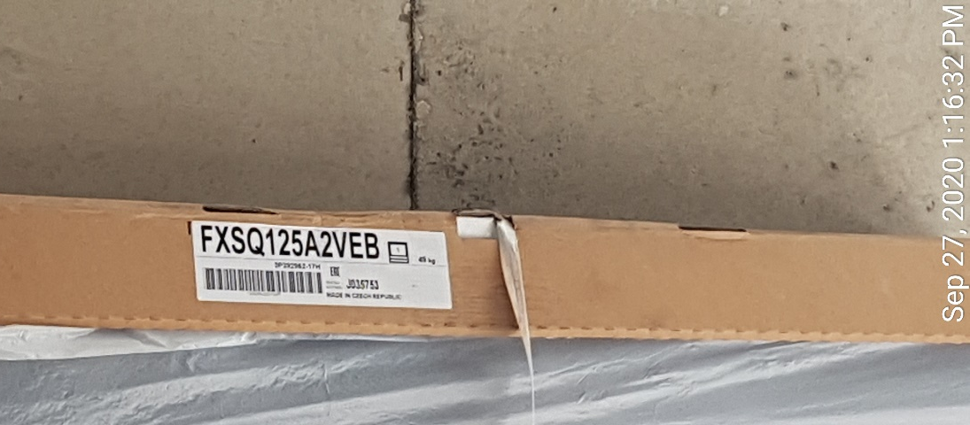
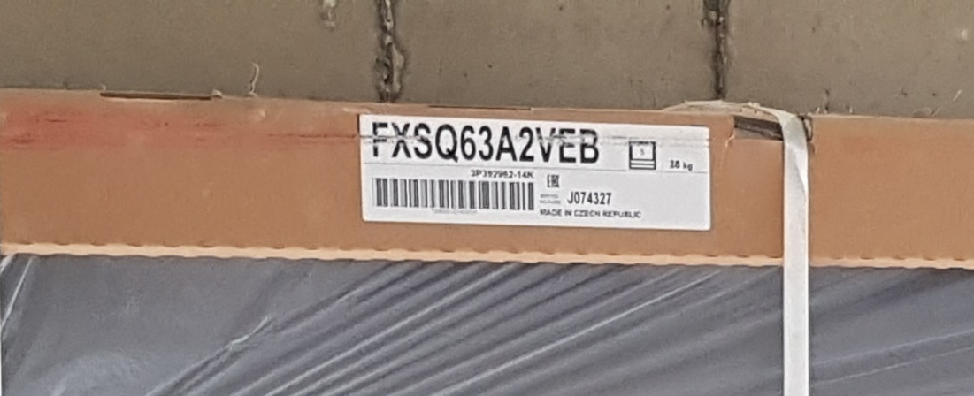
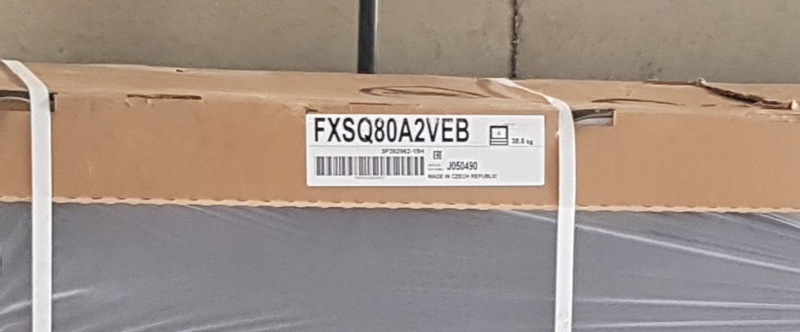

Slide 31





Slide 32


Slide 33


Water Efficiency Measures
35%

Slide 34








Delivery Note
Technical Datasheet
Design Drawings
Installation in Site

Slide 35



Material Efficiency Measures
24%

Slide 36





Slab Design and Construction
Delivery Notes

Slide 37




Achieved EDGE Advanced Certification

Slide 38

فوائد مستقبلية
للحصول على شهادة البناء الأخضر للمشروع
Expected Savings
$6,600 monthly
$79,000 annually
Payback Period in 20.5 month
فوائد تسويقية:
الإسراع في التأجير وطلب أسعار تفضيلية
استهداف الشركات العالمية والمؤسسات الدولية
فوائد تمويلية:
تسهيل الحصول على قروض خضراء بأسعار تفضيلية
تسهيل الحصول على منح دولية
فوائد بيئية محسوبة وموثقة:
يمكن استخدامها لحسابات الأثر البيئي للمشروع وخفض الكربون.
Carbon Reduction
712 tCO2 /year

Slide 39




The New Logo and Identity

Slide 40


Slide 41





Stainability is a Teamwork
Owner
Designer
Contractor
Green Consultant
Green Rating
Creator
Certifier

Slide 42


Tenants Guidelines (Core & Shell)

Slide 43


Tenants Guidelines (Core & Shell)
Efficient lighting fixtures
Efficient water fixtures
Floor finish material
Walls and Partitions
Energy-saving systems
Recycled & Recyclable material
Biophilic Design
Recycling Program
adaa, Sustainable Development Consultants office

Slide 44




Slide 45



Sharing sustainable thinking to sustain

Slide 46






Slide 47
Is it applicable outside the Business Park?

Slide 48



Slide 49


Oak Saraya
سرايا البلوط
The most recent project in Jordan achieved
EDGE Advanced Certification

Slide 50
Let Us Go Back to the Business Park.
https://businesspark-jo.com/photo-gallery/
https://www.google.com/maps/place/King+Hussein+Business+Park/@31.9714291,35.8333901,940m/data=!3m1!1e3!4m6!3m5!1s0x151ca17ed1965e8d:0xd93a3913affa5945!8m2!3d31.9717977!4d35.8338515!16s%2Fg%2F1hc36xpqk

Slide 51
KHBP Campus Growth

Slide 52





Slide 53


Slide 54






Slide 55




Slide 57


Slide 58





Slide 59
What do you think?

