Slide 1
International Community of Practice for Sustainable Urban Development
Green City Pioneers of Change: Joint Event on the Creation of Synergies between Mobility, Urban Space and Energy Solutions
Oliver Lah
olah@mit.edu
living-lab.center

Slide 2
The urban century
With the increase in global urban populations and new cities and towns to accommodate them the 21st century would be the urban century followed by six trends in urbanisation which are especially important in the context of climate change mitigation.
1
The increase of the urban population
is unprecedented and is predicted to have an addition of 2.5 billion people to urban areas by between 2018 and 2050. There is a positive and strong correlation between the urbanisation level and gross national income. High income countries have high levels of urbanisation, on average 80%. Low income countries have low levels of urbanisation, on average 30%.
2
Activities and sectors within a city are inter-connected; Changes in urban form and infrastructure can simultaneously affect multiple sectors, such as buildings, energy, and transport.
Notes:
8.1.3 Why focus on urban systems?

Slide 3
Cities occupy only about 2% of the total land, but generate 70% of the global GDP and 70% of the GHG emissions

Slide 4
The urbanization in developing countries
Urbanisation in the 21st century will be dominated by developing countries, and as such it is important to highlight aspects of it that are unique and especially relevant for climate change mitigation.
Three common elements of urbanization in developing countries:
2
Second, a number of cities in developing countries lack institutional, financial and technical capacities to enable local climate change action (Sharifi et al. 2017; Fuhr et al. 2018).
1
First, urbanisation will increase in speed and magnitude. Given their significant impact on emissions, mitigation action in Asian cities will have significant implications on global ambitions.
3
Third, there are sizeable economic benefits in developing country cities that can provide an opportunity to enhance political momentum and institutions (Colenbrander et al. 2016).
Notes:
8.1.3 Why focus on urban systems?
Urban system approach includes two concepts:
First:

Slide 6
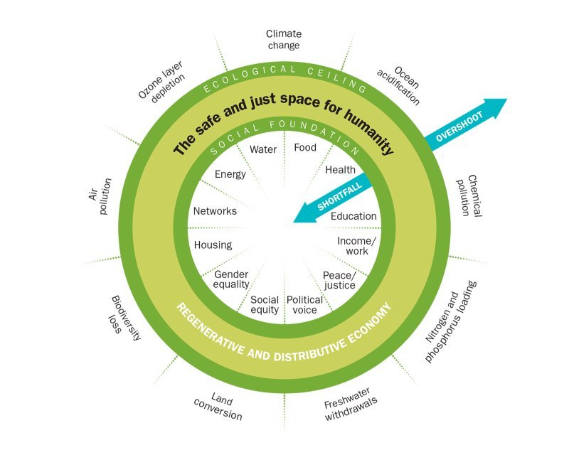

Slide 7
Synergies and co-benefits of urban mitigation
Co-benefits are “the positive effects that a policy or measure aimed at one objective might have on other objectives, thereby increasing the total benefits to the society or environment” (IPCC 2018b, p. 546).
_ A range of co-benefits are associated with urban climate change mitigation strategies including public savings, air quality and associated health benefits, and productivity increases in urban centres (Seto et al. 2014).
_ In developing countries, a co-benefits approach that frames climate objectives alongside other development benefits is increasingly seen as an important concept justifying and driving climate change action in developing countries (Sethi and Puppim de Oliveira 2018).
_ Communication of co-benefits could make a strong case for driving strong mitigation action where traditional methods have not succeeded (Bain et al. 2016) and it is possible to build win-win solutions through a combination of policies (Viguié and Hallegatte 2012).
Notes:
8.1.3 Why focus on urban systems?
Urban system approach includes two concepts:
First:

Slide 8
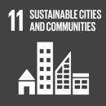
Sustainable development
One of the major co-benefit of climate mitigation is sustainable development which can assist countries to reach the goal of climate change (SDG 13) and another urban goal (SDG 11) – “to make cities and human settlements inclusive, safe, resilient and sustainable” (United Nations 2015, p. 14).
There is increasing evidence that climate mitigation measures can lower health risks that are related to energy poverty, especially among vulnerable groups, such as the elderly and in informal settlements (Monforti-Ferrario et al. 2018).
Results from cities in India, Indonesia, Vietnam, Kathmandu, and Thailand show that reducing emissions from major sources (e.g., transport, residential burning, etc.) could bring substantial co-benefits of avoided deaths from reduced PM2.5 (fine inhalable particulates) emissions and radiative forcing from black carbon (Pathak and Shukla 2016; Dhar et al. 2017; Permadiet al. 2017; Karlsson et al. 2020), reduced noise, and reduced traffic injuries (Kwan and Hashim 2016).
Notes:
8.2.1 Sustainable development

Slide 9
Economic development, competitiveness, and equity
Climate mitigation measures related to different sectors can also provide co-benefits and reduce social inequities. For Instance:
Safe public and non-motorised transport facilities contribute to fostering accessibility and equity among different social groups, which can improve access of low income populations to jobs and gender responsive transport systems that can enhance women’s mobility and financial independence (Viguié and Hallegatte 2012; Lecompte and Juan Pablo 2017; Reckien et al. 2017; Priya Uteng and Turner 2019).
In addition to cost savings, various measures such as stormwater management and urban greening can enhance social equity and environmental justice.
Low-carbon urban development that triggers economic decoupling can have a positive impact on employment and local competitiveness (Dodman 2009; Kalmykova et al. 2015; Chen et al. 2018b; García-Gusano et al. 2018; Hu et al. 2018; Shen et al. 2018).
Notes:
8.2.2 Economic development, competitiveness, and equity

Slide 10
Coupling mitigation and adaptation
Simultaneous integration of adaptation and mitigation into climate action plans is essential for taking account of their interactions.
Behavioral issues
Measures related to different sectors can provide both mitigation and adaptation benefits. Such as measures related to transportation, building, waste, and energy are primarily aimed at urban climate change mitigation. However, they can also offer adaptation benefits and enhance urban resilience.
There are also some categories that their primary focus is adaptation but can also offer mitigation co-benefits. For instance, stormwater management and thermal comfort provision, urban green infrastructure measures provide mitigation co-benefits through carbon sequestration and reduction of cooling energy demand.
Building
Adaptation
Energy
Green
Infrastructure
Mitigation
Transportation
Mitigation
Urban governance
Urban Planning
Waste
Water
Fig: Urban sectors and their links to mitigation and adaptation benefits.
Sharifi (2021, p. 9).
Notes:
8.1.3 Why focus on urban systems?
Urban system approach includes two concepts:
First:

Slide 11
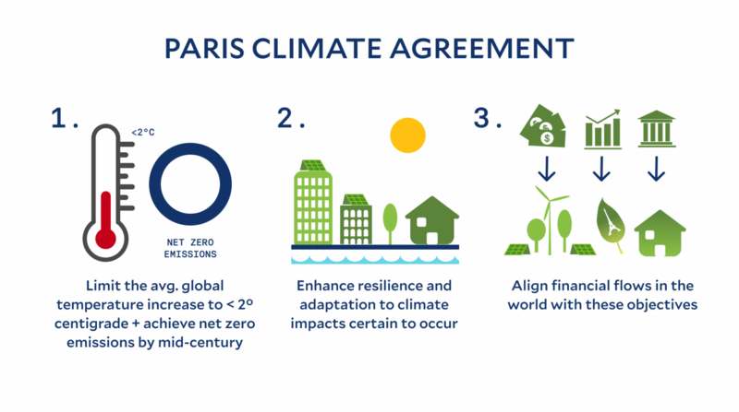

Slide 12
Identify key actors and stakeholders and their objectives
Veto players need to be identified early on the policy process as they are political actors who have a distinctive institutional role in the policy process and have the legal power to put a hold to an initiative.
Typical veto players are finance ministries and parliaments with legislative prerogatives. (Tsebelis 2002)
Stakeholders, have a vested interested in a particular policy process, but do not have the (legal) power stop it.
For broader political consensus both groups need to be involved in the process to successfully implement a measure.
Public participation can help ensuring durability and support beyond political parties.

Slide 13
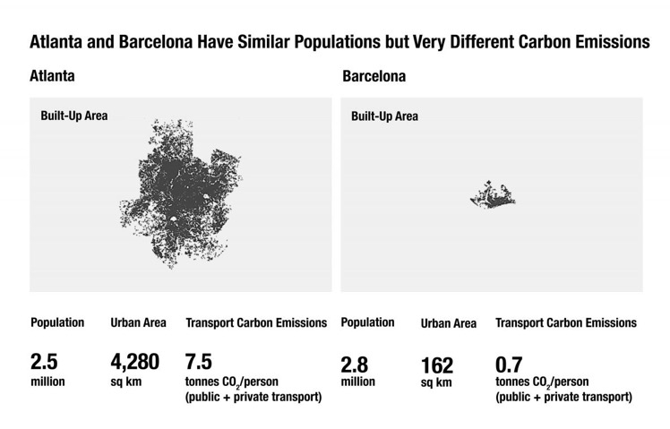
Composition of urban CO2 emissions

Slide 14
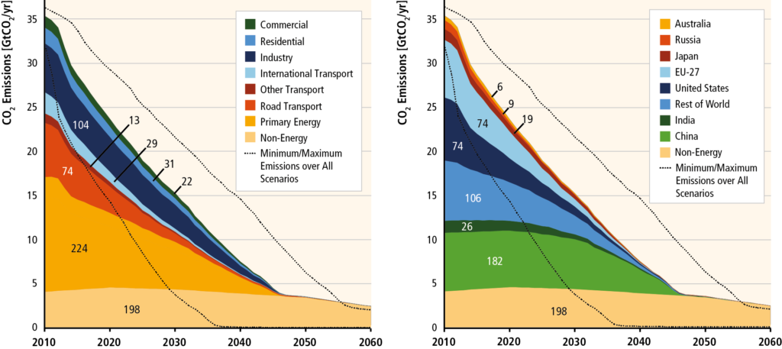
Decarbonisation by sector and country

Slide 15
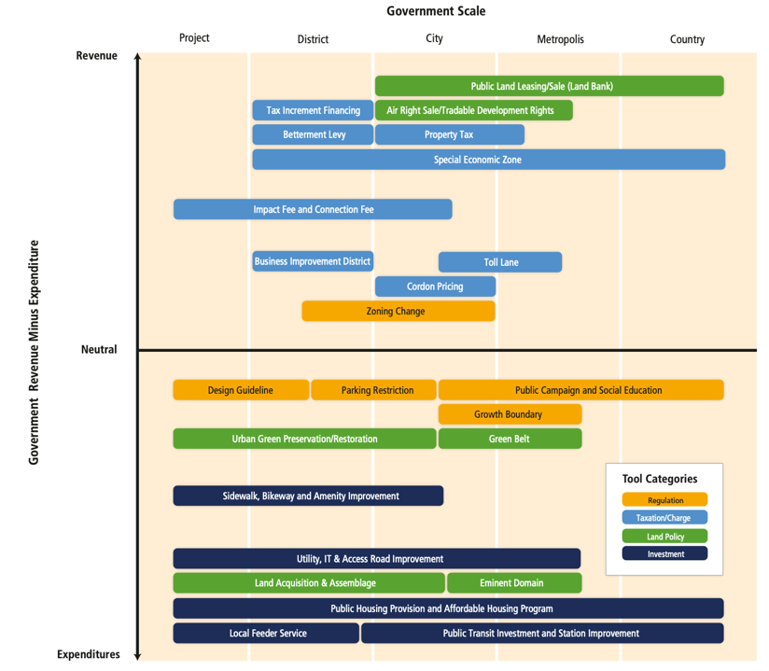

Slide 17
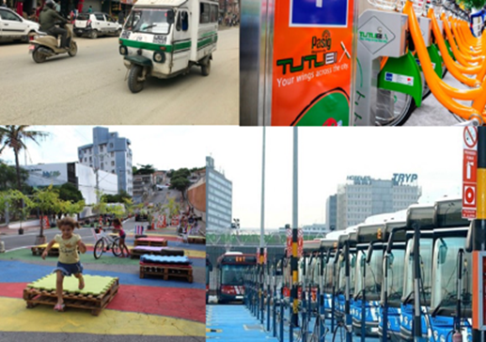
Transformative Living Labs
Showcase interventions for sustainable and inclusive development, building on the New Urban Agenda and the Paris Agreement.
Linking key sectors and actors is a vital step towards an integrated approach that helps decarbonizing urban systems and delivers liveable and accessible cities for all.
Testing innovative solutions in urban living labs can be a key steppingstone, transferring these learnings into scaled-up public or private sector actions is then a vital next step towards transformative change.

Slide 18
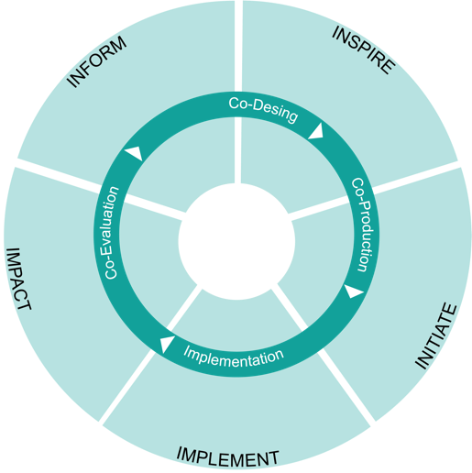
Co-development
Living Lab Approach: the 5-Is of co-development
Co-development of solutions with Urban Change Makers along five pillars:
Inform: Boost capabilities, provide tools to plan, assess and implement
Inspire: Foster the take-up through inspiring peer-to-peer exchange
Initiate: Strengthen collaboration by initiating partnerships
Implement: Create reference models by implementing demonstration actions
Impact: Scale-up, replicate and transfer

Slide 19
Prof. Dr. Oliver Lah
Wuppertal Institute for Climate, Environment and Energy I www.wupperinst.org
Technische Universität Berlin I www.urban-pathways.org
Urban Living Lab Center I www.living-lab.center
Neue Promenade 6, 10178 Berlin I +49 (0)30 2887458-16

