Slide 1
Green City Pioneers of Change:
1st Public Event on the Creation of Synergies beyond the Climate neutral Urban Development Cluster
19. JANUARY 2022

Slide 2
The Climate neutral Urban Development Cluster is part of the COVID Programme:

Slide 3
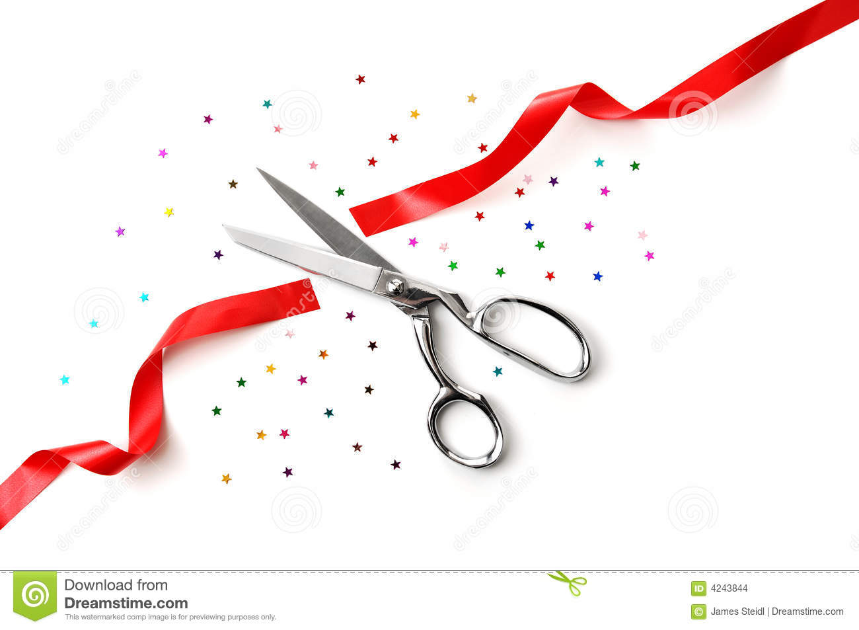
Opening video

Slide 4
Technical aspects
Very short „Hello“ from Frank
Welcome of the technical team: Translators, Jasmin, facilitators
Leading over to Jasmin on how translation is working and how screen can be enlarged, mute rules
Frank hands over to Ricarda, introduces her

Slide 5
Welcome to the Workshop
Ricarda Meissner
Ricarda.Meissner@giz.de
Head of project “Connective Cities” GIZ GmbH
Get connected on www.connective-cities.net Follow Connective Cities on Facebook, Youtube & Linked-in!

Slide 6
Short introduction into the Program and the Cluster “Climate neutral Urban Development”
Frank Waeltring
Mesopartner PartG
www.mesopartner.com

Slide 7
Main objective today
Sharing inspirational practices
Reflecting jointly on key questions
Strengthening ourselves as pioneers of change to promote concrete initiatives
Initiating a Green City Pioneer of Change Exchange beyond the Cluster and Connective Cities Platform

Slide 8
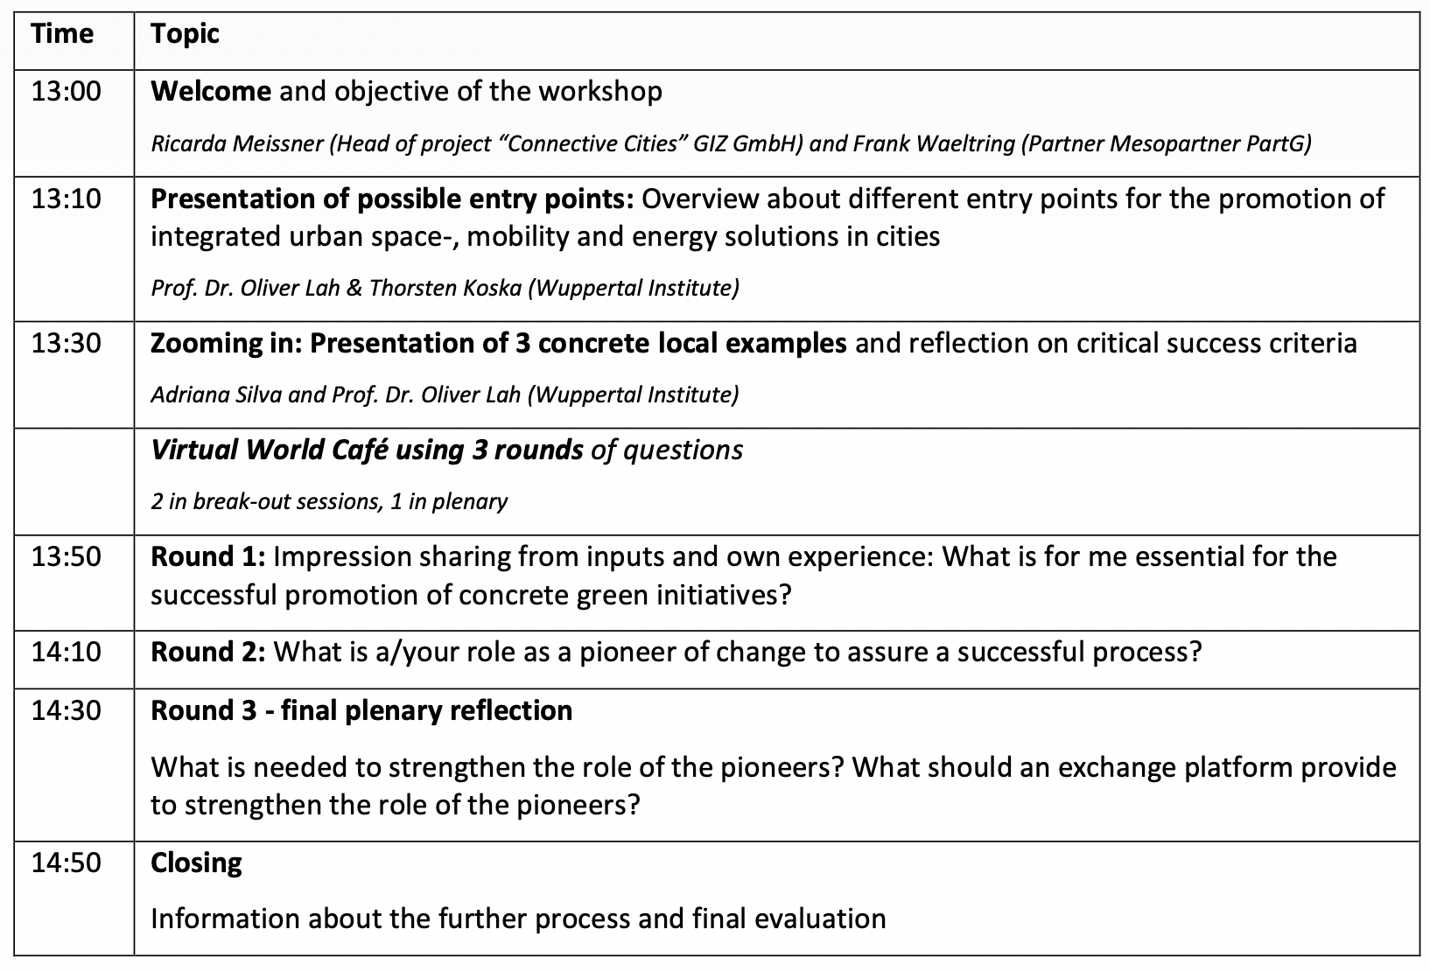
Agenda

Slide 9
Working groups and question on who needs translation in working groups
The idea of the working groups:
getting into an exchange in small groups
English does not need to be perfect, encouragement
Still the question: Who needs translation, does not speak a bit of english? Reason: 2 groups with translation
Jasmin will ask participants with question
Leading over to the cluwter team

Slide 10
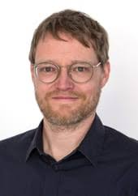
The facilitation team of the Cluster „Climate neutral Urban Development“
Frank Wältring (Partner of Mesopartner PartG)
Prof. Dr. Oliver Lah (Wuppertal Institute, Urban Electric Mobility Initiative (UEMI)
Thorsten Koska (Wuppertal Institute)
Adriana Marchiori Silva (Wuppertal Institute, UEMI)
Abhijeet Chandel (freelance consultant and Architect)
Martina Argerich (freelance consultant)
Cities involved:
Buenos Aires, Kigali, Belo Horizonte, Kisumu, Bremen, Lalitpur, Dortmund, Ahmedabad/Bhuj, Quito, Montevideo, Hamburg

Slide 11
Experience sharing cities
Approach of the “Climate Neutral Urban Development Cluster”
E
E
E
FC
FC
FC
Focal cities
Ax
Ax
Ax
Cities integrated through additional Workshops
Peer Exchange learning in 3 WGs: Sharing project ideas, good practices, project concretisation & design of way forward action plans and proposals
Ax
2 public Green City Pioneers of Change-Workshops
Ax
FC
FC
Ax
Ax
Mobility
Integra-tion Space-Mobility-Energy
E 3
E1
E 2
E1
Other additional cities
Ax
E 2
Ax
E1
E 3
Urban Space
E 3
FC
Ax
Support of Pioneer of Change-Academy-Approach from CC & international experiences
Ax
E 2
Ax

Slide 12
Examples of concrete entry points for integrated approaches (40 min.)
Overview of integrated urban space-, mobility and energy solutions in cities
Prof. Dr. Oliver Lah & Thorsten Koska (Wuppertal Institute)
Presentation of concrete cases from working groups
Adriana Silva & Prof. Dr. Oliver Lah

Slide 13
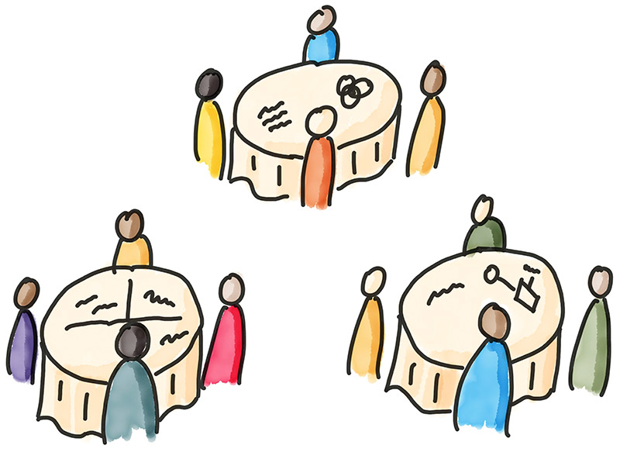
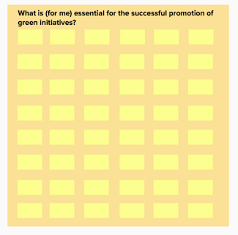
1st Break-out Group reflection
Question 1:
What is (for me) essential for the successful promotion of concrete green initiatives?

Slide 14
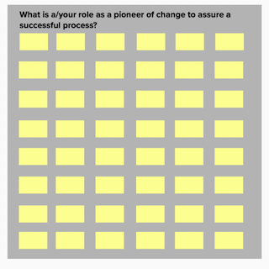
2nd Break-out Group reflection
Question 2:
What is the/my role as a pioneer of change to assure a successful process?

Slide 15
3rd Reflection in the Plenary
Question 3:
What do I need to be better equipped
in my role as a pioneer?

Slide 16
Further Process
2nd Pioneers of Change Event
End of February 2022
Sharing of Findings and Presentation from this Workshop
Via Mail
Identification of further Opportunities for Exchange and Learning
With Connective Cities and other international platforms

Slide 17
Final joint reflection
Please provide us final comments in the chat:
What are your final impressions about this event?

Slide 18
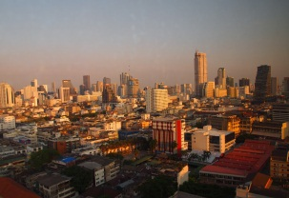
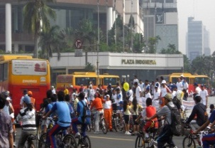
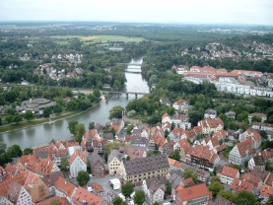
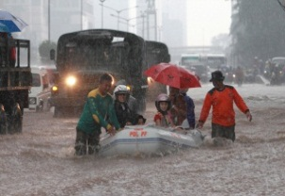
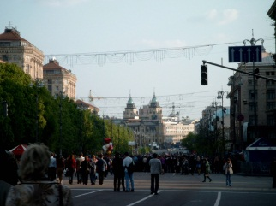
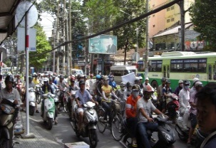
Thank you for your active participation! See you end of February!

Slide 19
Information for facilitators
The following slides are for the facilitators as description of the process.
Please be 20 min before 13:00 at the event to check the process with the technicians

Slide 20
Facilitators of break-out sessions
Marcus Jenal (Group 1)
Ulrich Harmes-Liedtke (Group 2)
Adriana Silva (Group 3)
Monica Munoz (Group 4)
Oliver Lah (Group 5)
Muna Shalan (Group 6, with translation into Arabic)
Frank Waeltring (Group 7, if needed with translation into Arabic)
If additional facilitation is needed:
Franziska Loibl and Jimmy Yoedsel (Group 8)

Slide 21
Break out group facilitation
Facilitators will take over their group with 4 to 5 participants (depending on number of participants)
In the first round the group will answer the first question
Facilitators encourage a reflection on the question, document comments on the mural board but do not share the mural board on the screen (we would like to see each other and have a conversation between each other in the group)
All participants will come back to the plenary (see time countdown of 20 min. at the top of your screen in the working group)
Frank will introduce the second question in the plenary
The groups will be shuffled into new break-out sessions, the facilitators will go back into their defined group and introduce the second question
Like in the first round, answers will be documented on the mural board by the facilitators without showing the board itself
All participants will come back to the plenary (see time countdown of 20 min. at the top of your screen in the working group)
In the plenary Frank will reflect on the third question in the plenary (supported by Marcus and Uli on the visible a nd shared mural board)
The further process will be explained by Frank
Final reflection and farewell words

Slide 22
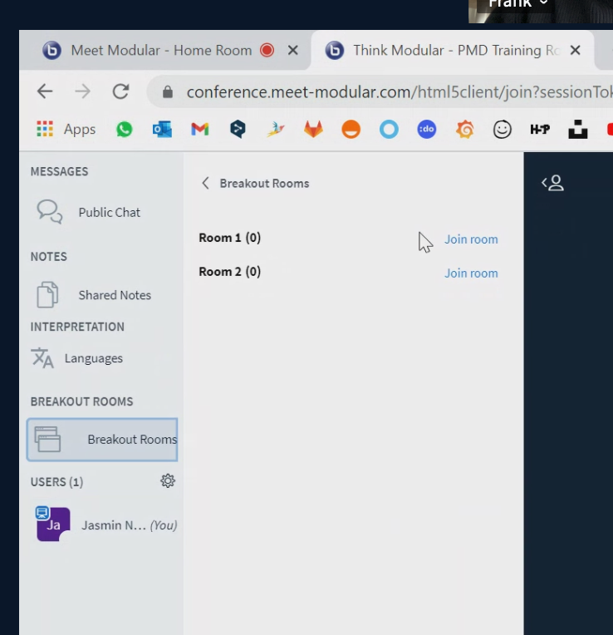
How can facilitators enter their groups and the mural board
Every facilitator has facilitation rights in the bluebotton software
On the left side of the screen (see screen shot) you can enter into your group once we start with the sessions
The mural board for documentation of the reflection in the two question rounds is here: https://app.mural.co/invitation/mural/mesopartner2671/1642418224498?sender=fw1021&key=1bc0fe3b-30d5-4793-9e94-899bf6262eee
Please document answers on question 1 on the cards on the orange board (click twice on the card to write into it)
Please document answers on question 2 on the cards on the grey board
All groups will write into one board, so do not get worried when there are others also contributing cards while you are writing ☺

