Slide 1
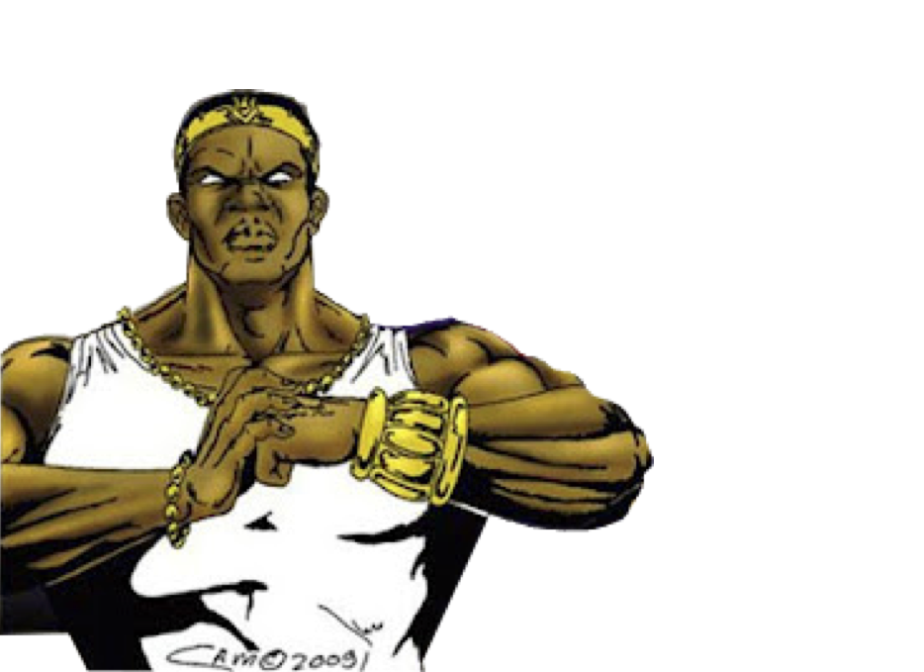
Dzitri Check
Fake News Detector
Connective Cities Hackathon 18-20 Nov. 2021
Collaboration WoeLab Lomé X Democracy Studio

Slide 2
Problem:
Fighting trolls and fake news with media & tech literacy.
In the wake of the COVID-19 outbreak, what tools should social actors use to combat dangerous misinformation and radicalization tendencies?

Slide 3
Solution:
A web robot to prevent fake news and radical propagandists on social media.
Combination of algorithms: natural language processing and sentiment analysis, filtering each message before it is published on a private group.
Suspends “weird” publications and asks the user a confirmation, reminding that sensitive users could be affected by a fake news or hate speech.

Slide 4
Weekend’s achievements:
Brainstorming the idea with teammates.
Sketching the UX
Choosing a matching visual identity.
Coding a simplified working MVP
Writing the pitch

Slide 5
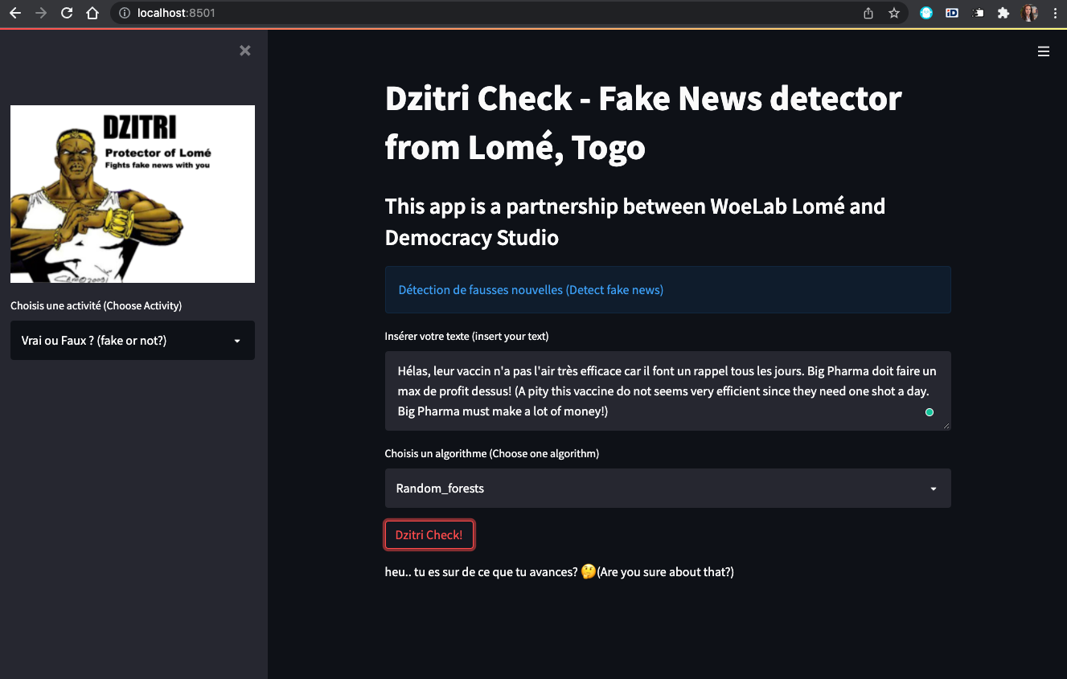
MVP:

Slide 6
Next steps:
Train the machine learning models
Develop the plug-in version of the app
Test it on personal social media
Propose it to groups facing issues with fake news
Possibly develop version in other languages

Slide 7
Link to the app: https://github.com/DemocracyStudio/fakenews_detector
Contact: now@democracy.studio

