Slide 1
Digitalisation Cluster
Title

Slide 2
Working Groups
1
Session One

Slide 3
Where are we?
Welcome
Intro to Digital Divide
Daiva Matonienė - Smart Cities and Digital Divide
Oswaldo Nomura - Gammara Cliick Lima Perú
3. Workspace for WGs on Breakout Rooms
4. Networking- Icebreak

Slide 4
Working Groups

Slide 5
Working Groups
Helping citizens and public servants to be knowledgeable and skilled with technology
Digital Literacy
Digitalisation of Services and Digital Transformation
Offering digital services that complement in-person services and improve the quality of local public services and citizen’s access to them
Finding strategies to make access to technology equal for all citizens and overcome the technological barrier
Digital Divide

Slide 6
Welcome! please fill your participation form
https://docs.google.com/forms/d/e/1FAIpQLScapAjx7lJrwVg7U6VizaY2s13Vy5IOgJEs8eUTKBgTGCeZpA/viewform?usp=sf_link
15 min

Slide 7
Smart Cities and Digital Divide
1
Daiva Matonienė

Slide 8
Working Groups
Working groups will help you inspire and develop your Project Idea or Challenge
You can be in one or all working groups.
3. Meetings will discuss topics and have experts.
4. Workshops will be hands on session to develop project proposal.
5. Digital Service Prototypes may be developed in the WGs, Citylab and Hackathon.
Digital Literacy
Digitalisation of Services and Digital Transformation
Digital Divide

Slide 9
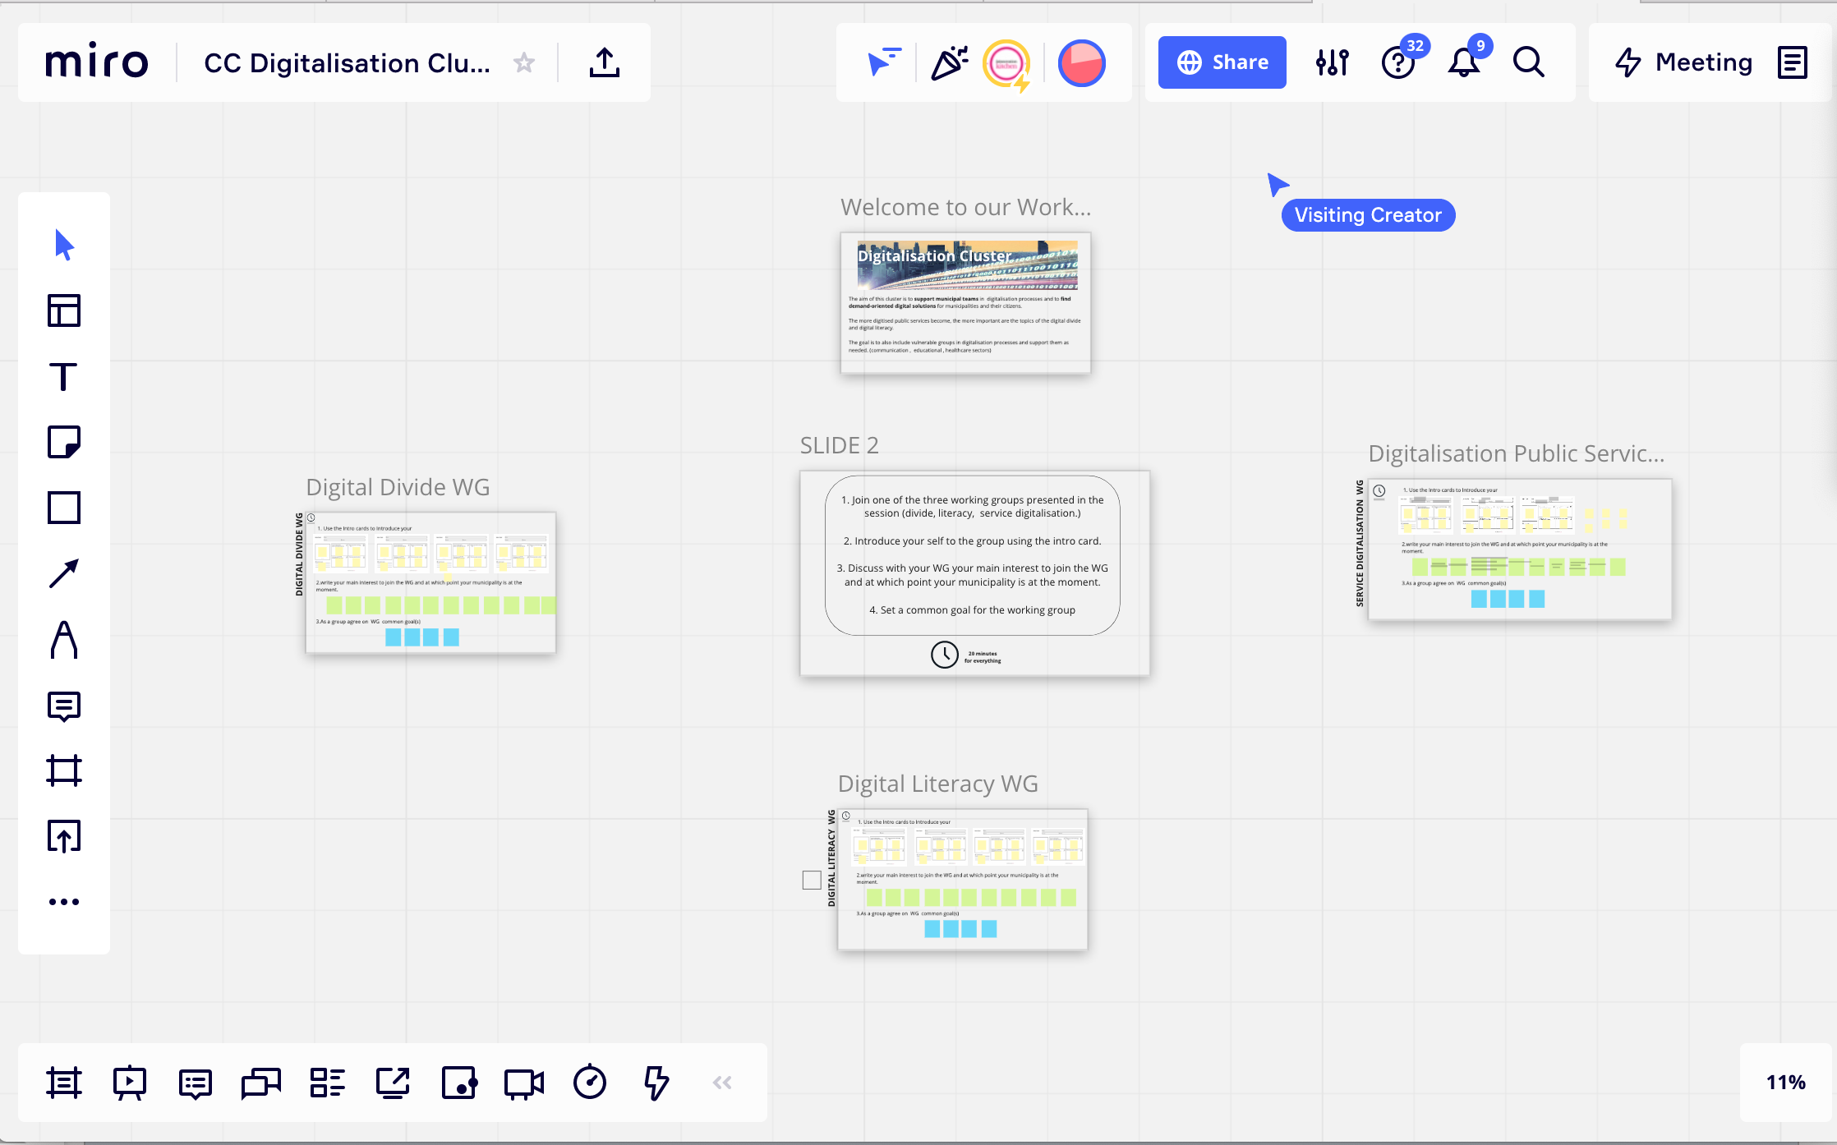
Working Groups
https://miro.com/app/board/o9J_lzqYArY=/?invite_link_id=362529004238

Slide 10
Gamarra Click Perú
1
Oswaldo Nomura

Slide 11
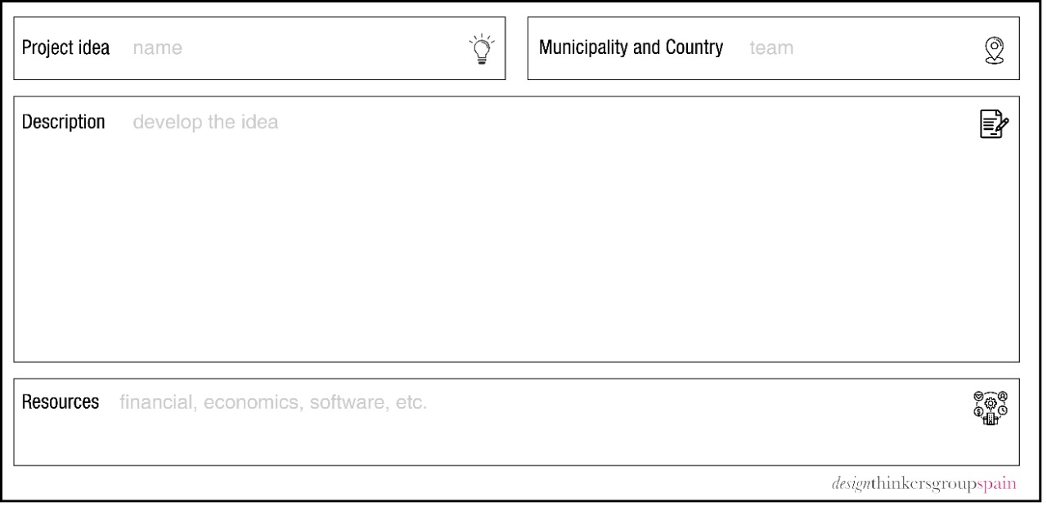
Project Ideas / Challenge
Project Idea / Challenge per municipality or organisation
Draft your general idea
Validate with policy
Share your idea
Detect Funding Sources
15 min

Slide 12
Funding Sources
Detect Necessities and Viability in your municipality
Develop a Fundable project
Draft your general idea
Validate with policy
Share your idea + co-create
Detect Funding Sources
Apply for funding
Source: Public Funding Sources – Cranberry Isles & USDA Community Connects. https://www.islandinstitute.org/

Slide 13
Coming Next
Meeting canvas for working groups
Digitalisation of Services and Digital Transformation
Event date: 3 Nov / 2021 11:00 - 12:30 (CEST)
Overcoming the Digital Divide and Access to Technology
4 Nov 2021 11:00 - 12:30 (CEST)
Daiva Matonienė - Smart Cities Central Project Management Agency Turkey
Owaldo Nomura - Gamarra Click Perú
Digital Literacy Strategies Design
9 Nov 2021 11:00 - 12:30 (CEST)
Laia Ramirez - Citilab Barcelona
Haris Piplas Co-Director Urban Design and Planning Development - Drees & Sommer Switzerland

Slide 14
Networking
1
Activity
10 min

Slide 15
Networking
Share your favourite song in the chat
Grab something red
Show something alive
Write the name of somebody famous from your country in the chat

Slide 16
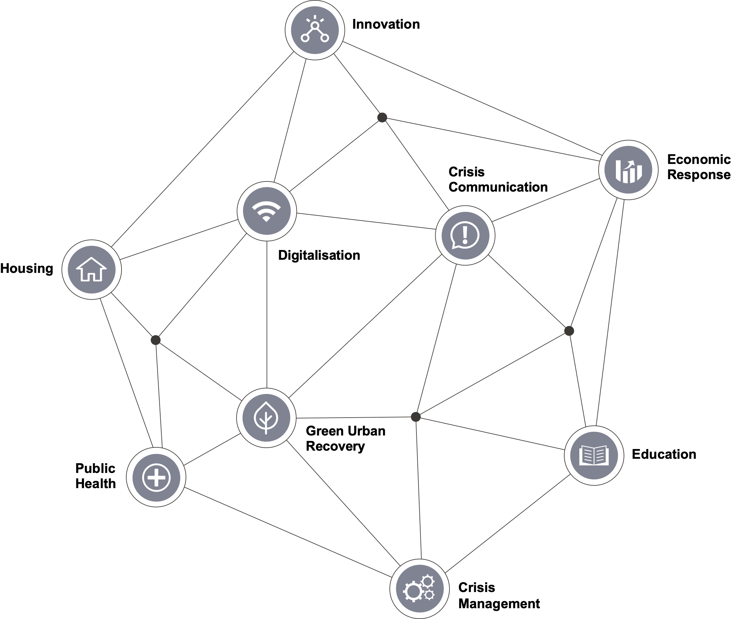
Implemented by

Slide 17
Thank
you

